Slide 1
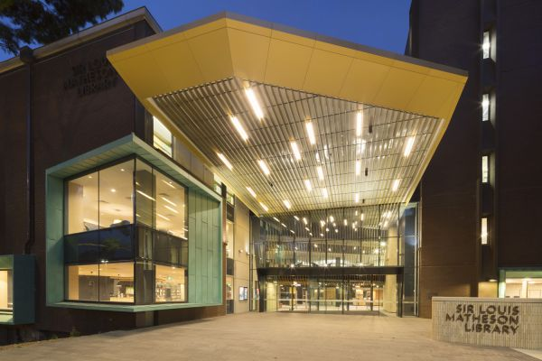
Digitisation on the sound stage
Sharing our stories
Irene Guidotti
Digitisation Centre
13 October 2021

Slide 2
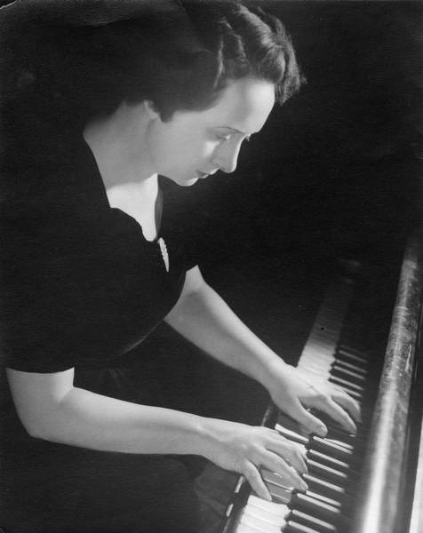
2019 Theme: Beyond the Beat: Taking music libraries to our users
The Vera Bradford Collection: A Digitisation Project
https://doi.org/10.26180/5d96b07d8bf2f
http://hdl.handle.net/1959.1/1404337
2021 Theme: Music Rights for All: Libraries as enablers

Slide 3
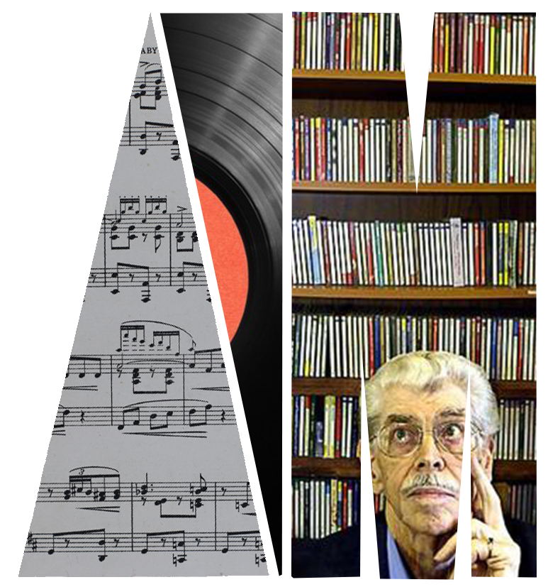
Digitising John Cargher
78 rpm records
at Monash University Library
Irene Guidotti
irene.guidotti@monash.edu
IAML 2021

Slide 4
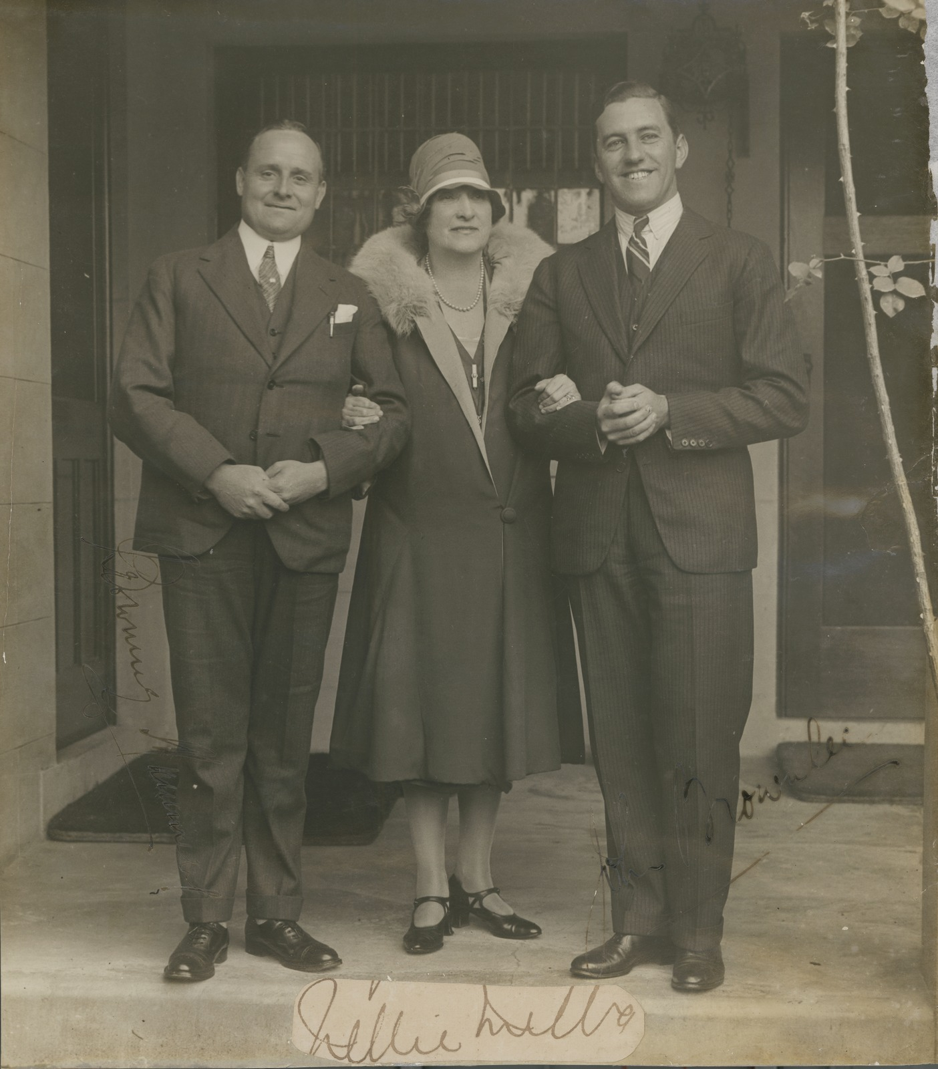
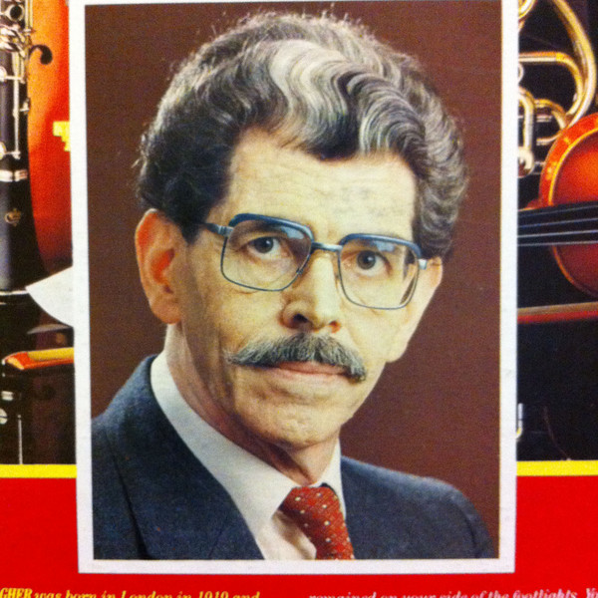
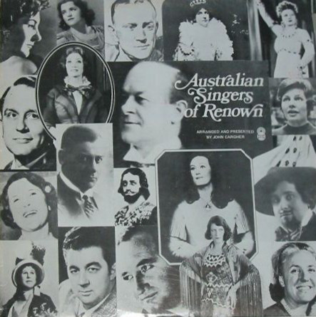
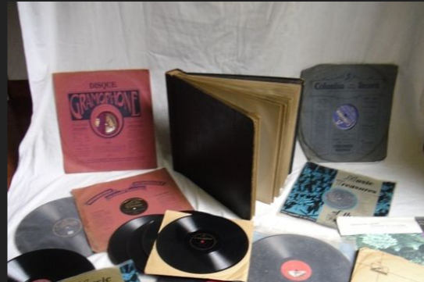
John Cargher Collection
Donated in 2009
By Robyn Walton
Cultural Gifts Program
Matheson Library
2000+ vinyl
1200+ CDs, LPs, etc.
Ephemeral material
68 singers
34 conductors
53 composers
Autographed photograph of Nellie Melba with Browning Mummery and John Brownlee
Pictures Collection, H2007.74, State Library of Victoria
Notes:
Self help pages about copyright, data management, loans and document delivery explain how services work
Generous loans and automatic renewals if there are no requests for the item
Information Service point available during opening hours of any Library: ask in person.
Ask.Monash : if you can’t find your answer in the FAQs your email will be answered within 24 hours.
Intercampus loans and Document delivery
Library Guides for Music, Theatre

Slide 5
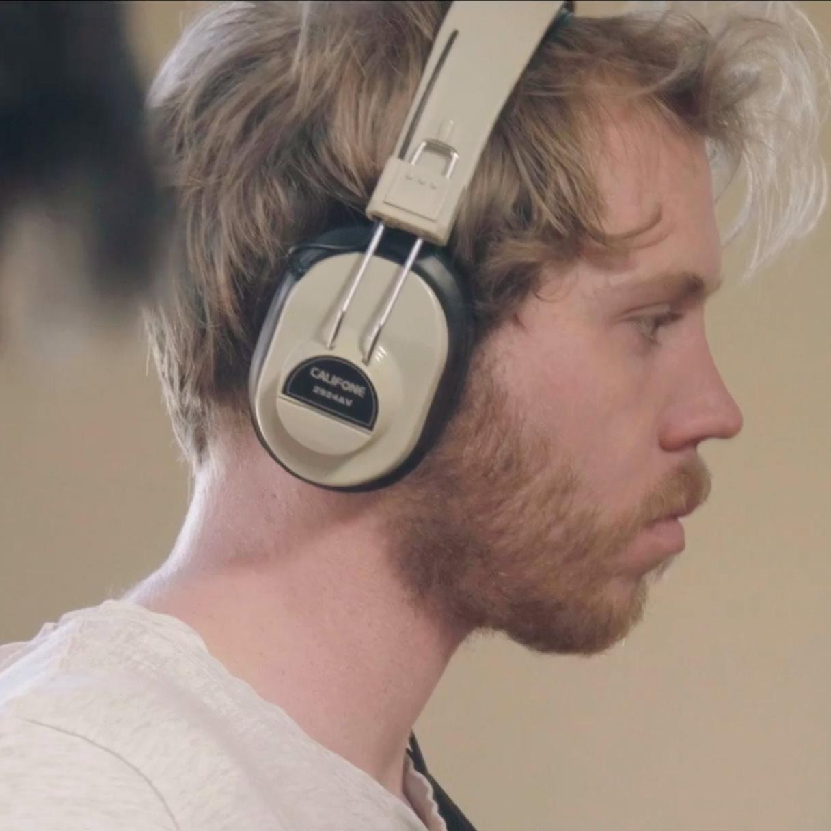
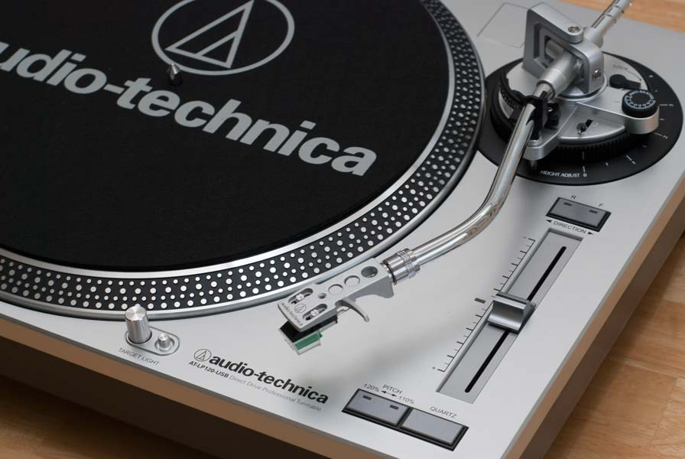
The Project
Faculty of Arts, Work Integrated Learning
Professional Practice
PD from previous WIL internship
Library selected as a host by the student
12 weeks
Academic assessments:
Online Induction - Value %:10
Report Plan - Value %:20
Reflexive Portfolio - Value %:30
Final Report - Value %:40
Brandon Meyer, Monash University Student, ATS3935
Notes:
Self help pages about copyright, data management, loans and document delivery explain how services work
Generous loans and automatic renewals if there are no requests for the item
Information Service point available during opening hours of any Library: ask in person.
Ask.Monash : if you can’t find your answer in the FAQs your email will be answered within 24 hours.
Intercampus loans and Document delivery
Library Guides for Music, Theatre

Slide 6
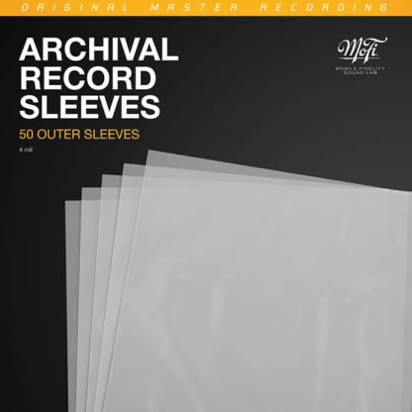
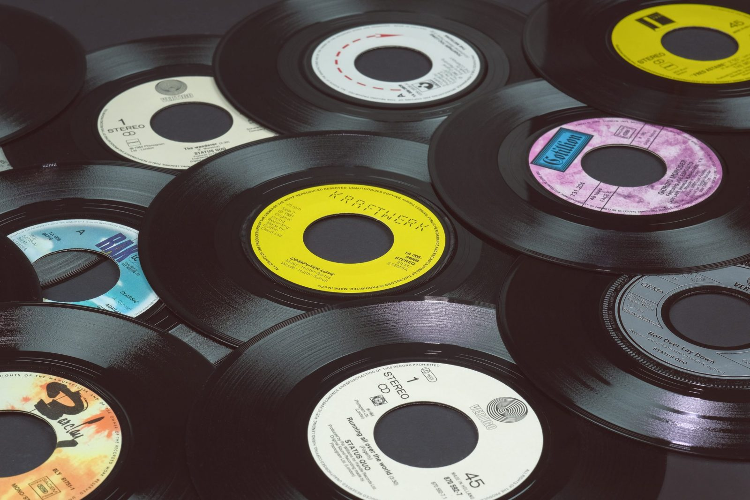
The Project
First recording collection
Project start date 2019
First assessment
Selection (JC’s list)
Copyright clearance
78 rpm player
Ordering sleeves, acid free covers, etc.
Notes:
Self help pages about copyright, data management, loans and document delivery explain how services work
Generous loans and automatic renewals if there are no requests for the item
Information Service point available during opening hours of any Library: ask in person.
Ask.Monash : if you can’t find your answer in the FAQs your email will be answered within 24 hours.
Intercampus loans and Document delivery
Library Guides for Music, Theatre

Slide 7
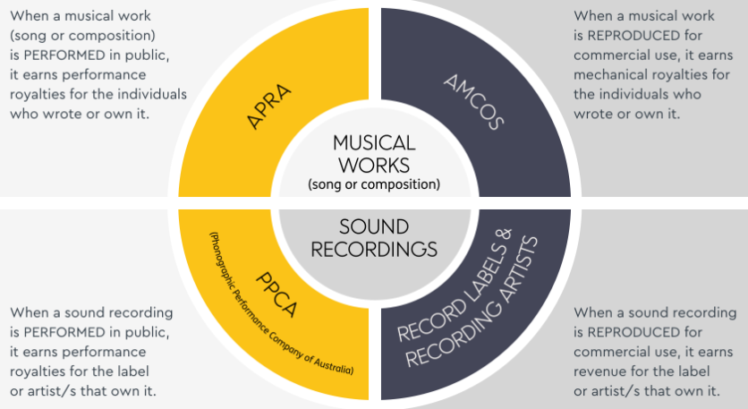
Music and Copyright
Define who owns the copyright
usually multiple: composer, lyricist, artist, maker
Case by case
Some cases have the composer’s music out of copyright, but still in copyright if considering the lyricist
Restricted access for research purpose
E.g. ‘Ole Man River’ from Showboat
Composition and recording: two forms of copyright
Notes:
Self help pages about copyright, data management, loans and document delivery explain how services work
Generous loans and automatic renewals if there are no requests for the item
Information Service point available during opening hours of any Library: ask in person.
Ask.Monash : if you can’t find your answer in the FAQs your email will be answered within 24 hours.
Intercampus loans and Document delivery
Library Guides for Music, Theatre

Slide 8
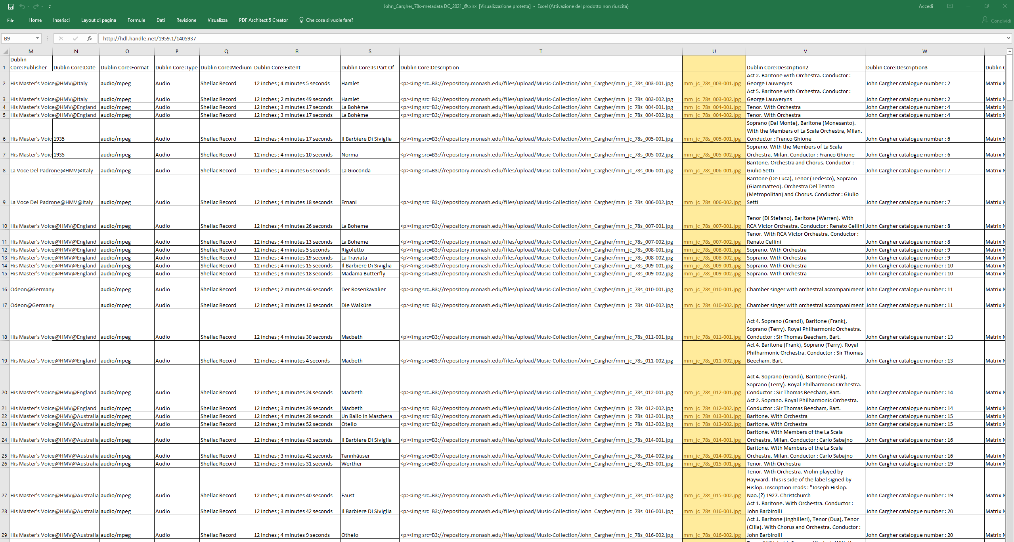
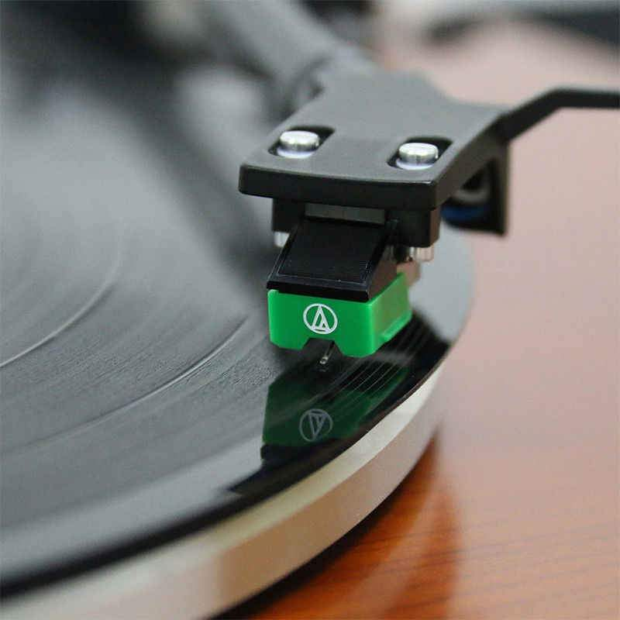
Challenges
First time project
Training
Small team / High demand
Noise reduction
Information retrieval and description
Equipment
Notes:
Self help pages about copyright, data management, loans and document delivery explain how services work
Generous loans and automatic renewals if there are no requests for the item
Information Service point available during opening hours of any Library: ask in person.
Ask.Monash : if you can’t find your answer in the FAQs your email will be answered within 24 hours.
Intercampus loans and Document delivery
Library Guides for Music, Theatre

Slide 9
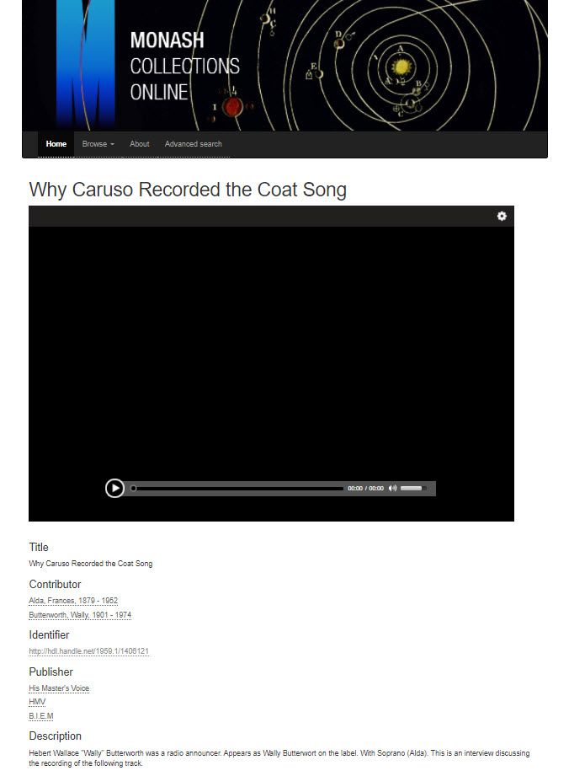
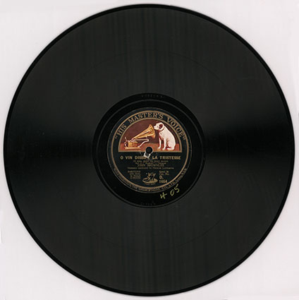
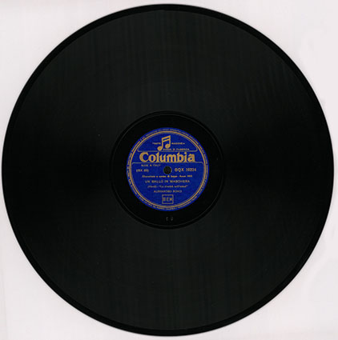
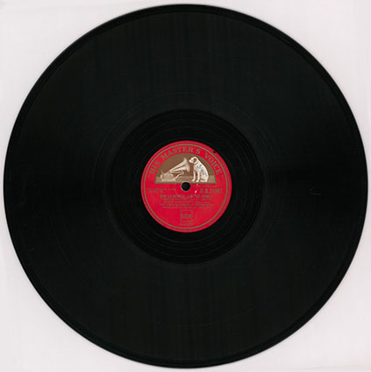
Outcomes
Collection Management
Preservation
Digitisation best practice => reusable
Strengthen Collaboration with Faculty
Online Collection Discoverability
Promotion
Events, seminars, and exhibition
Feuilletons and newsletter
Shareable
Wider Interest
Stories from the Collection
Notes:
Self help pages about copyright, data management, loans and document delivery explain how services work
Generous loans and automatic renewals if there are no requests for the item
Information Service point available during opening hours of any Library: ask in person.
Ask.Monash : if you can’t find your answer in the FAQs your email will be answered within 24 hours.
Intercampus loans and Document delivery
Library Guides for Music, Theatre

Slide 10
Student reflection
“I was able to contribute to a project important for the Library and the community of artists”
“The project has highlighted the issue of managing noise in the recorded audio files”
“I suggested problem solutions in discussion with the Digitisation Coordinator”
“I learned what it means to work in a team and in a Digitisation Centre”
“I am willing to know more about these singers and John Cargher’s story”
ENGAGEMENT
IMPACT
COMMUNITY
Notes:
Self help pages about copyright, data management, loans and document delivery explain how services work
Generous loans and automatic renewals if there are no requests for the item
Information Service point available during opening hours of any Library: ask in person.
Ask.Monash : if you can’t find your answer in the FAQs your email will be answered within 24 hours.
Intercampus loans and Document delivery
Library Guides for Music, Theatre

Slide 11
Library collaboration across divisions
Megan Deacon
Simon Devanny
Anita Dewi
Glenda Hill
Danielle Low
Violeta Milenkovic
Beth Pearson
Clare Presser
Jackie Waylen
THANK YOU!!!

Slide 12
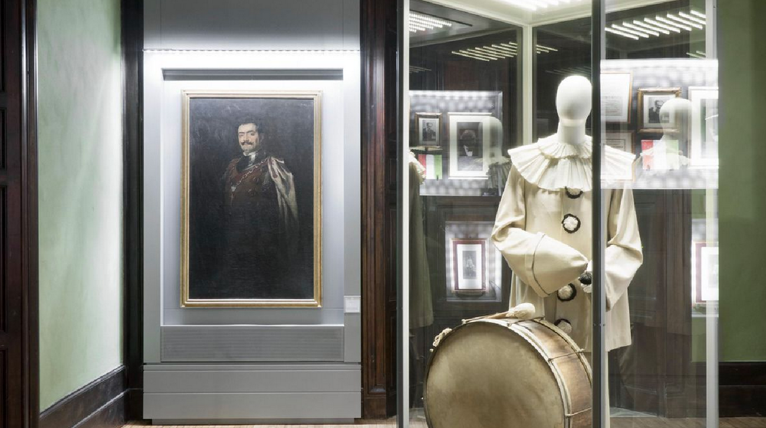
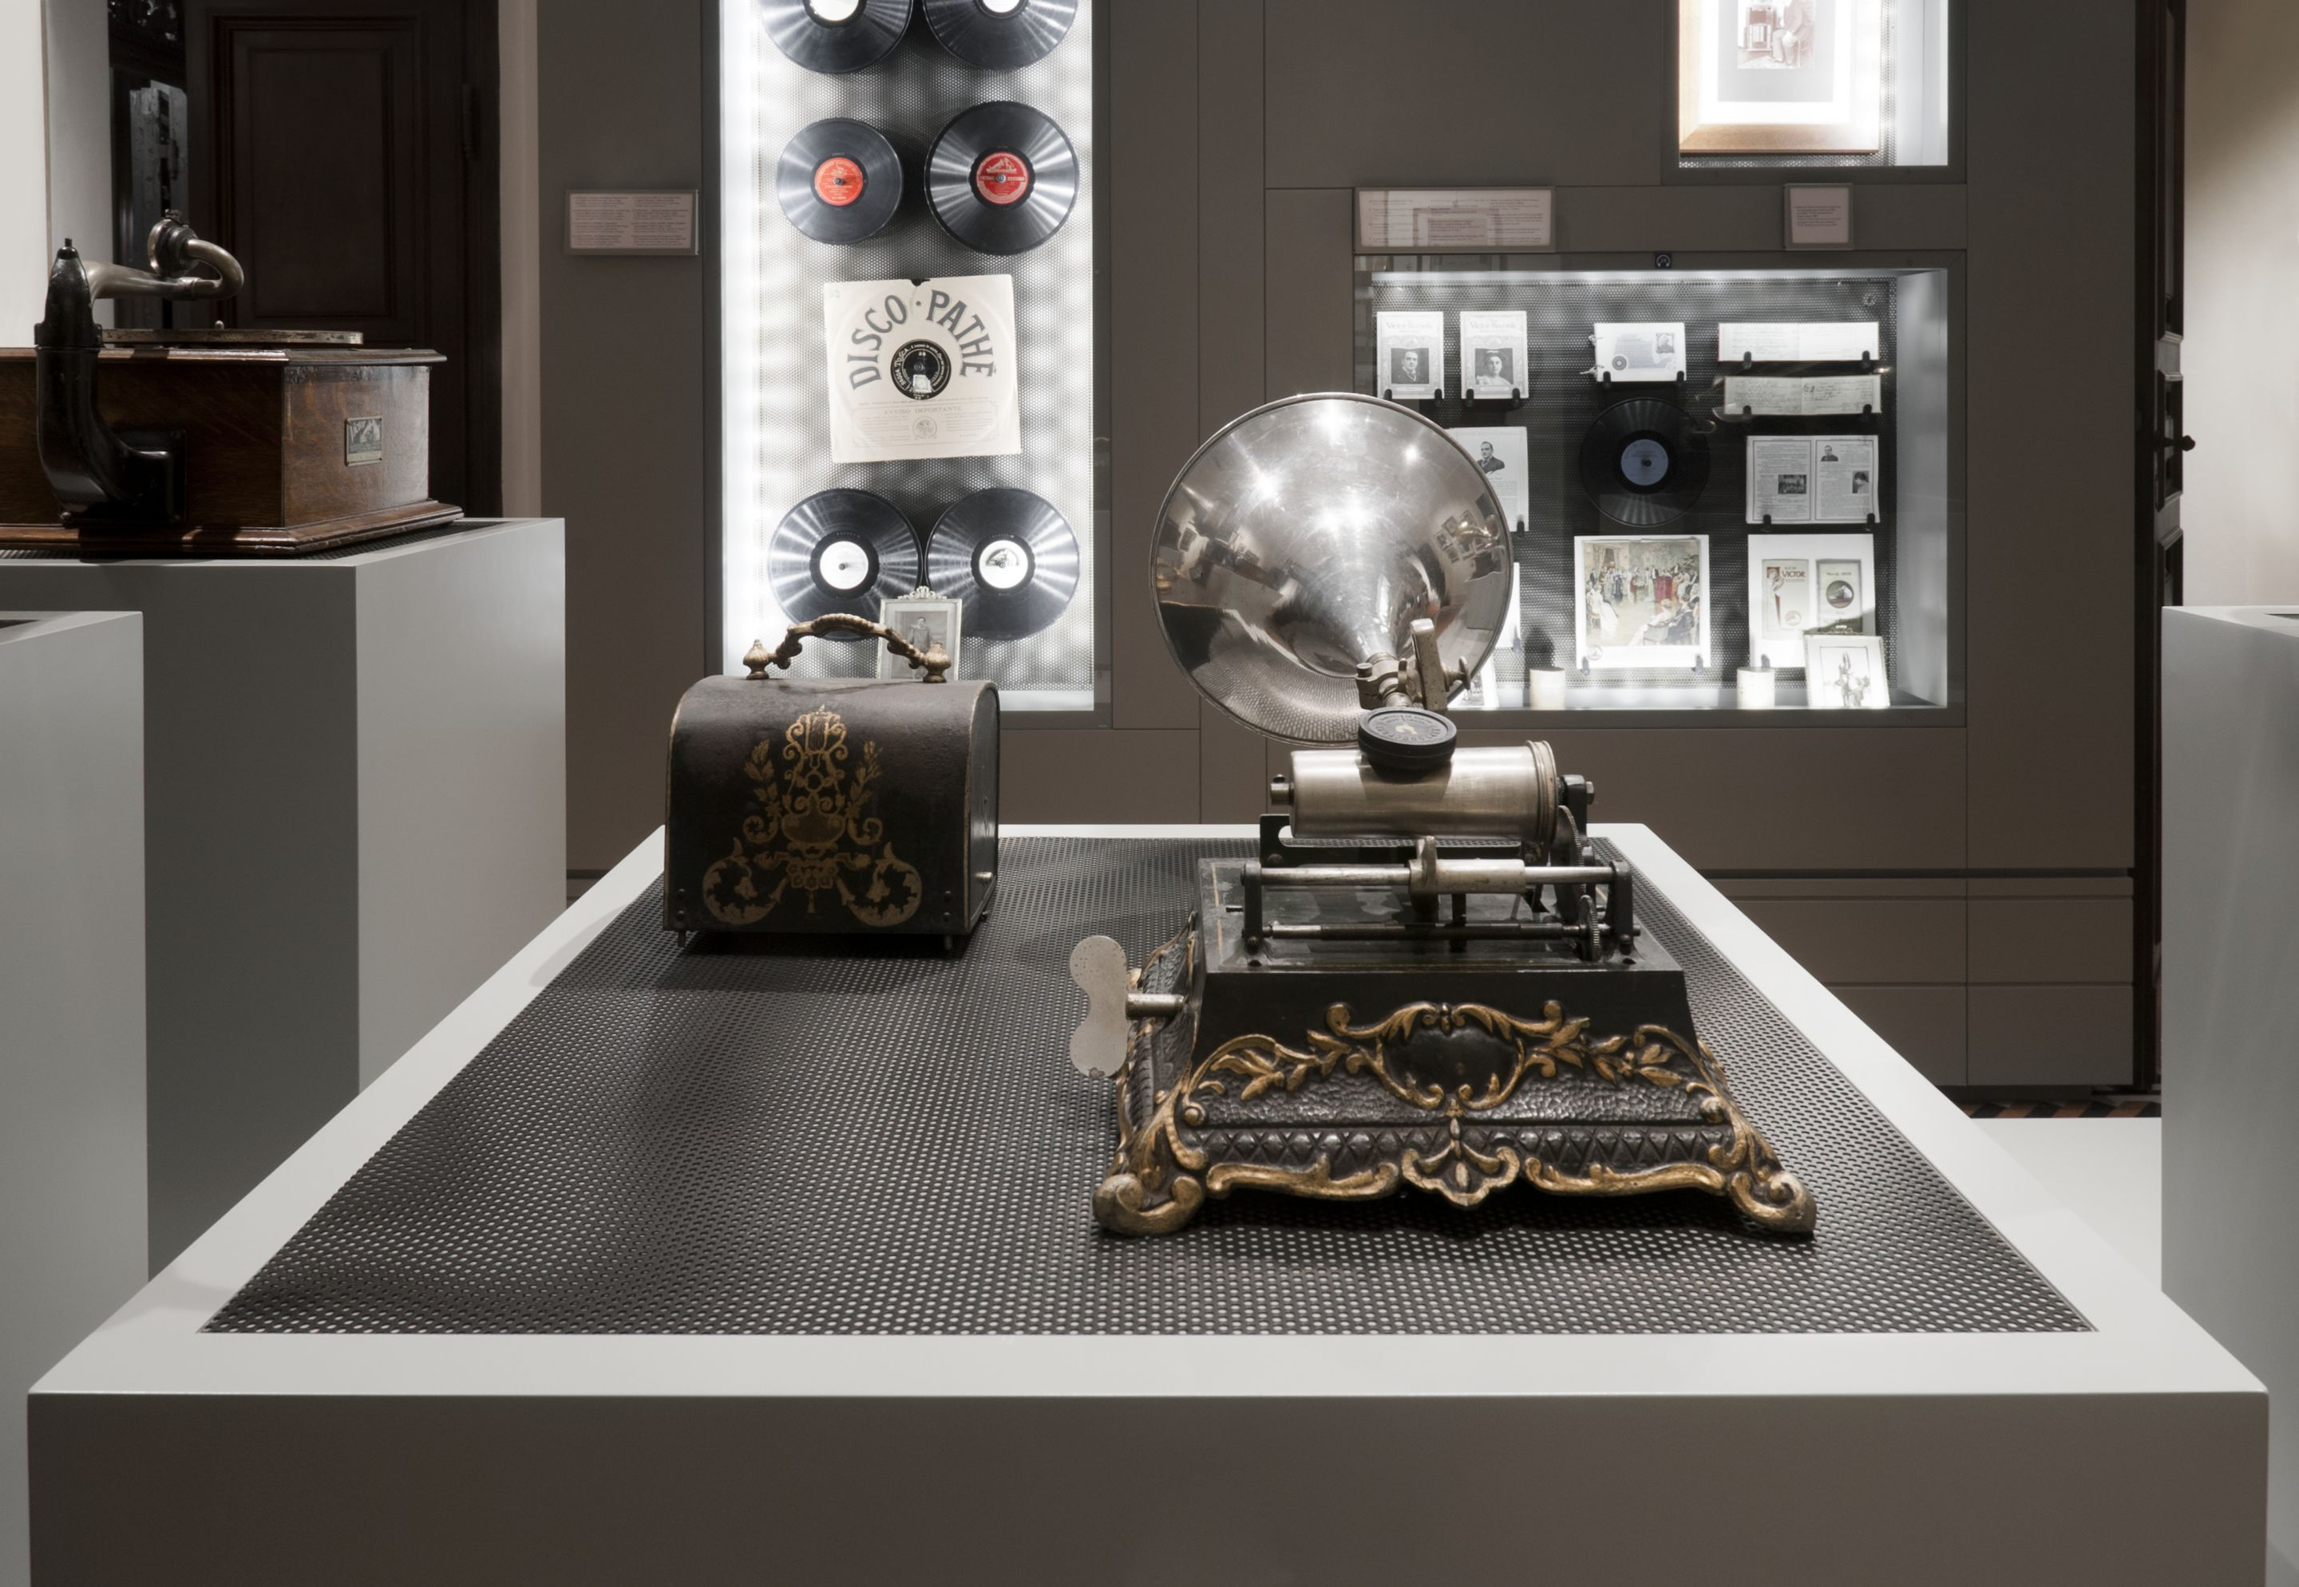
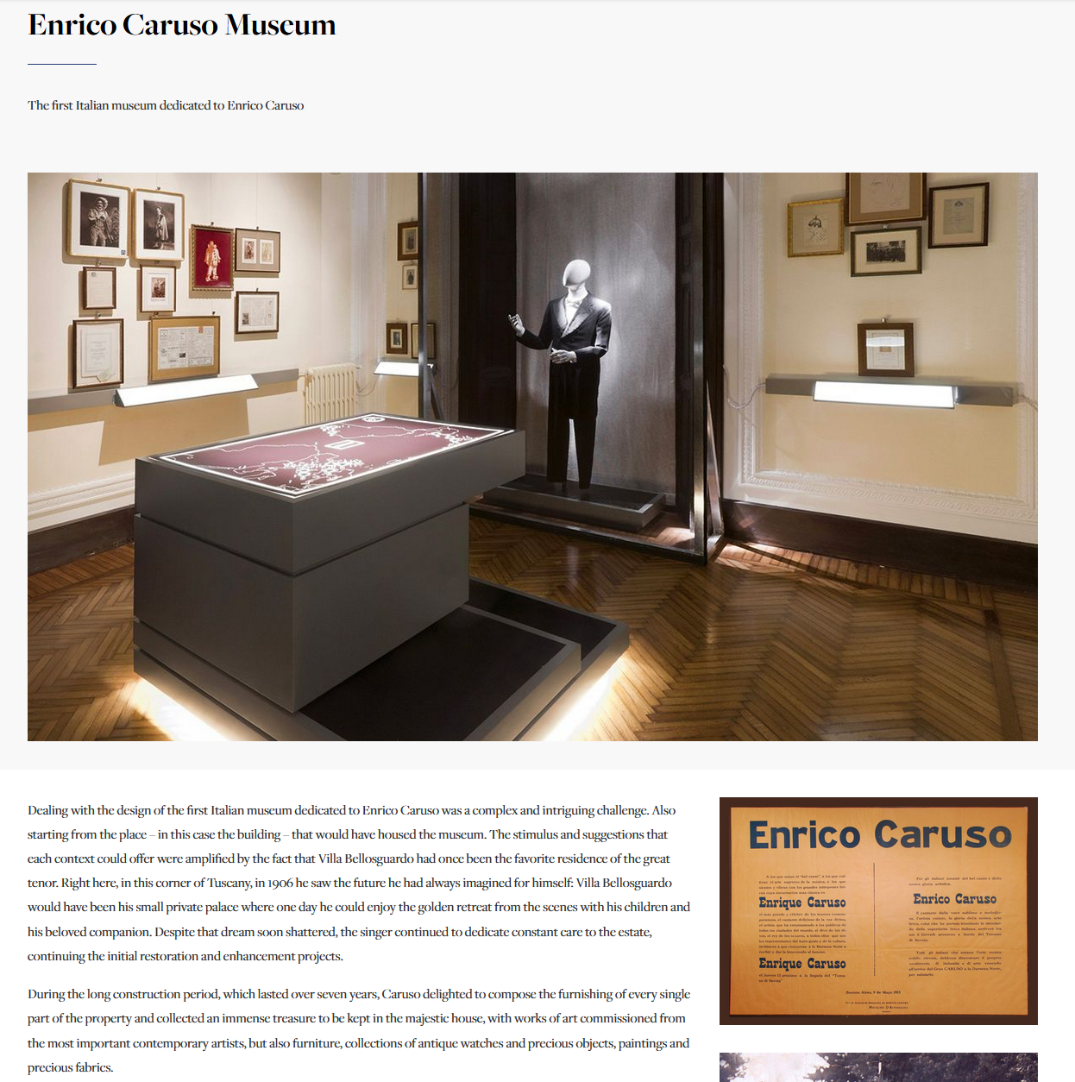
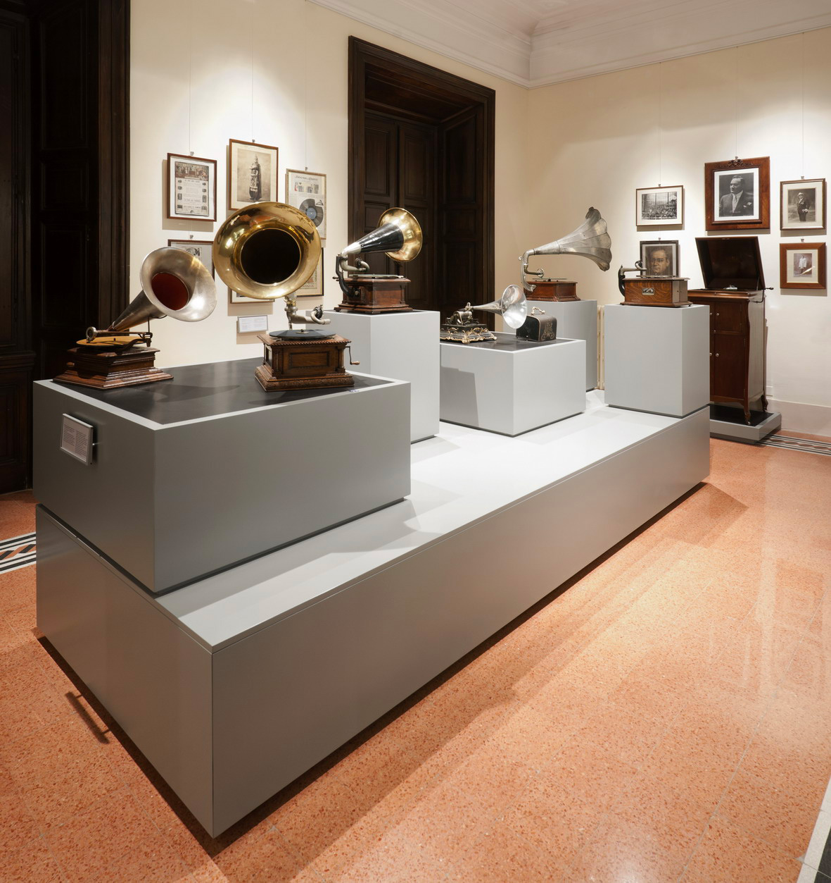
Enrico Caruso Museum

