Slide 1
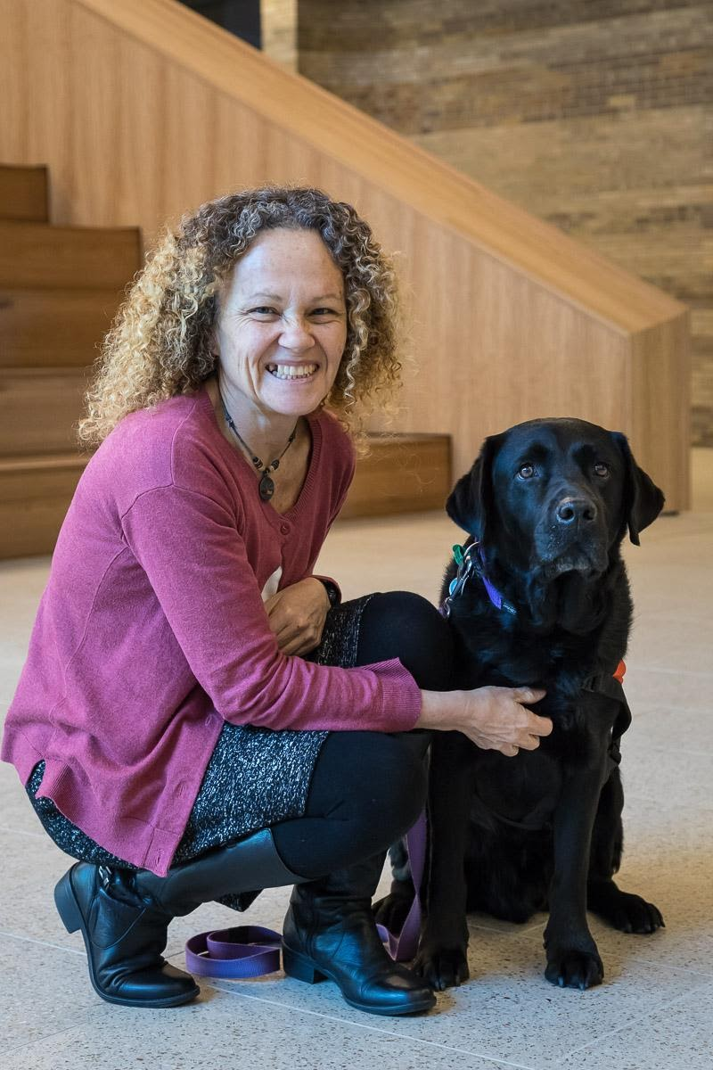
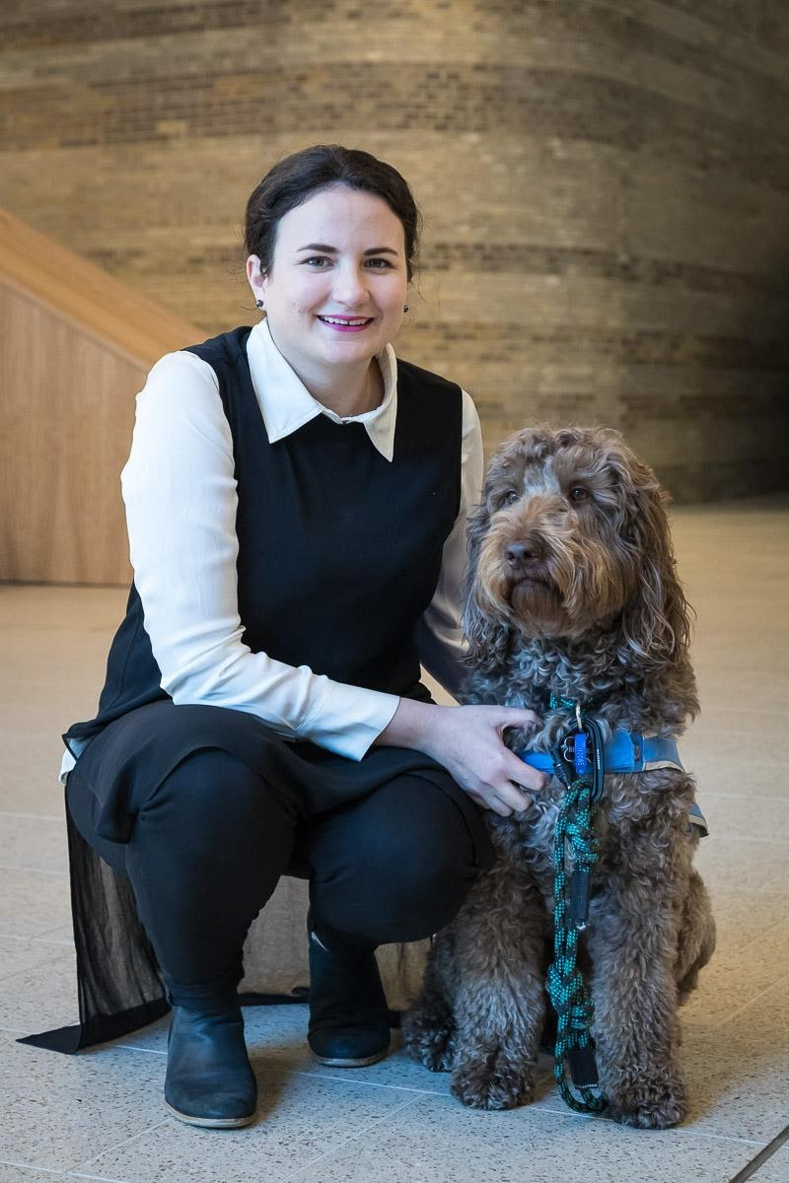
2021 APS CEDP Conference
Title: Exploring the impact of therapy dogs on children’s wellbeing in school settings
Research team: Dr Christine Grove, Dr Linda Henderson, Louisa Trainer, Hannah Schena, Marcelle Prentice, Felicia Lee and Phoebe Wardlaw
Monash University, Faculty of Education
Notes:
L

Slide 2
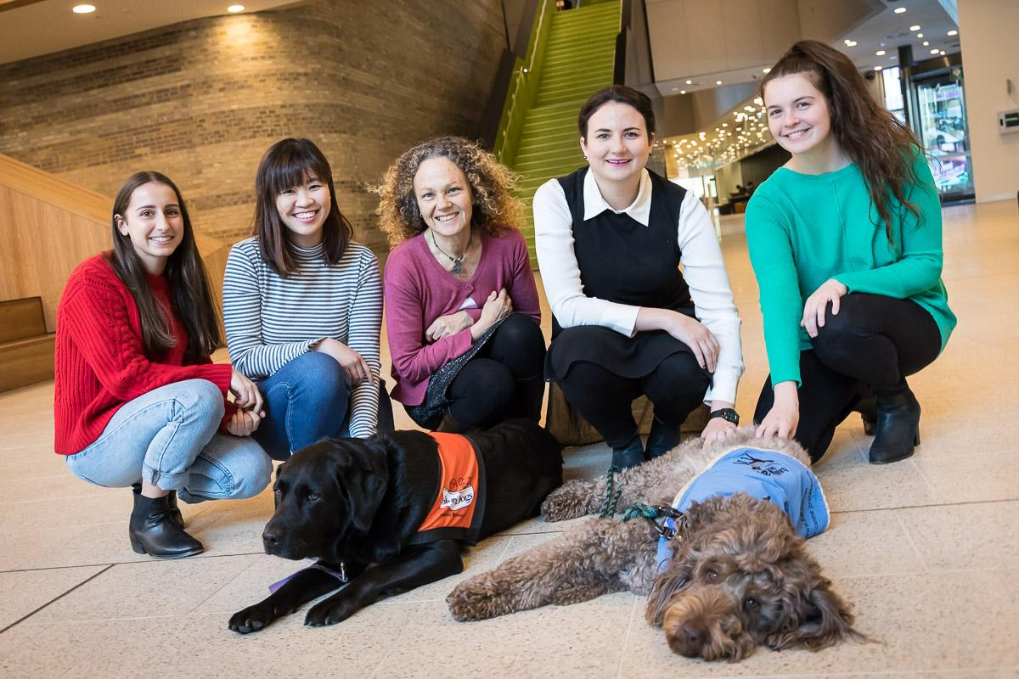
Research Team:
From left researchers, psychologists & teacher: Louisa Trainer, Felicia Lee, Linda Henderson, Christine Grove Hannah Schena, with Daymon the lab and Bronson the labradoodle.

Slide 3
Role of Therapy Dog
The role of therapy dogs is to react and respond to people and their environment, under the guidance and direction of their owner. For example, an individual might be encouraged to gently pat or talk to a dog to teach sensitive touch and help them be calm
Therapy dogs can also be used as part of animal assisted therapy. This aims to improve a person’s social, cognitive and emotional functioning. A healthcare professional who uses a therapy dog in treatment may be viewed as less threatening, potentially increasing the connection between the client and professional.
Notes:
L

Slide 4
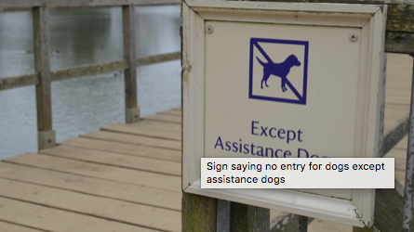
Therapy Dog v’s Service Dog: Is there a difference?
Service Dog: trained to perform tasks and do work that eases their handler’s disabilities. Work as a ‘team’ to attain independence and safety. These dogs are not for petting. Access rights for Service Dogs and handlers is covered under legislation and are allowed access to all areas except hospital theatres.
Therapy Dog: Their role and responsibility it to provide psychological or physiological therapy to individuals other than their handler. The dogs have been trained and assessed to undertake this work. They have stable temperaments and friendly easy-going personalities.
http://www.abc.net.au/news/2018-04-18/fake-assistance-dogs-gaming-system/9670848
Notes:
L

Slide 5
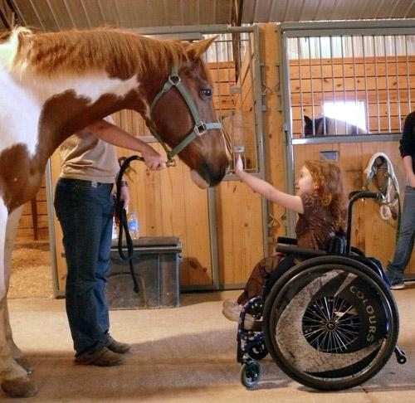
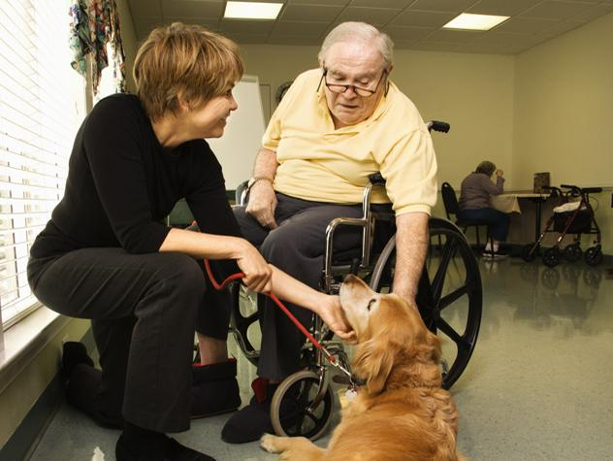
Animal Assisted Activities
There are also animal-assisted activities, which is an umbrella term covering many different ways animals can be used to help humans.
One example is to facilitate emotional or physical mental health and wellbeing through pet therapy or the presence of therapy dogs. These activities aren’t necessarily overseen by a professional, nor are they specific psychological interventions.
Notes:
C

Slide 6
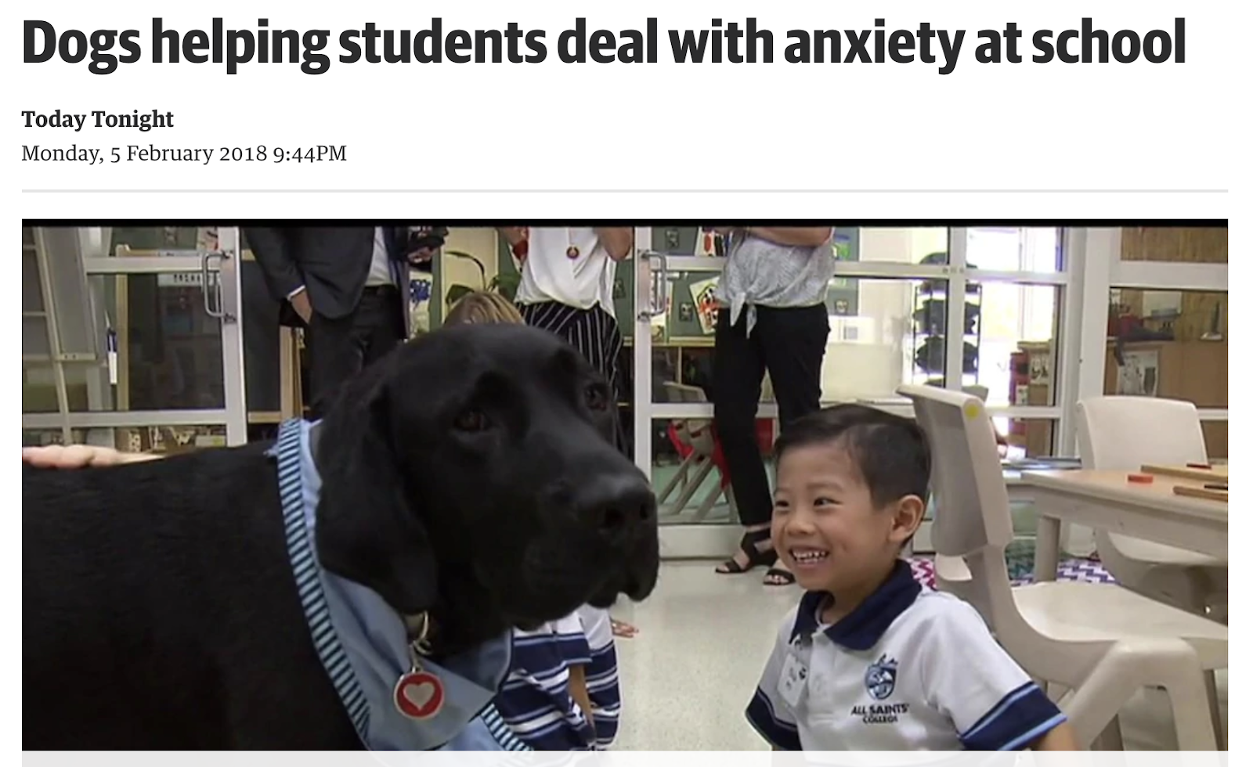
Therapy Dog Video Example
https://thewest.com.au/news/today-tonight/dogs-helping-students-deal-with-anxiety-at-school-bc-5726337013001
Notes:
C

Slide 7
Benefits of Therapy Dogs
Therapy dogs in classrooms aren't just very, very, very good pups. They can reduce students' anxiety and improve learning outcomes.
Animal assisted therapy can:
teach empathy and appropriate interpersonal skills
help individuals develop social skills
be soothing and the presence of animals can more quickly build rapport between the professional and client, and
improve individual’s skills to pick up social cues imperative to human relationships. Professionals can process that information and use it to help clients see how their behaviour affects others.
Notes:
L

Slide 8
Boofred, the therapy dog, in Action
Notes:
L

Slide 9
What’s happening?
The human-animal bond can impact people and animals in positive ways. Research shows therapy dogs can reduce stress physiologically (cortisol levels) and increase attachment responses that trigger oxytocin – a hormone that increases trust in humans.
Dogs also react positively to animal-assisted activities. In response to the human-animal bond, dogs produce oxytocin and decrease their cortisol levels when connecting with their owner. Often dogs feel the same when engaging in animal assisted activities as if they were at home, depending on the environmental context.
Notes:
C

Slide 10
Evaluation of dog school program called Story Dogs
Notes:
C

Slide 11
Current Monash Study
Story Dogs and Faculty of Education Research Partnership
A reading program for all of Australia
Making reading fun by reading to a dog
Story Dogs Facts: Help over 1870 children each week Currently 373 volunteer dog teams Partner with 224 schools in NSW, VIC, TAS, WA, SA, & ACT Currently 220 dog teams fully sponsored (59%)
Notes:
L

Slide 12
A ‘Story Dog’ Story
http://www.abc.net.au/news/2017-03-10/story-dogs-help-kids-read-literacy-skills/8341060
Notes:
L

Slide 13
Benefits of Therapy Dogs in Schools
A recent report highlighted children working with therapy dogs experienced increased motivation for learning, resulting in improved outcomes.
Therapy dogs are being used to support children with social and emotional learning needs, which in turn can assist with literacy development.
Notes:
C

Slide 14
Benefits of Therapy Dogs in Schools
Research into the effects of therapy dogs in schools is showing a range of benefits including:
increase in school attendance;
gains in confidence;
decreases in learner anxiety behaviours resulting in improved learning outcomes, such as increases in reading and writing levels;
positive changes towards learning and improved motivation;
enhanced relationships with peers and teachers due to experiencing trust and unconditional love from a therapy dog. This in turn helps students learn how to express their feelings and enter into more trusting relationships.
Notes:
C

Slide 15
Benefits of Therapy Dogs at University
Researchers have found university students reported significantly less stress and anxiety, and increased happiness and energy, immediately following spending time in a drop-in session with a dog present, when compared to a control group of students who didn’t spend any time with a therapy dog.
Notes:
L

Slide 16
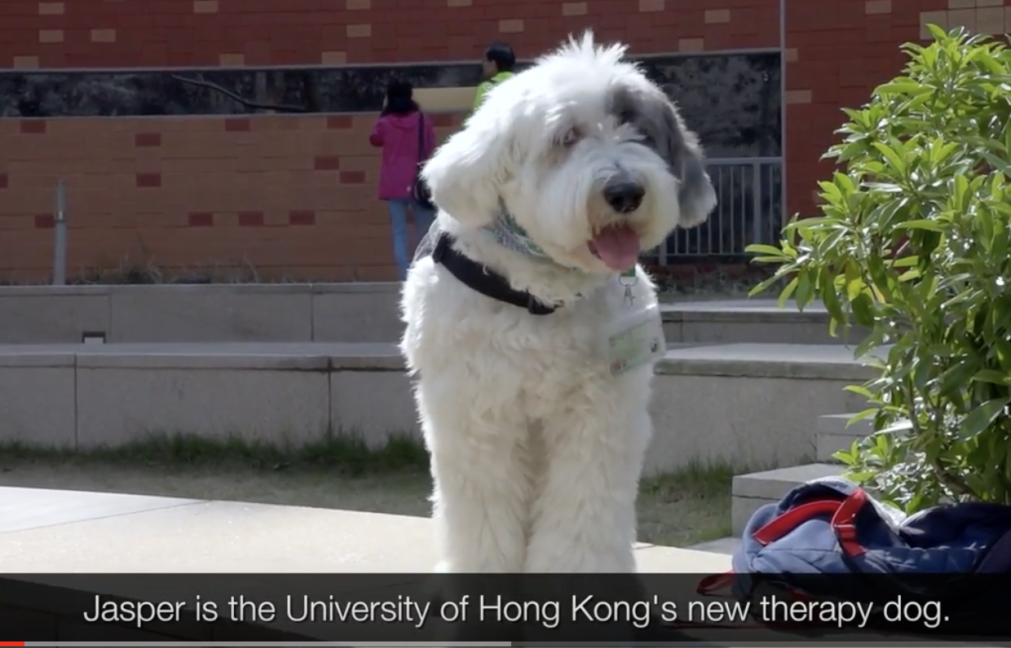
Meet Jasper a Therapy Dog at University
https://www.youtube.com/watch?time_continue=5&v=ftJJgX5hASs
Notes:
L

Slide 17
Perceived Risks
Despite these known benefits, many schools choose not to have therapy dog programs due to perceived risks. These range from concerns about sanitation issues to the suitability of dog temperament when working with children. But therapy dogs and owners are carefully selected and put through a strict testing regime prior to acceptance into any program.
The main reason for the lack of take up has been linked to the limited research into the benefits of therapy dogs in schools
Notes:
L

Slide 18
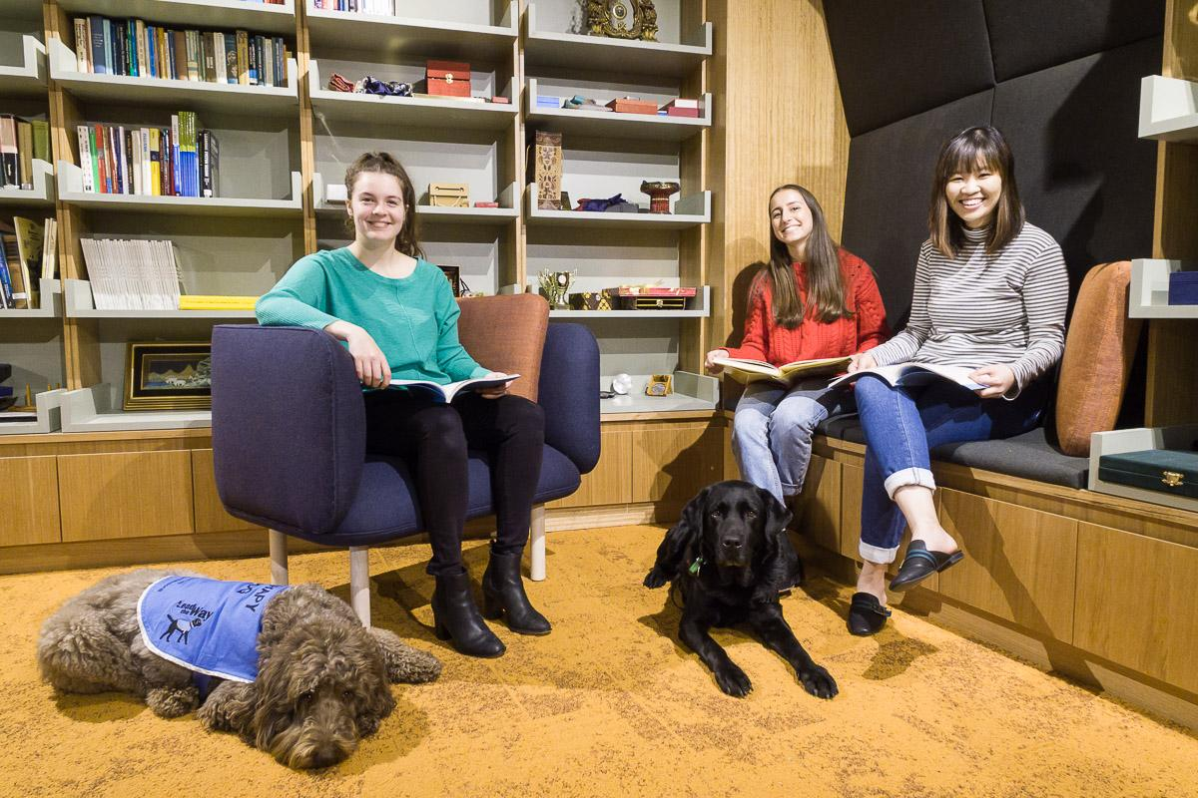
Need for ongoing and long-term research
Here is a snapshot of one of our research projects: Bronson and Daymon with our Masters of Ed/Dev Psychology at Monash research students who are examining whether therapy dogs may or may not have an impact on student wellbeing in educational settings:
From left students Hannah Schena, Louisa Trainer, Felicia Lee with Daymon the lab and Bronson the labradoodle.
Notes:
C

Slide 19
Our work so far: Policy framework for schools
Grove, C. Henderson, L. & Lee, F. (2021). Chapter 28. Policy Framework for the Use of Therapy Dogs in Educational Settings. Building Better Schools with Evidence-based Policy: Adaptable Policy for Teachers and School Leaders. Routledge
https://www.routledge.com/Building-Better-Schools-with-Evidence-based-Policy-Adaptable-Policy-for/Allen-Reupert-Oades/p/book/9780367458898
Notes:
C

Slide 20
Our work so far: Evaluation of dog school program
Notes:
C

Slide 21
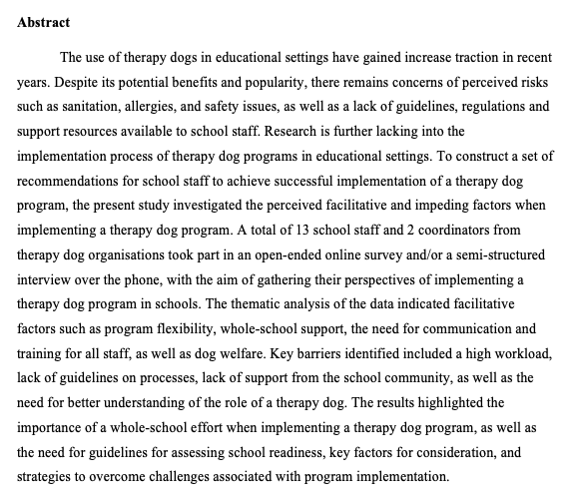
Our work so far: Recommendations & guidelines for implementation
Grove, C. Henderson, L., Lee, F., & Wardlaw, P. (Under review, forthcoming 2021). Using Therapy Dogs in Educational Settings: Guidelines and Recommendations for Implementation.
Notes:
C

Slide 22
Next steps in Research
Future collaborations
Partnerships with University
Funding for long-term research
Challenges
Volunteer status of most therapy dog organisations and implications for funding
Integrating therapy dogs into a whole school approach to student well-being
Notes:
C + L

Slide 23
For more information
Read our piece in the conversation;
Look out for our upcoming research with Story Dogs;
We’ll keep our followers up to date via ResearchGate & FigShare
https://theconversation.com/therapy-dogs-can-help-reduce-student-stress-anxiety-and-improve-school-attendance-93073
Notes:
C

Slide 24
THANK YOU
We welcome your feedback, look forward to the Q&A and also please get in touch if there are any materials or resources we can provide:
Dr Christine Grove:
Christine.grove@monash.edu
Dr Linda Henderson:
Linda.henderson@monash.edu

