Slide 1
Japanese collection
at Monash University Library
Ayako Hatta
Japanese Studies Librarian
Monash University Library
2nd July, 2019 at the JSAA Conference

Slide 2
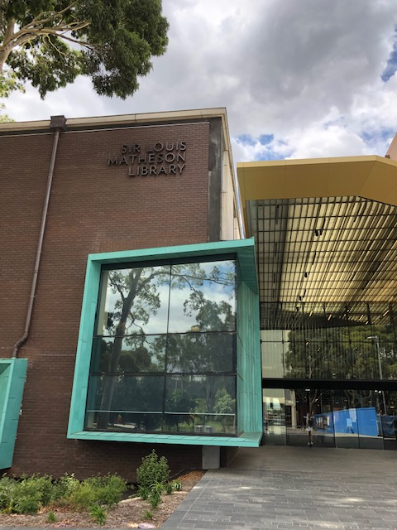
Japanese collection
Clayton campus, Sir Louis Matheson Library
Popular culture, Manga and animation
Contemporary Japanese society
Japanese language learning, education
Linguistics, Literature, Translation
Music, History
Japanese Teaching collection
Japanese Music Archive
Manga Library on campus

Slide 3
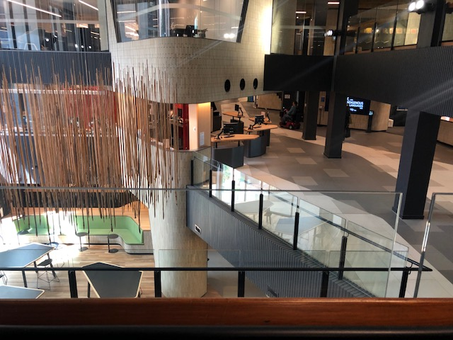
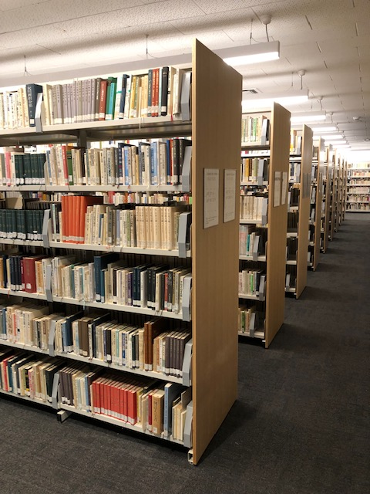
To the Japanese collection
Kulata Tjuta 2012-14

Slide 4
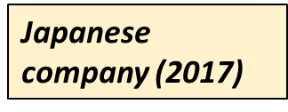
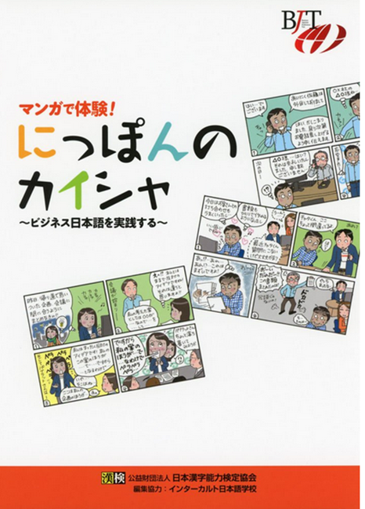
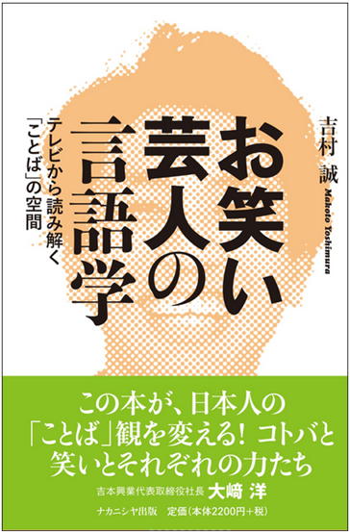
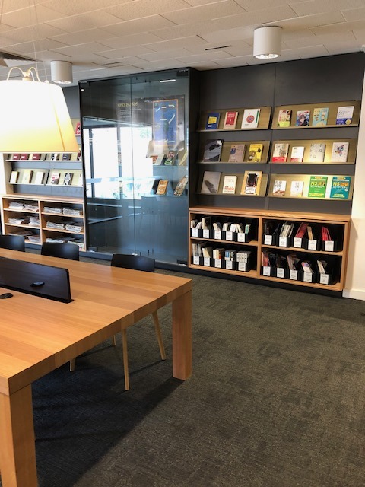
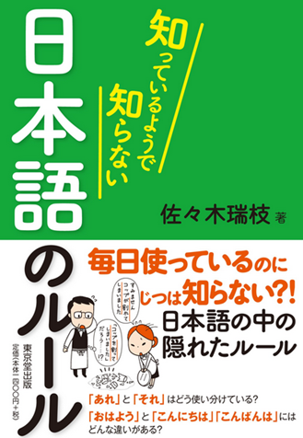
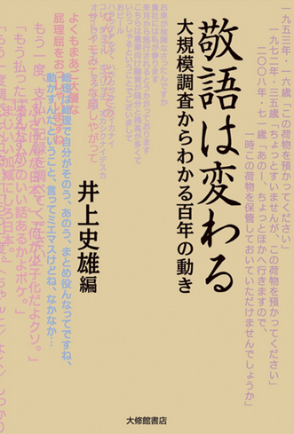
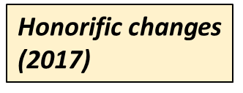
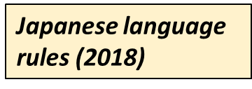
New arrivals from the Japanese collection

Slide 5
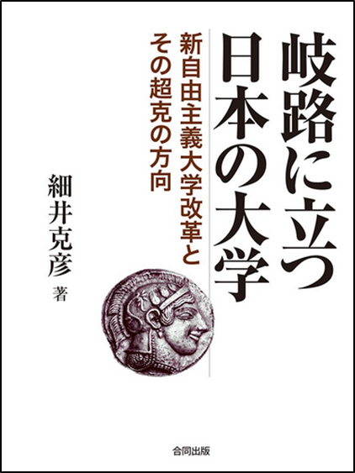
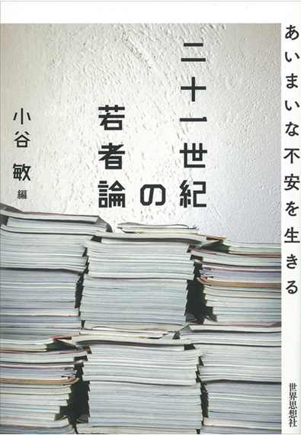
Reading contemporary Japanese criticism through literary studies (2017)
Kuroshima’s women (2017)
Japanese universities standing at the turning point (2018)
Narrating and inheriting the war experience (2018)
Translation works of Haruki Murakami (2017)
Youth theory in the 21st century (2017)

Slide 6
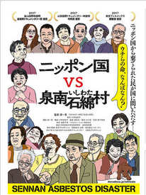
DVDs and multimedia resources
Killing for the prosecution (2019)
Future of Mirai (2019)
Japan vs. Sennan Ishiwata-mura (2019)

Slide 7
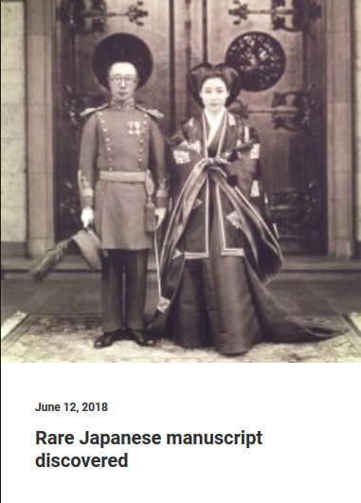
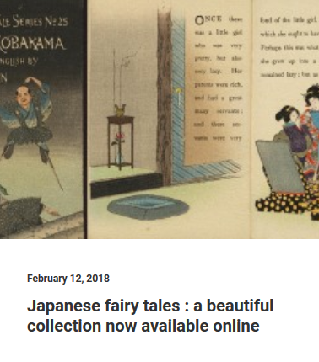
Library blogs available from the Library homepage

Slide 8
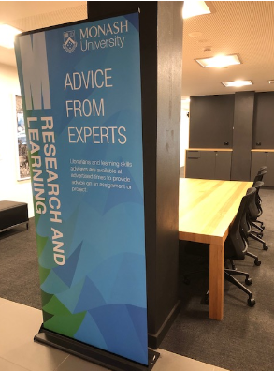
Teaching & Learning at Monash University
Library guides
Library catalogue, Databases, Citing and referencing
Moodle
Research & Learning Point in the libraries
Research consultations

Slide 9
Researching at Monash University

Slide 10
Researching at Monash University
Social networking tools and profiles in Japan
Grants-in-Aid for Scientific Research (KAKEN) https://nrid.nii.ac.jp/index/
Includes information on adopted projects, assessment, and research achievements from the Grants-in-Aid for Scientific Research(KAKENHI) Program.
Institutional Repositories DataBase (IRDB) https://irdb.nii.ac.jp/
A database service that provides metadata contents that has registered at the institutional repositories in Japan.
Researchmap https://researchmap.jp/
Enables users to create personalized websites, manage their research information, and network and collaborate with other researchers.
J-GLOBAL https://jglobal.jst.go.jp/en
Researchers (Researchmap), institutions, articles, research projects, etc.

