Slide 1
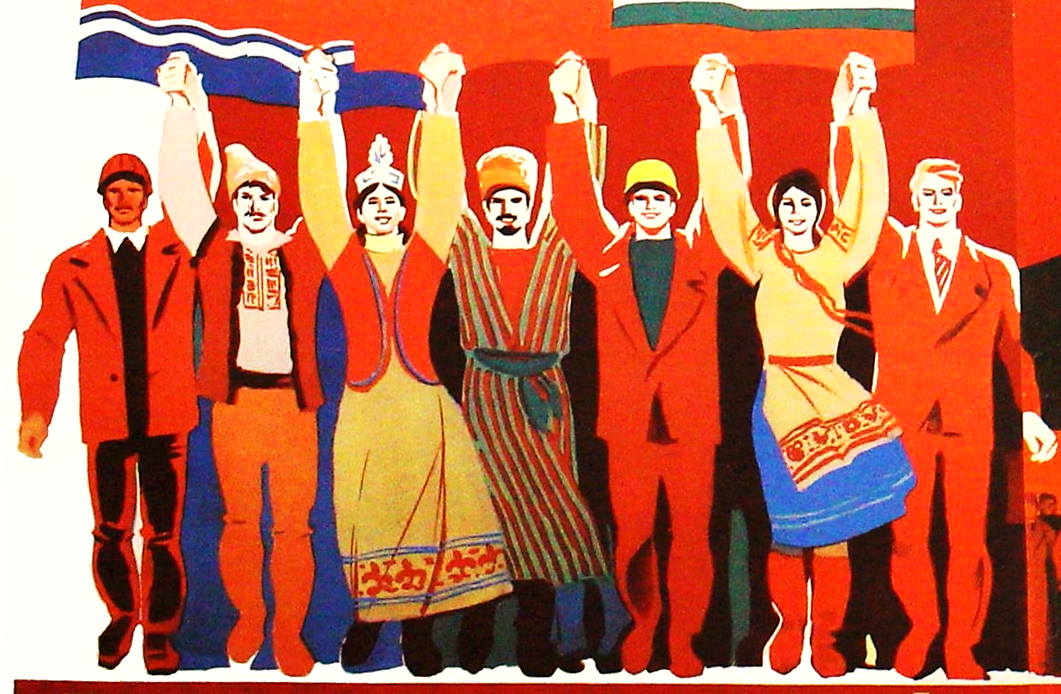
SLAVIC MUSIC IN THE ADA BOOTH COLLECTION
DEANNA RAMSEY (Ada Booth Librarian, Monash University )

Slide 2
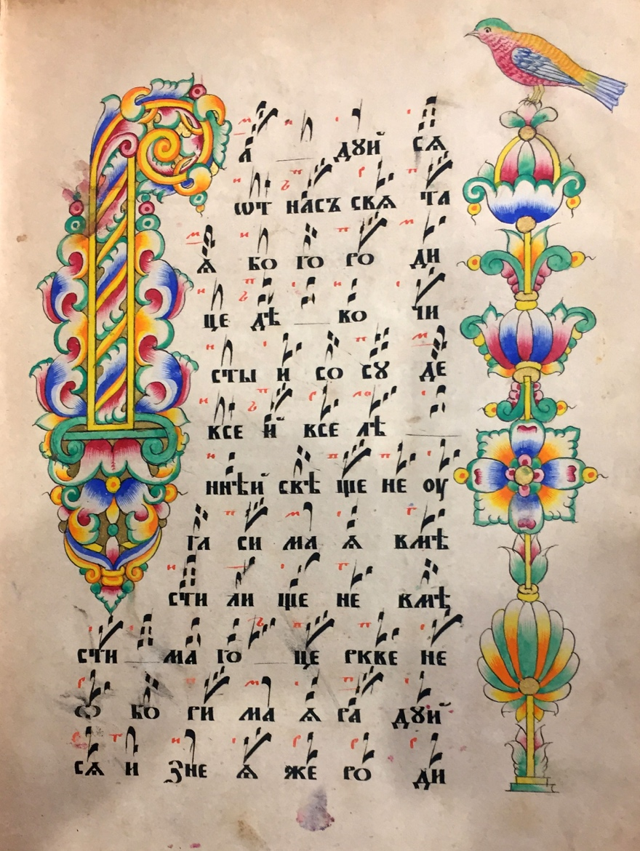
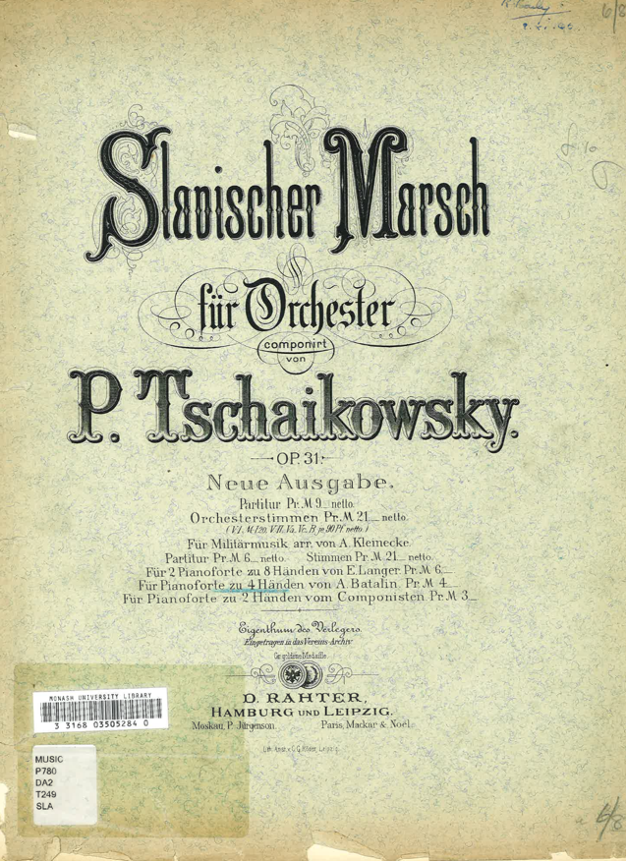
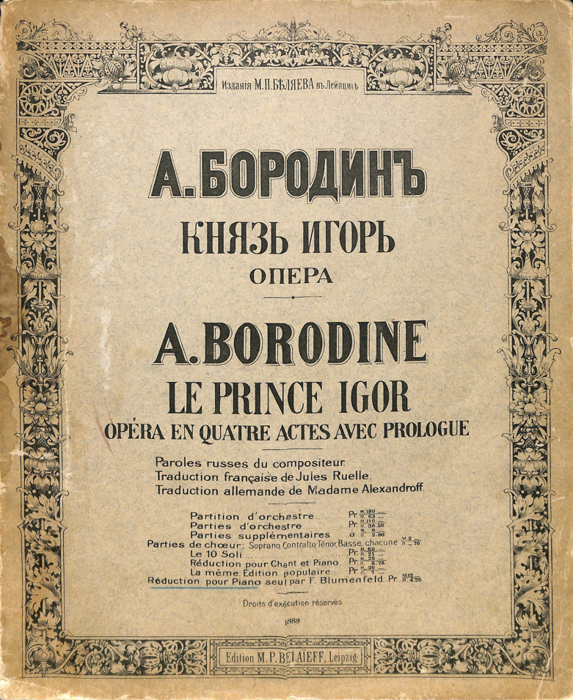
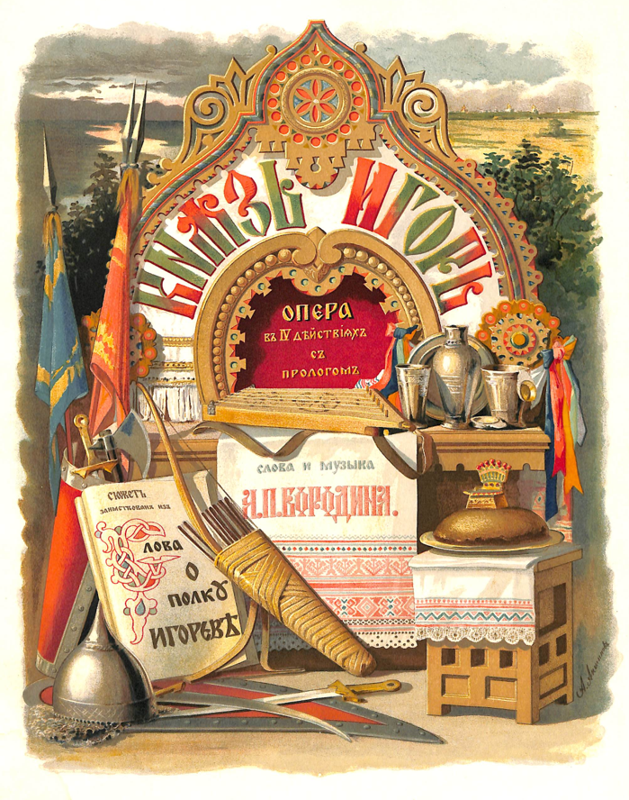
PRE-TWENTIETH CENTURY
Slavischer Marsch :
für Orchester, Op. 31.,
P. Tchaikowsky, [189?]
Kniaz’ Igor’: Opera,
A. Borodin,1888.
Old Believers Chant Book, 1860
Notes:
1. Old Believers Chants,
[Moscow?] 1860
2. Slavischer Marsch :
für Orchester, Op. 31.,
P. Tschaikowsky,
Leipzig [189?]
3. Kniaz’ Igor’: Opera,
A. Borodin,
Leipzig, 1888.

Slide 3
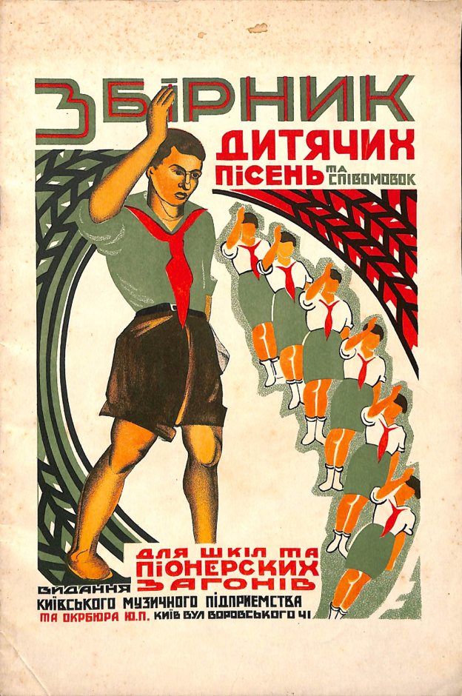
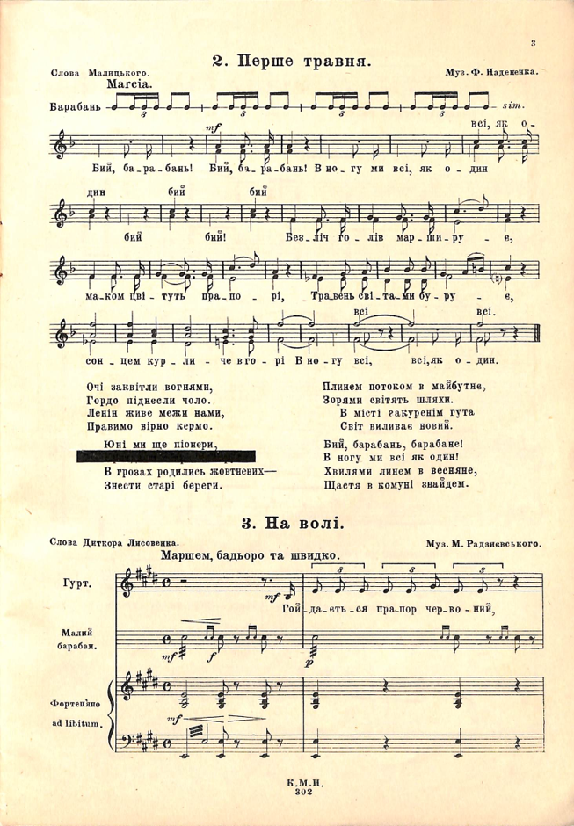
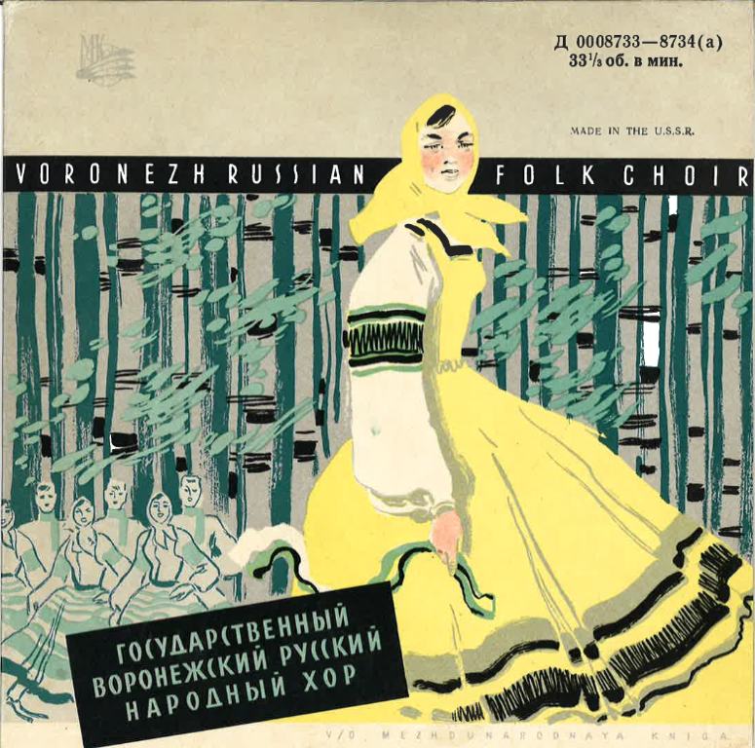
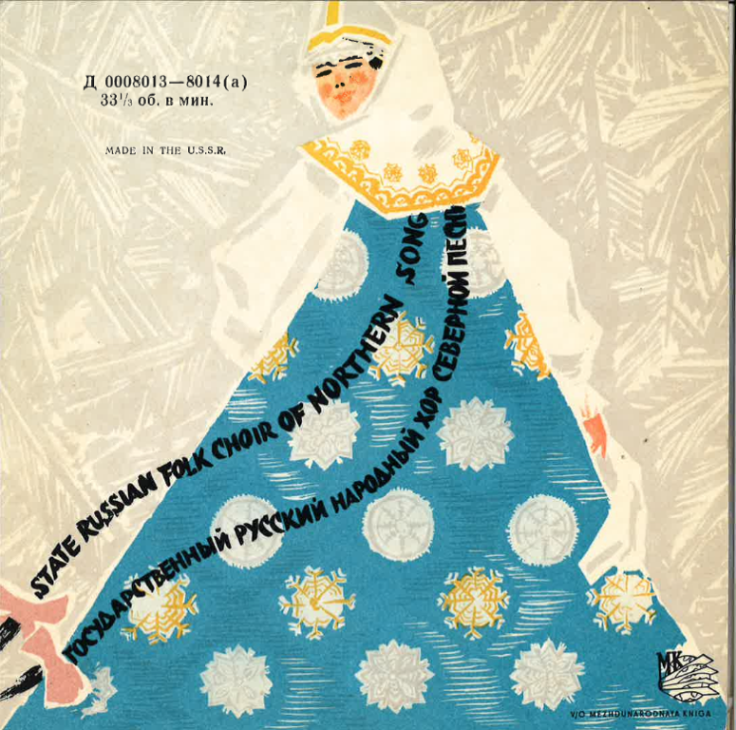
MUSIC IN THE SOVIET UNION
Voronezh Russian Folk Choir,
1967?
State Russian Folk Choir of Northern Song, 1963?
Zbirnyk dyti︠a︡chykh pisen' ta spivomovok : dli︠a︡ shkil ta pionerskykh zahoniv
[Children’s song book for pioneer units],1927
Notes:
1. Zbirnyk dyti︠a︡chykh pisen' ta spivomovok : dli︠a︡ shkil ta pionerskykh zahoniv
[Children’s song book for pioneer units]
Kyiv, 1927
2. Voronezh Russian Folk Choir, Moscow, 1967?
3. State Russian Folk Choir of Northern Song
Moscow, 1963?

Slide 4
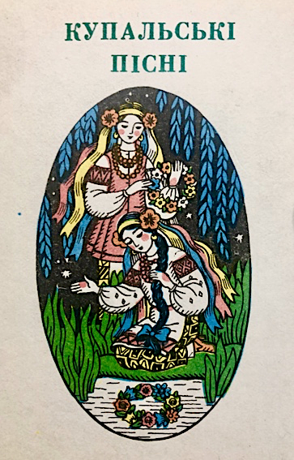
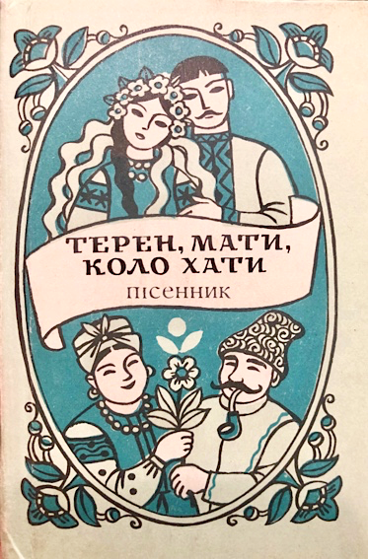
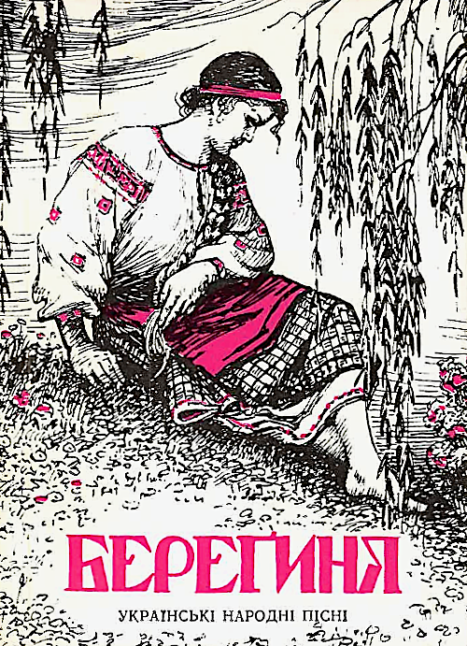
UKRAINIAN FOLK MUSIC
Kupalʹsʹki pisni,1989
Teren, Maty, Kolo Khaty: Pisennyk, 1989
Berehyni︠a︡ : ukraïnsʹki narodni pisni, 1991
Notes:
1. Kupalʹsʹki pisni
[Kupalo Songs]
Kyiv, 1989
2. Teren, Maty, Kolo Khaty: Pisennyk
Kyiv, 1989
3. Berehyni︠a︡ : ukraïnsʹki narodni pisni
Kyiv, 1991

Slide 5
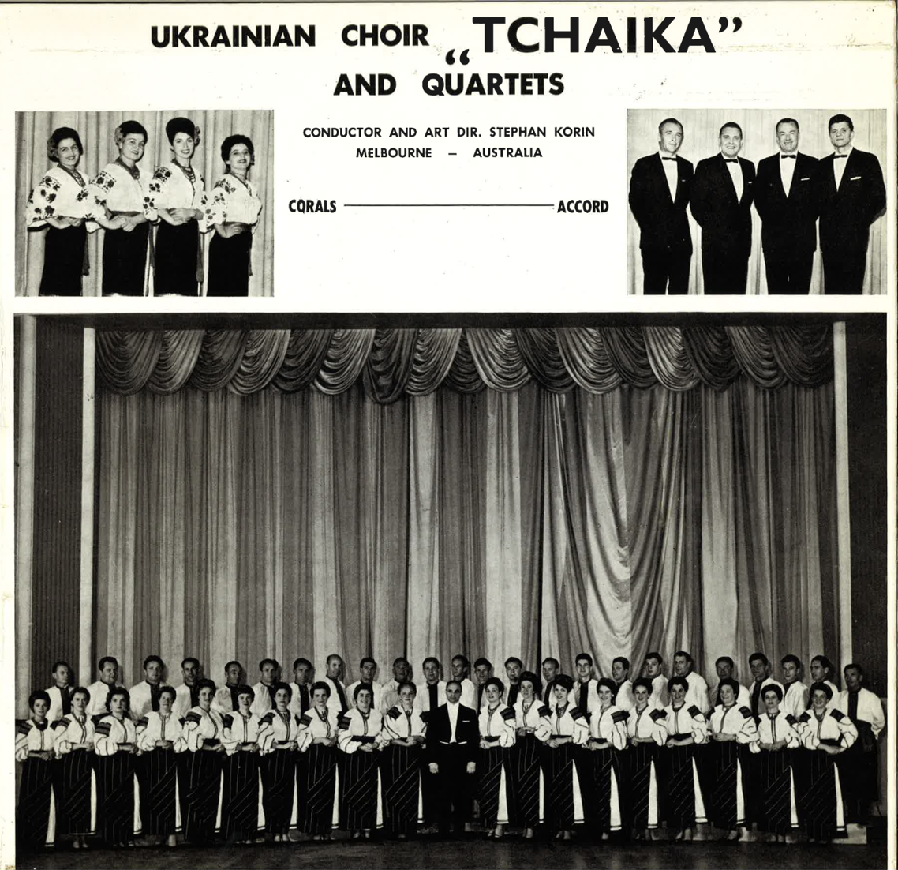
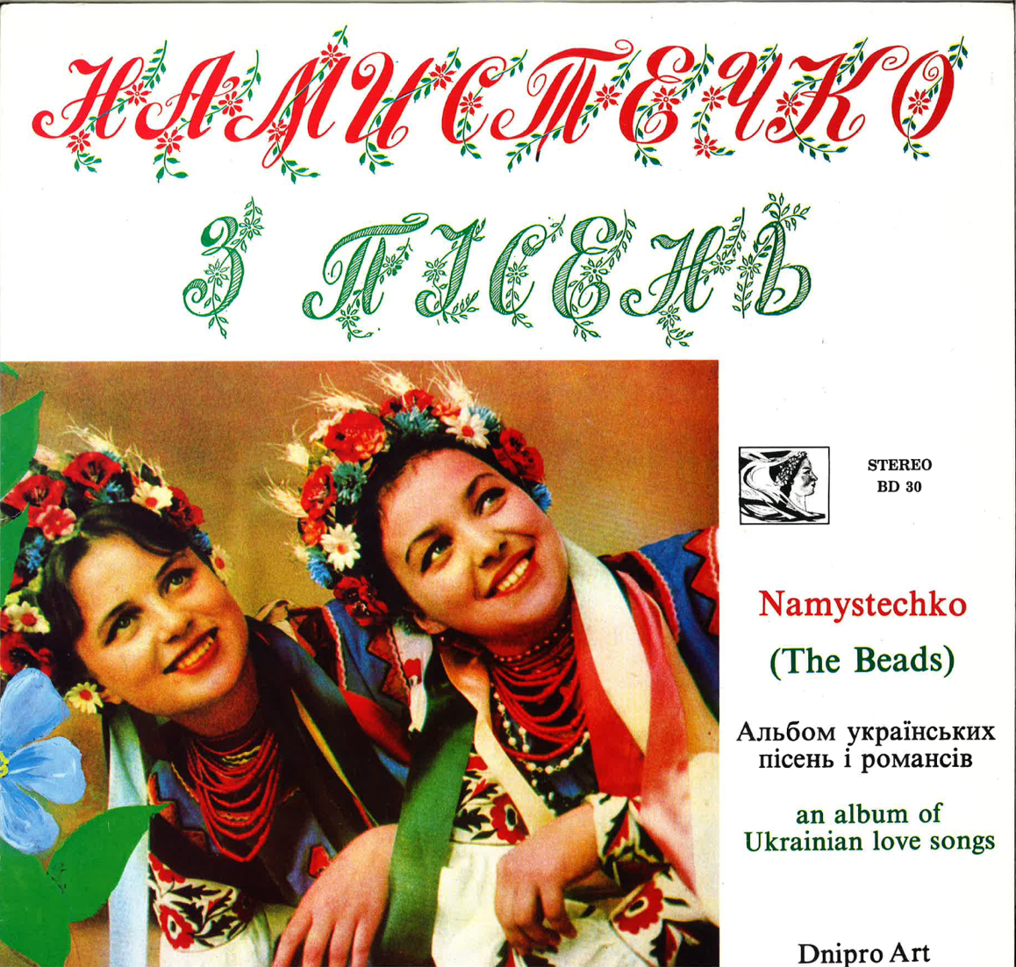
MUSIC IN THE DIASPORA
Ukrainian Choir “Tchaika” and Quartets
Melbourne, 1980
Namystechko (The Beads): an album of Ukrainian love songs
Toronto, 1978
Notes:
1. Ukrainian Choir “Tchaika” and Quartets
Melbourne, 1980
2. Namystechko z pisenʹ: al'bom Ukraїns'kykh pisen' i romansiv
[Namystechko (The Beads): an album of Ukrainian love songs
Toronto, 1978

