Slide 1
The Library’s role in students’ success:
Transition, Orientation, Retention
Lisa Smith
Library Director, Education
11 July 2019
STARS Showcase, Monash University

Slide 2
Students’ success: Transition, Orientation, Retention
In the Library context what does this look like for our students?
A successful student:
Engages with their Library
Uses Library spaces and places
Develops their research and learning skills
for their current studies, future work and a range of learning and life contexts

Slide 3
Engagement
Early and often, physical and online, a ‘sense of belonging’
Monash University Library User Surveys have shown that 79% of students who used the Library achieved at least a Distinction (InSynch National Benchmarking Survey)
The facilities are wonderful and enable a student to pursue their education to the depth and breadth they want …the library is the perfect place for students to equip themselves with the resources they need to do well
It was a great place for my assignments. Miss it so much!
Monash graduate
Library 2019 Orientation Banner
Clayton UG, Arts

Slide 4
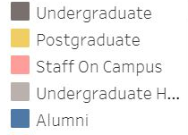
What does Physical Engagement look like?
In 2018:
Discussion room bookings
April 84% & August 89%
Physical Library use by month
Total 4,121,311 Visits to 6 Library branches
Physical loans by month

Slide 5
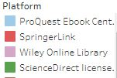
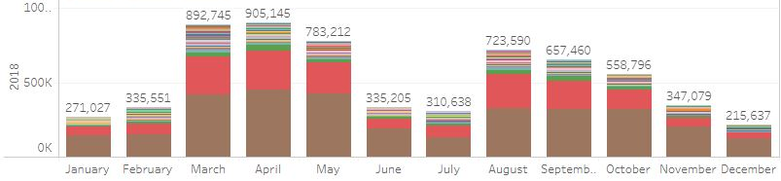
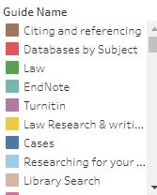
What does Online Engagement look like?
In 2018:
8,821,732 Book section downloads 9,881,181 Journal downloads
6,335,973 views of 141 Library Guides
eBook section downloads by month
Library Guide views by month

Slide 6
Spaces and places
Spaces and technology to inspire and enable the learning of all students
I really love the renovations of Caulfield Library. It's so clean, modern, spacious and it is a beautiful environment to study in. It caters for all my needs and I especially love how open and light it is with all the natural lighting
Life is so much easier in the lib
6,379 seats across 6 libraries at 4 campuses
4,127 Study Seats – individual, quiet; group, collaborative
688 Computer workstations
650 Teaching room seats
22 Wheelchair Access Tables
Open a total 465 hours per week in semester, and 505 hours during exam study weeks
Monash students
Caulfield UG, Arts
all these are the reasons why I always go to campus
the Library is the only place I would consider to meet up as a group
Caulfield UG, BusEco

Slide 7
Skill development
Research and Learning Programs, Resources, Drop-ins
2018 snapshot
Depth, breadth, scaffolded learning, anywhere, anytime, inclusive of and for all
982 skill development programs with 2,169 f2f sessions for 72,497 UG, PG, HDR participants
60% of programs delivered in-curriculum
40% of these used a blended learning approach
37 Library owned Moodle courses for student learning
260,985 views of 5 newly created Moodle courses
6,175 drop-in sessions at Library Research and Learning points

Slide 8
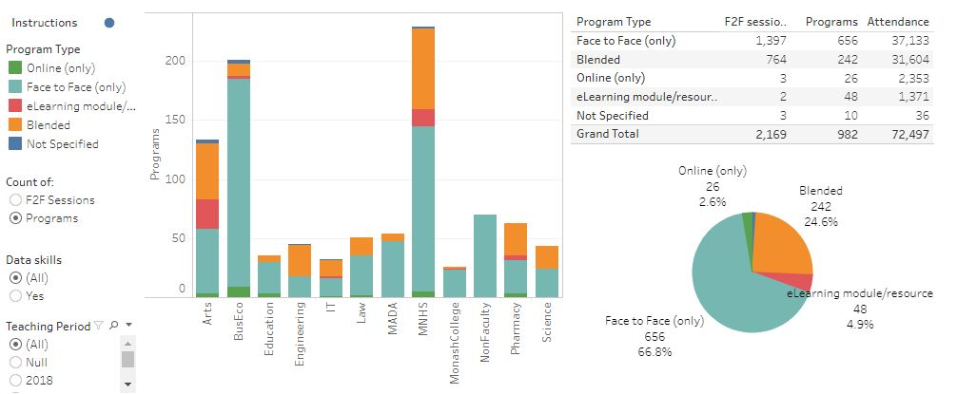
2018 Skill development – Research and Learning Programs
A program is a holistic suite and approach to skill development
eg in a unit with a series of workshops, elearning resources; at course level developing skill development teaching resources for use by tutors
A program may also be an independent stand-alone offering
eg in week 4 of semester, in a specific unit

Slide 9
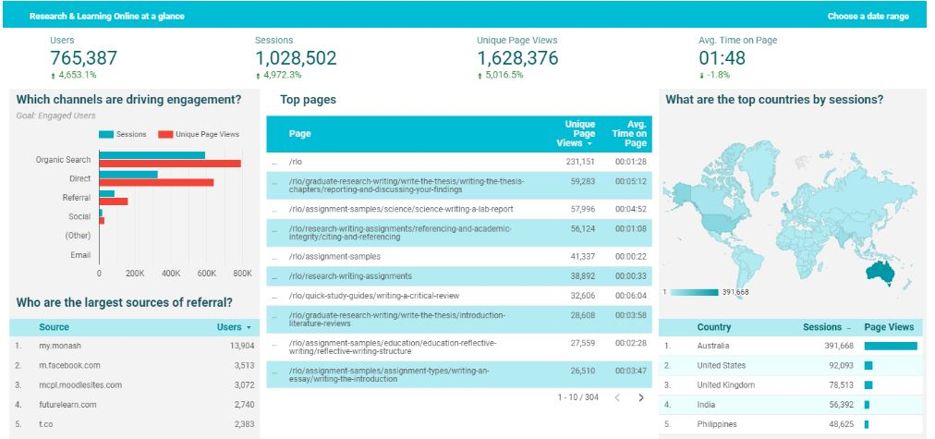
2018 Skill development – Research and Learning Online Resources
1,628,376
unique page views
Academic Integrity Tutorial
48,677 unique page views
Citing and Referencing Tutorial
110,244 unique page views
Other top pages: preparing and studying for exams; writing assignments, essays, reports, theses

Slide 10
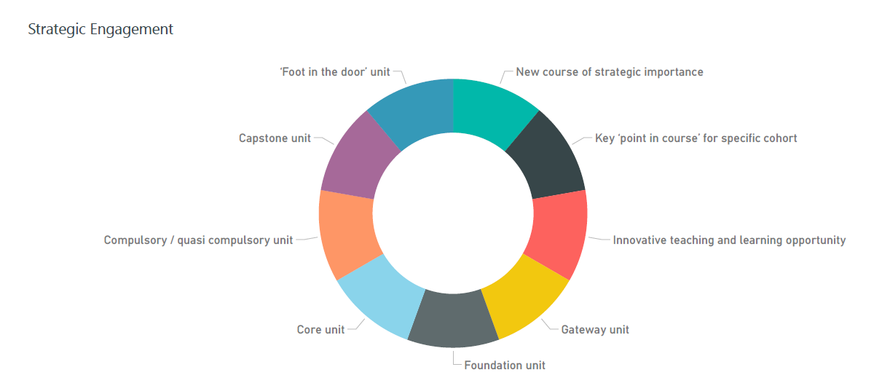
2018 Skill development – Programs
Strategic Engagement
Core unit
Foundation unit
Gateway unit
Key ‘point in course’ for specific cohort
New course of strategic importance
Innovative teaching and learning opportunity
‘Foot in the door’ unit
Compulsory/quasi compulsory unit
Capstone unit

Slide 11
2018 Skill development – Programs
What are the research and work skills being developed through these programs?
Research Skill Development framework
Work Skill Development framework

Slide 12
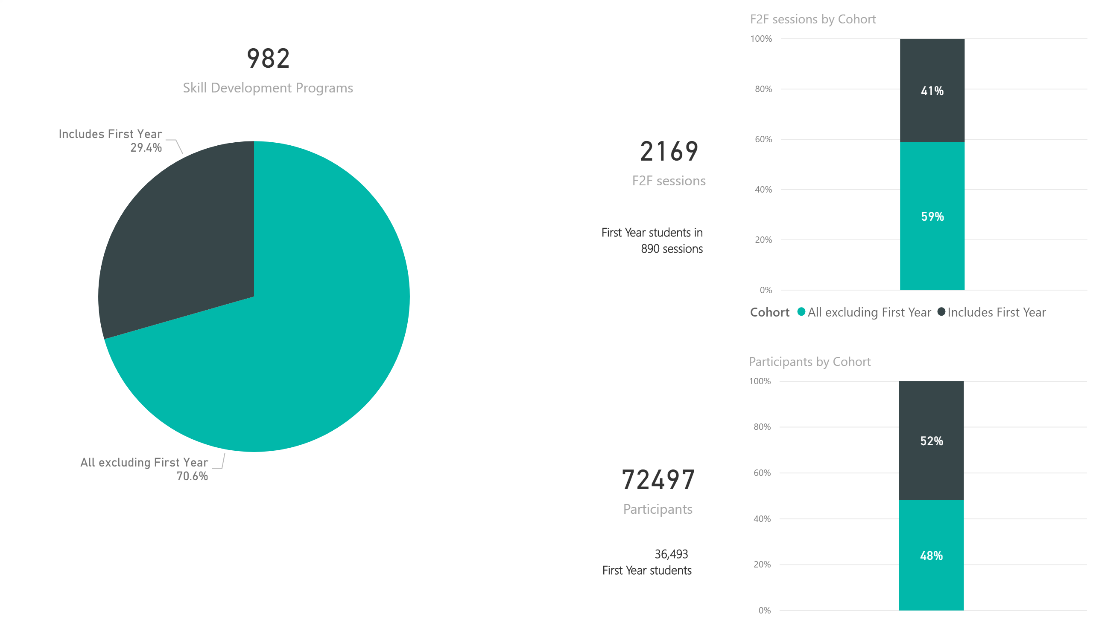
2018 Skill development – Programs
Focus on First Year undergraduate students

Slide 13
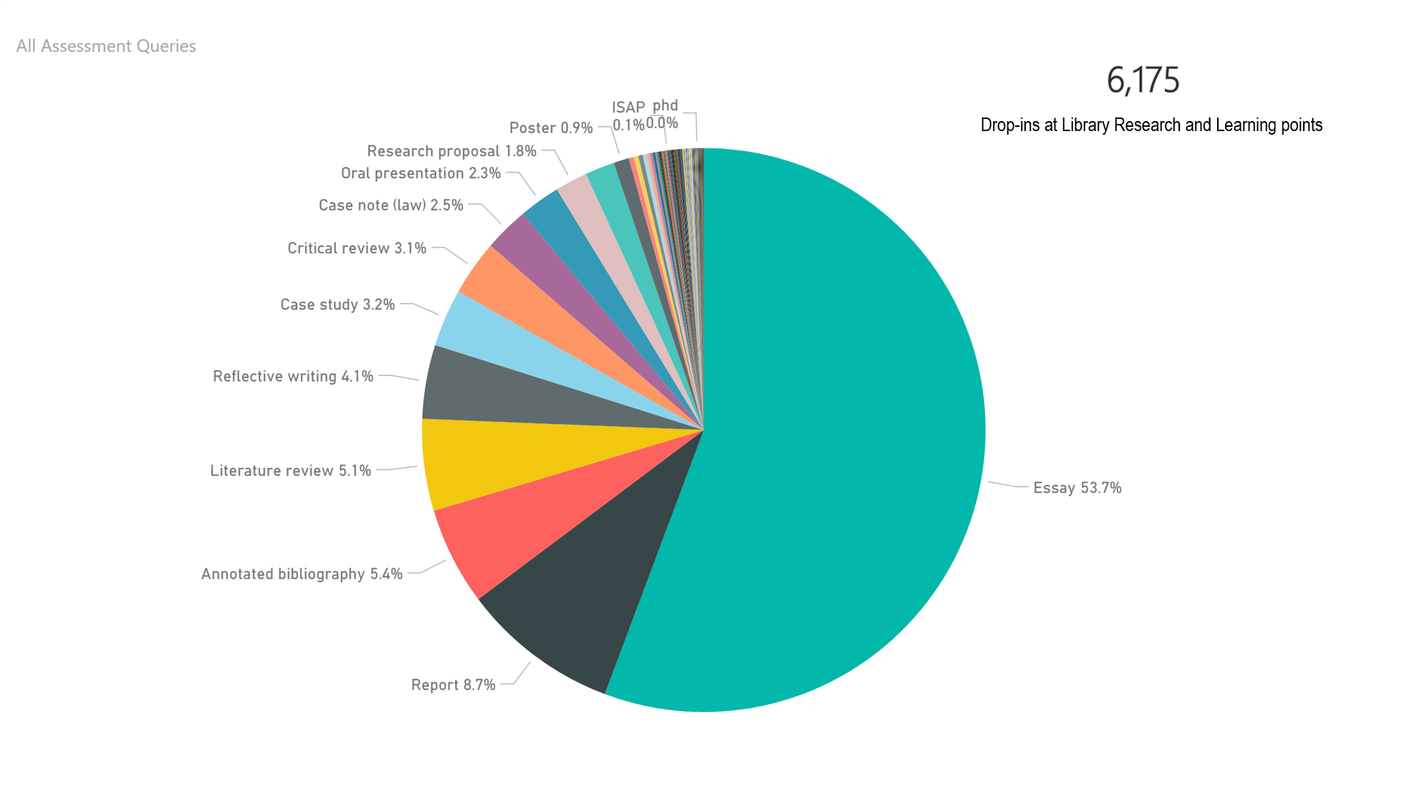
2018 Skill development – Research and Learning Point
By assessment type

Slide 14
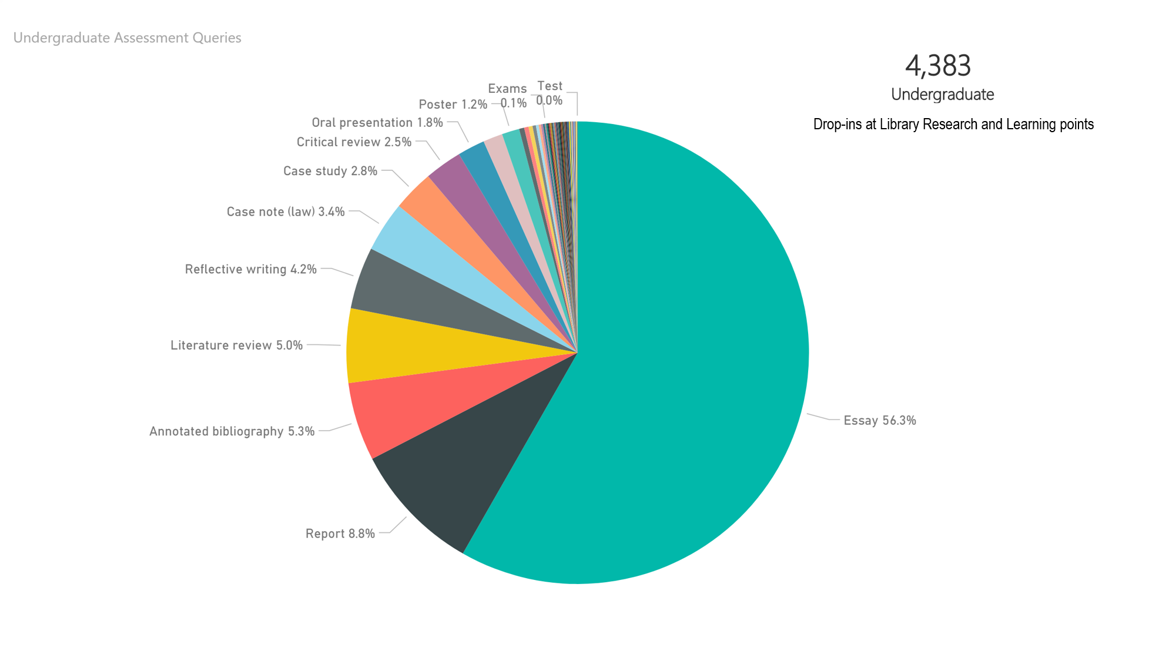
Undergraduate – by assessment type

Slide 15
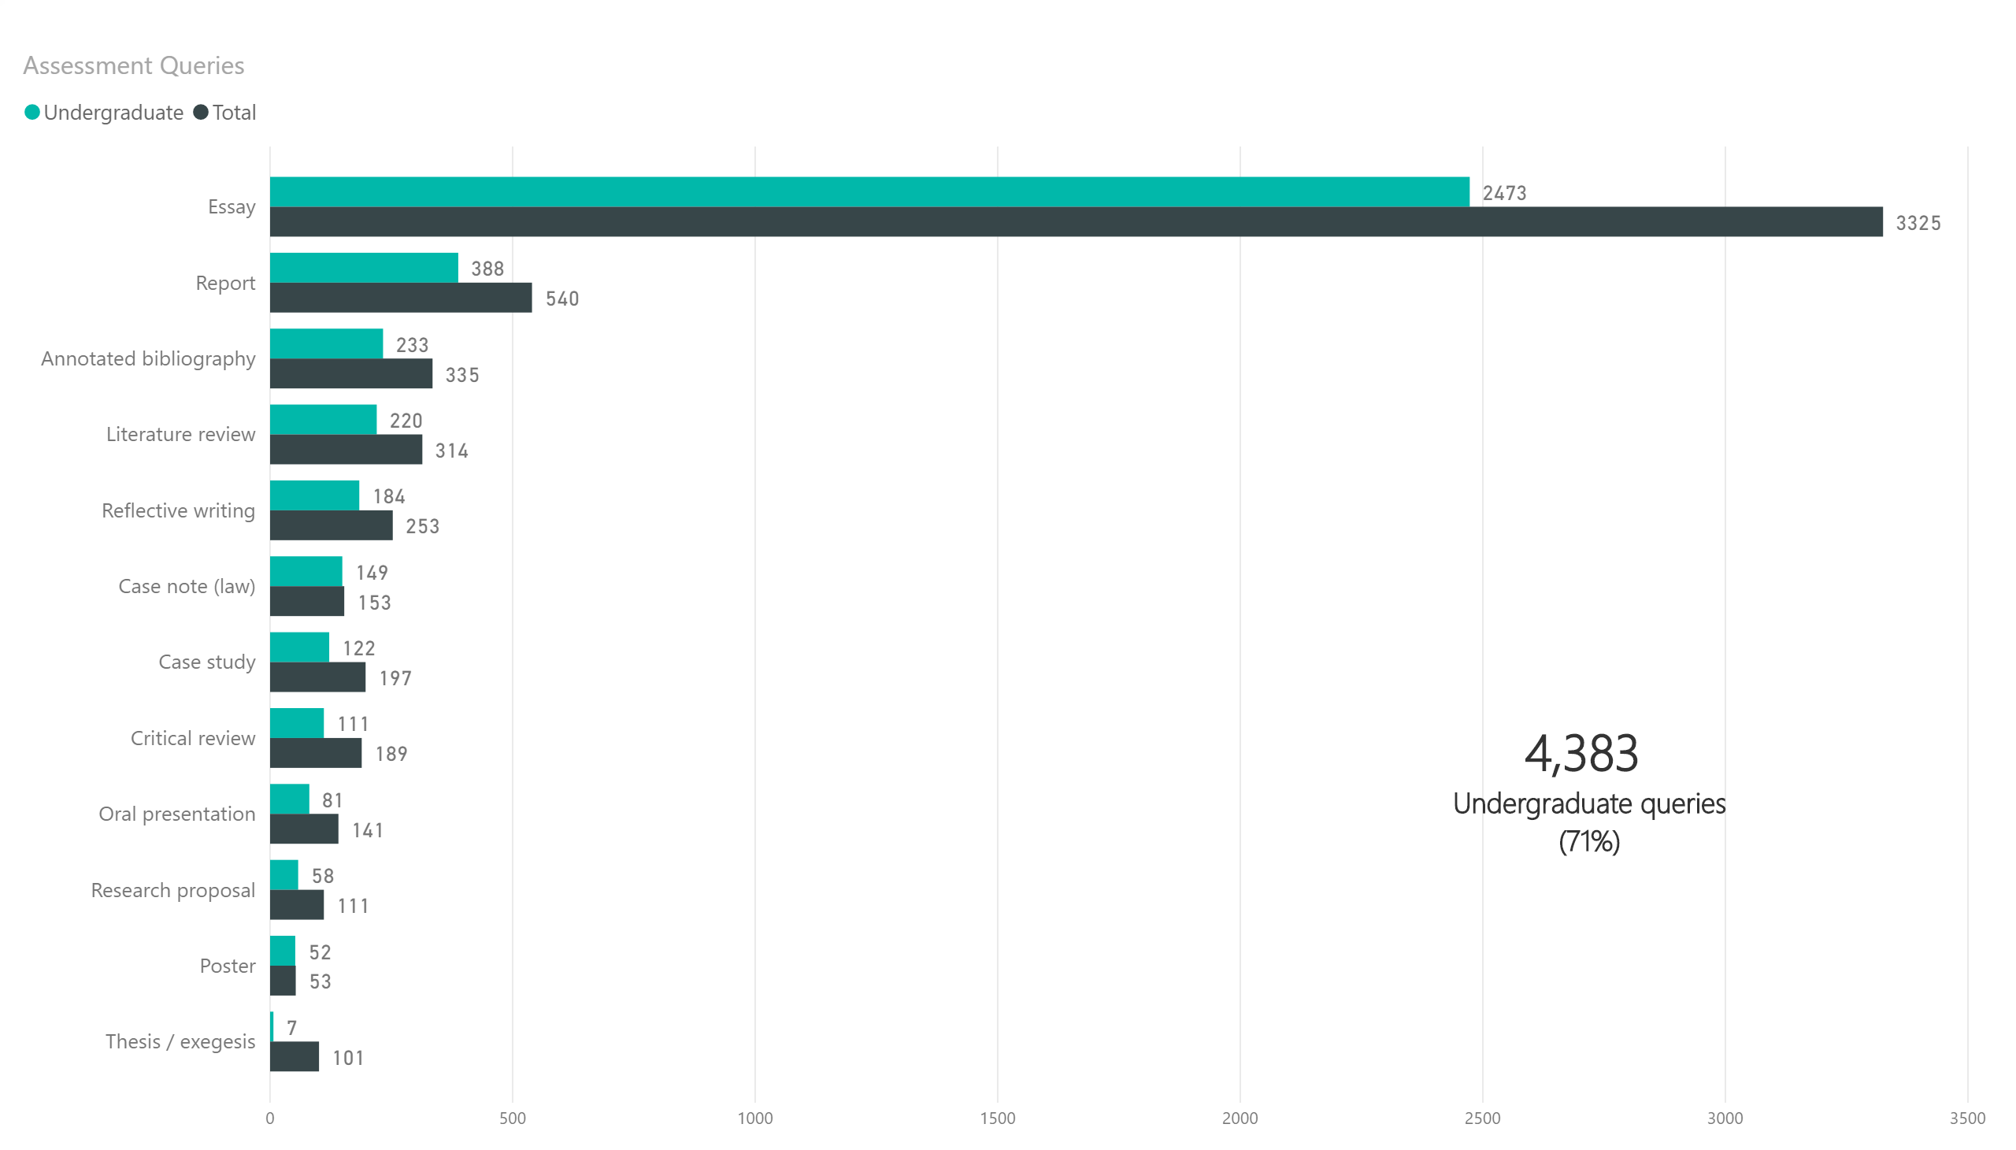
Undergraduate – by assessment type

Slide 16
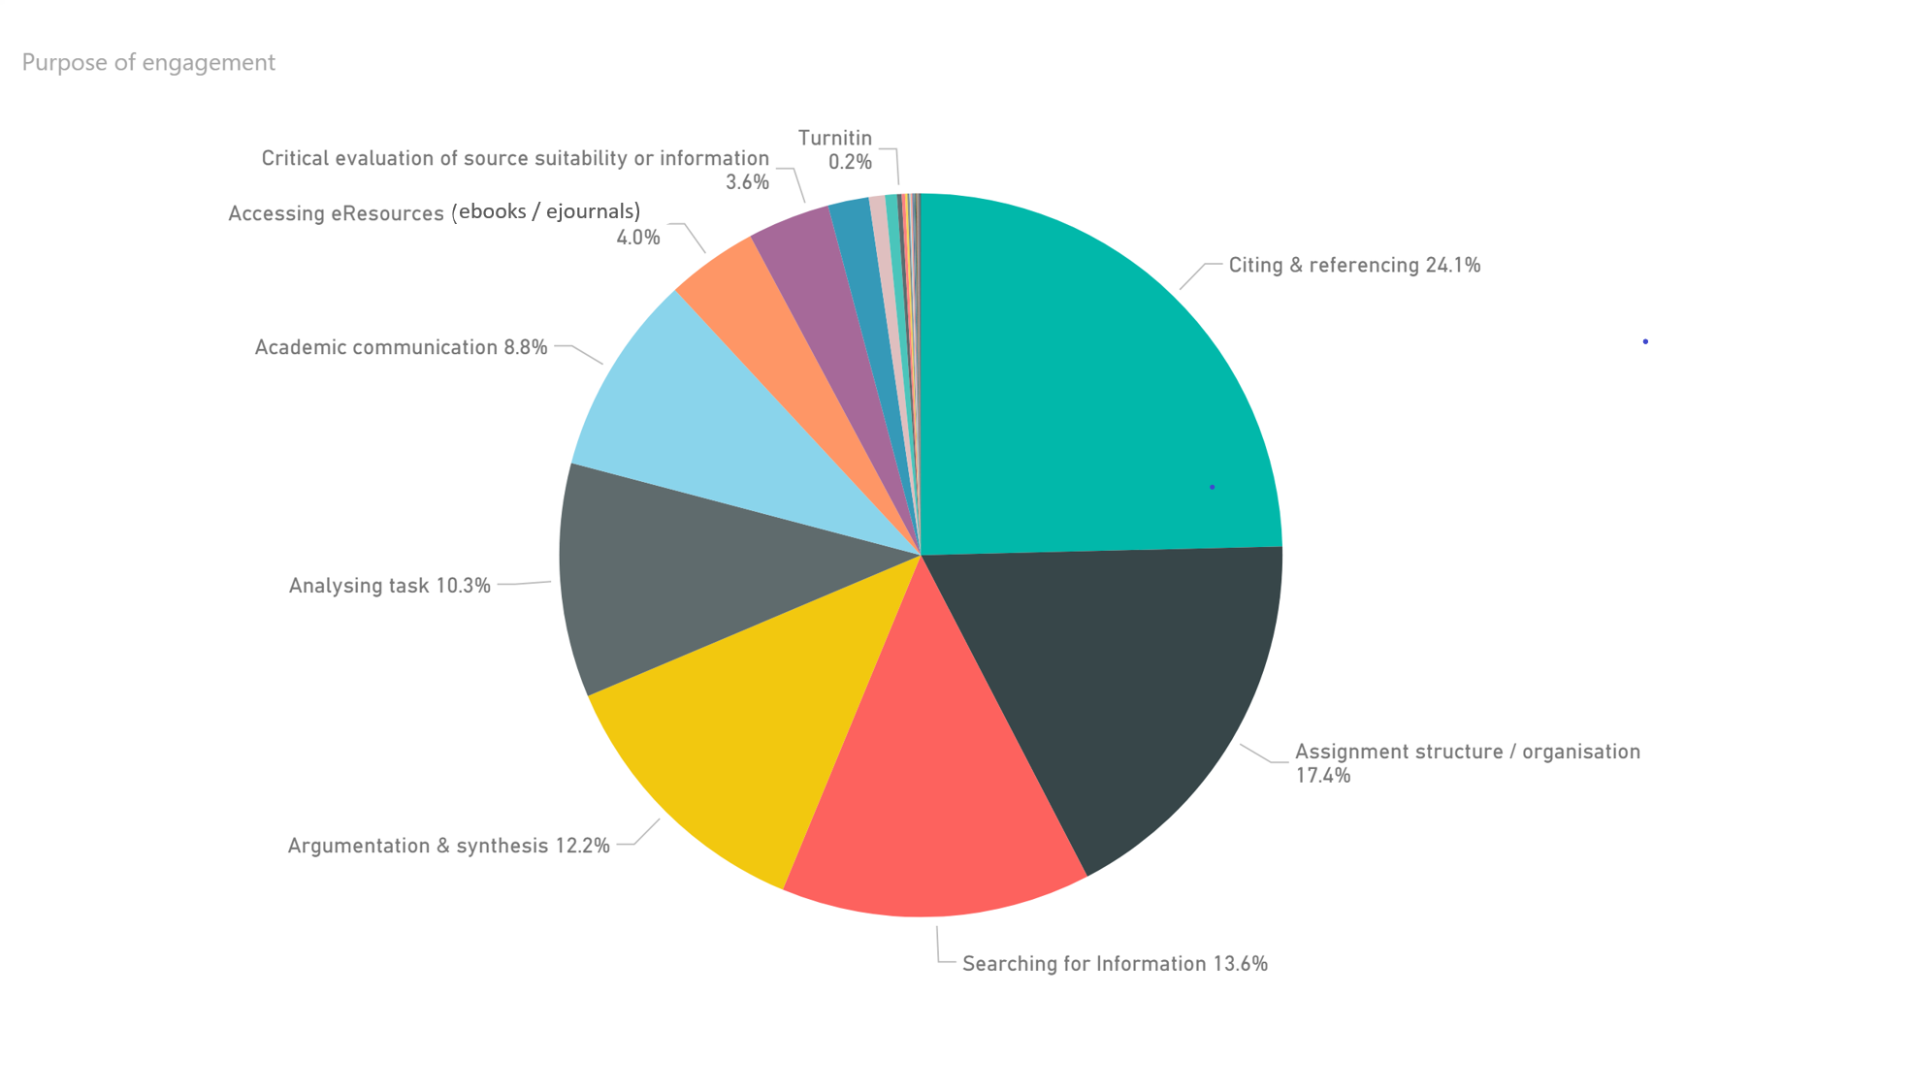
2018 Research and Learning Point
By purpose of engagement

Slide 17
Undergraduate – by purpose of engagement

Slide 18
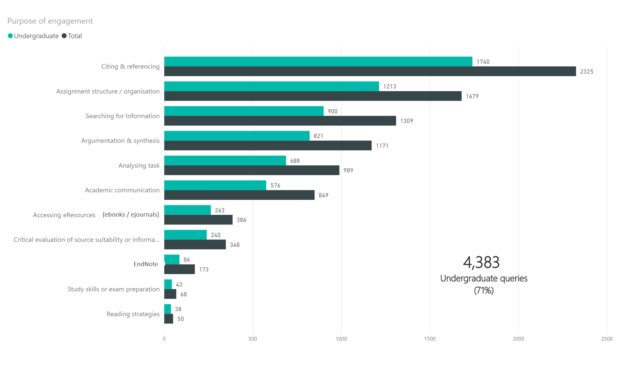
Undergraduate – by purpose of engagement

Slide 19
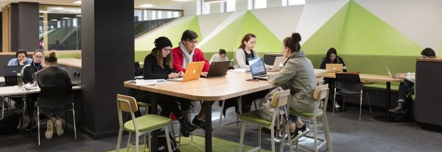
2018 Program examples – at every stage, for every cohort
MCPathways: Monash English Bridging Course 10,15 or 20 week duration, students transitioning to University, very large, repeat cohorts across year. Set of 6 e-learning modules (iLearn) developed to form the basis of an embedded research skills development program for MEB.
Follow up teaching program – 2 students from each class attend a follow up workshop on developing and applying a research strategy for their assignment, then run this in their own classes for peers, using Library resources
Feedback from course coordinators is very positive – program now in its third year

Slide 20
2018 Program examples – at every stage, for every cohort
UG: Art, Design, Architecture first year prescribed gateway unit Introduction to Visual Culture with large enrolment of c.600 students per semester. Library redesigned f2f program to blended learning approach in 2018 to extend reach and impact in developing students’ research and academic writing skills.
Embedded assignment aligned program of workshops and 4 Moodle lessons at key weeks.
Increased student engagement from prior years: 541 participants in set of 4 workshops in 2018 – 234 for first assignment (39% of cohort). 1,629 views by 512 unique users of Moodle lesson for first assignment (85% of cohort), used throughout semester for subsequent assignments, with similarly strong numbers for later lessons.
Students and academic teaching staff said ‘workshops and Moodle lessons were very useful, accessible and key to developing students’ academic skills’

Slide 21
2018 Program examples – at every stage, for every cohort
this…program [is] a way of making a soft landing for us that come from all over the world and get to the same level, to have the same basic starting point, and from there having a better student life.
PGC: Arts Master Skills 3 day Orientation program developed in partnership with Faculty to address academic and social needs of a diverse international cohort for the Faculty of Arts Masters’ programs.
Covers academic and career skills such as time management, research, referencing, writing, argumentation and oral presentation skills.
F2F sessions are replicated with interactive resources on Moodle and continues to build skills with a semester workshop program
80-120 new students participate each semester, with 29,524 student views/posts to the Moodle site in sem 1 2018
100% of participants state they had a positive student and would recommend the program to future students
2018 Arts Master Skills participant

Slide 22
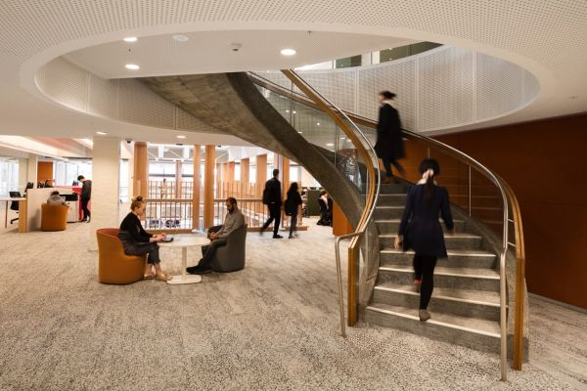
2018 Program examples – at every stage, for every cohort
HDR: The Library contributes twelve workshops to the official Monash Doctoral Program – covering all stages of the HDR journey:
Developing a Plan for Successful Doctoral Students
Writing a Literature Review (H&SS)
Preparing the Research Proposal
Writing about Quantitative Data
Writing about Qualitative Data
Developing a Successful Publishing Strategy
Building an Online Research Profile (to maximise impact)
Faculty specific programs include – Thesis/Publication Writing Groups, Shut Up and Write sessions, Intensive Writing Course for Science Communication

Slide 23
WIL, Internships, employment
Library-Faculty Collaborations
Faculty of Art, Design and Architecture - Master of Design
For their final year project, 8 students selected by unit coordinators are designing and installing interactive AR/VR experiences for the Library’s forthcoming WWI Repatriation exhibition
Now course complete, the students are being employed as casual staff for six weeks to complete their project.
Faculty of Arts - Korean Studies, Music and History Internships
History students are preparing a showcase of items from the Library’s Special Collections for the above exhibition as Work Integrated Learning interns.
Selected Korean Studies students undertake an industry internship with the Library to work in the Library’s Asian Collection at Matheson Library – now in its second year, expanded to Music students from 2019

Slide 24
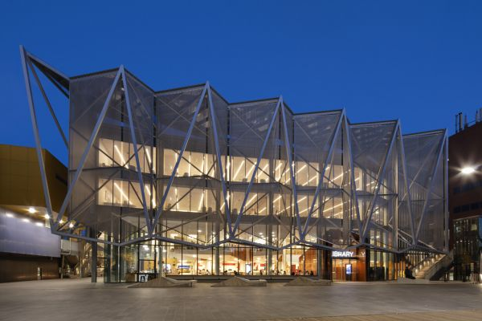
 The Library employs students from a wide range of faculties as casual staff in client facing, technology, and other roles
WIL, Internships, employment
Library-Faculty Collaborations
Faculty of IT – Information Management – Bachelor, GradDip and Masters
Annual intake of students undertaking WIL to the Library
Selected students recruited as casual staff, further developing team work, communication and other employability skills directly related to their studies

Slide 25
Inclusive Teaching Toolkit
Principles, guidelines, resources for teaching inclusively in library environment
Library developed, being used by Library staff to inform their practice
Inclusive teaching helps all students succeed at university
Inclusive teaching is making sure that every student in the classroom regardless of their individual needs and circumstances isn’t disadvantaged in any way. Everyone is included and everyone … benefits equally.
When teaching staff made an effort to include me or others, I felt elated because someone actually took the time to care. It make the university a more welcoming and positive environment and energised me to attend classes and do my work.
Library staff member
Monash student

Slide 26
Specific social inclusion programs
Learning Skills Adviser and Subject Librarian (Social Inclusion)
78.4% of 37 survey respondents agreed or strongly agreed that ‘I
better understand how to structure an essay after this class’,
2018 highlights
Embedded research and learning skills development programs
Faculty of Education Pathways Programs: Diploma of Tertiary Studies and Diploma of Higher Education 2 core sem 1 and 2 units (Learning in a University Context; Knowledge and Content) 159 students Clayton and Peninsula campuses 24+ hours f2f in 19 workshops on research skills and assignment writing; +45 consultations for total 418 participants
Mature Age and Part-time Students – low SES tailored cohort tour, orientation and skill development for first assignment in core unit (Learning in a University Context) 2 hours f2f + Moodle elearning resources on research skills; + tour, information session, orientation for total 55 participants

Slide 27
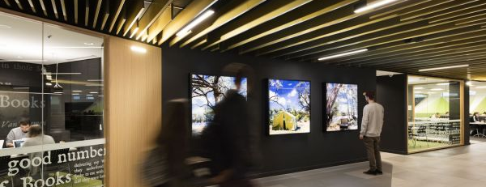
Specific social inclusion programs
Learning Skills Adviser and Subject Librarian (Social Inclusion)
Yulendj Indigenous Engagement Unit Programs designed to facilitate Indigenous students’ access and retention: Monash Indigenous Enabling Program Library induction and study skills workshop
Yulendj ‘Hands on Monash Camp’ for 37 prospective Indigenous students (years 10-12) ‘Indigenous Rights: Protest in Print’ exhibition and artefacts exploration, Library ‘scavenger hunt’
Yulendj Lounge Drop-in Research and Learning Sessions One to one expert advice on study, research and writing skills 38 sessions, 61 students at Clayton and Peninsula campuses
Maree Clarke On the banks of the Murray 2017

Slide 28
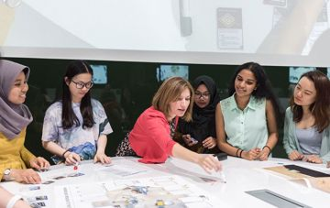
Specific social inclusion programs
Learning Skills Adviser and Subject Librarian (Social Inclusion)
Programs for Students in Low-SES High Schools designed to reduce intimidation of University study, critically engage with advantages of attending university and develop teamwork, critical thinking, research skills:
Access Monash Leadership Day program for years 9-10 students - 2 days at 2 venues 4 research and critical thinking skills workshops for 120 students – project on promoting benefit of tertiary education to peers
Year 10 Champions Camp 2 Library scavenger hunts with 38 participants
Advancement via Individual Determination (AVID) Program Library tour, research workshops tailored for 60 year 9 and year 10 students

Slide 29
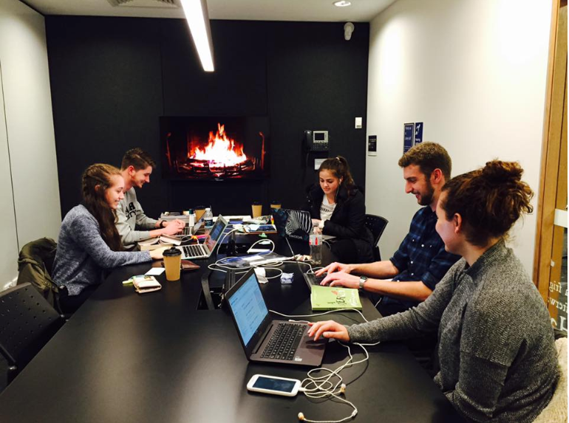
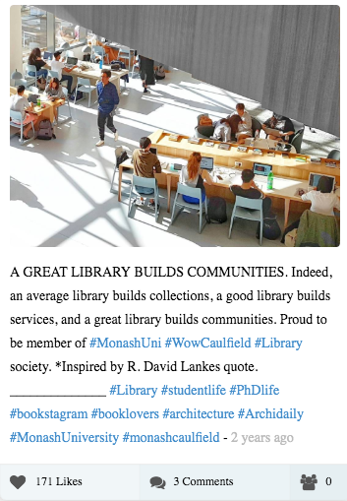
Thank you
Questions?
Lisa.Smith@monash.edu

