Slide 1
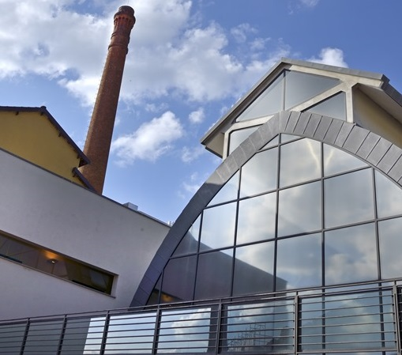
Re-shaping the past, preserving the future Libraries as cultural heritage holders: the case of the Biblioteca Lazzerini in Prato
Irene Guidotti
Librarian (Digitisation and Research Repositories)
14th CIRN Conference, Prato – 26.10.2017

Slide 2
Library Guides Interface Restyling to increase access and usability
Overview
Irene Guidotti
Librarian – Monash University
14.09.2017
Redesigning existing buildings: some examples
The case of the Lazzerini Centre
Prato and its textile tradition
Timeline of the project
From the Campolmi Textile Factory to the Culture Factory
Preserving memory
Conclusions

Slide 3
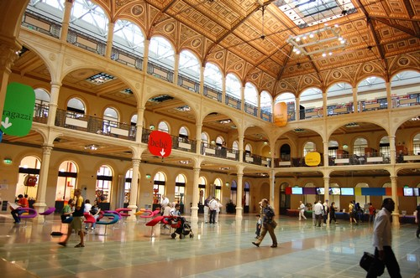
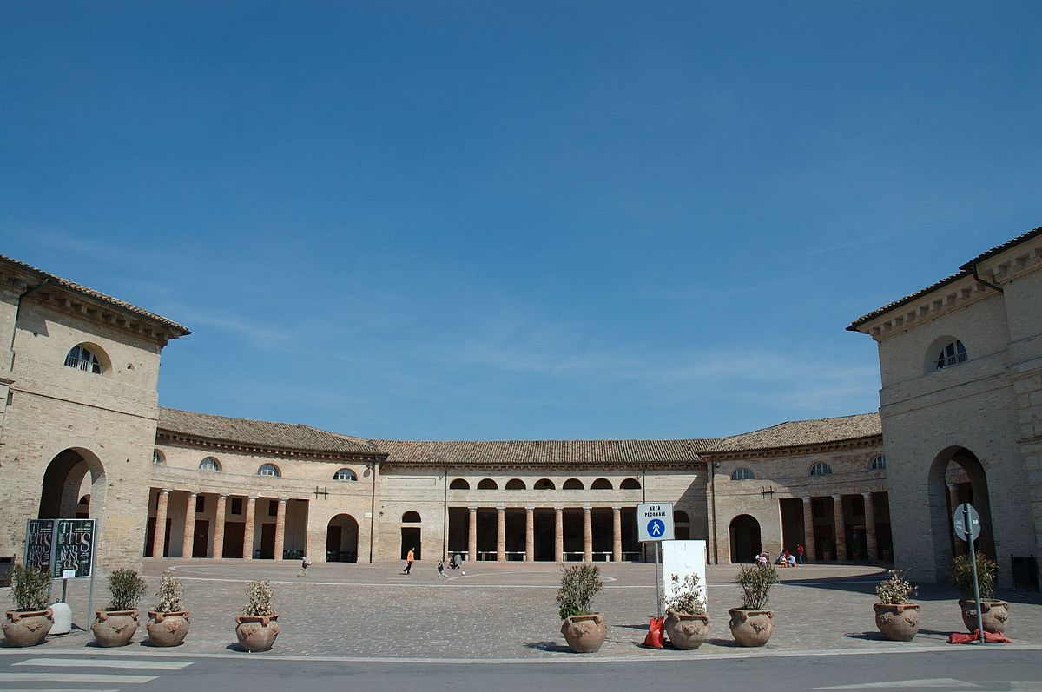
Library Guides Interface Restyling to increase access and usability
Irene Guidotti
Librarian – Monash University
14.09.2017
Salaborsa Library - Bologna
Historical Archive and
The Antonelliana Library - Senigallia

Slide 4
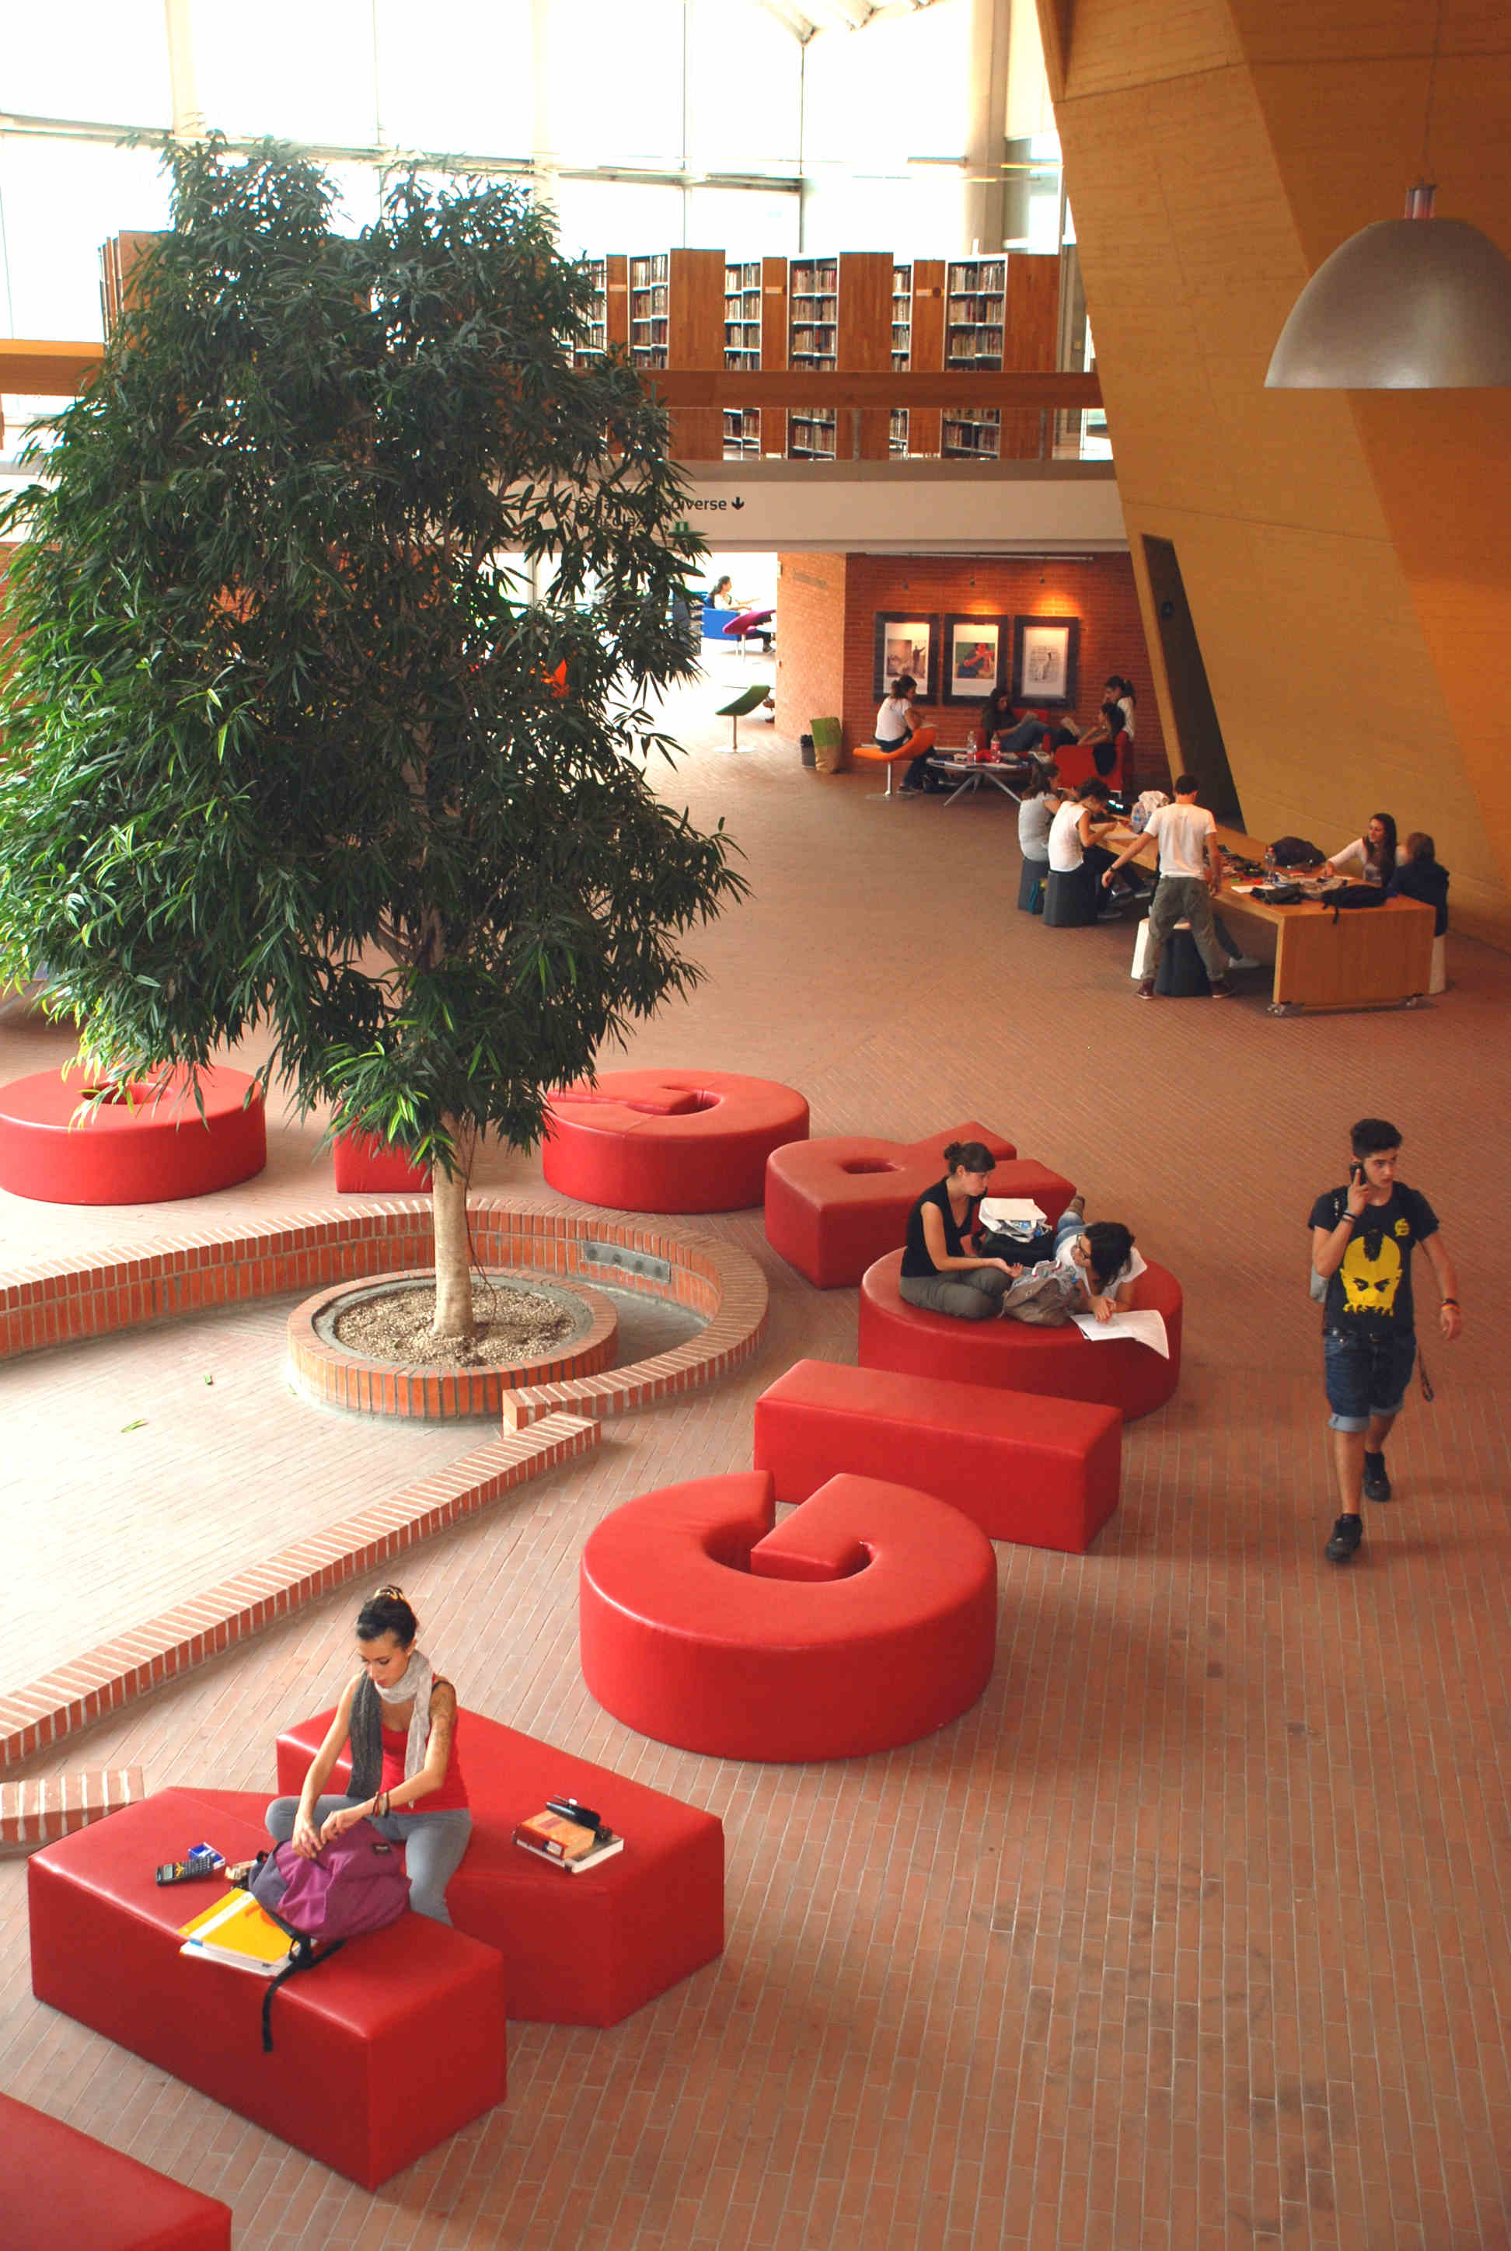
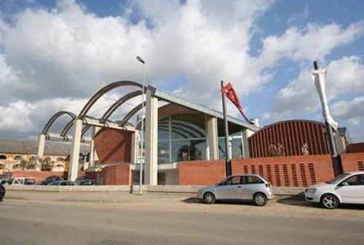
Library Guides Interface Restyling to increase access and usability
Irene Guidotti
Librarian – Monash University
14.09.2017
San Giorgio Library - Pistoia

Slide 5
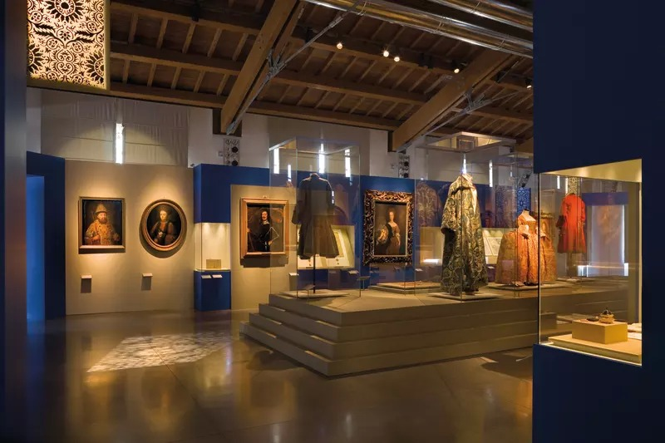
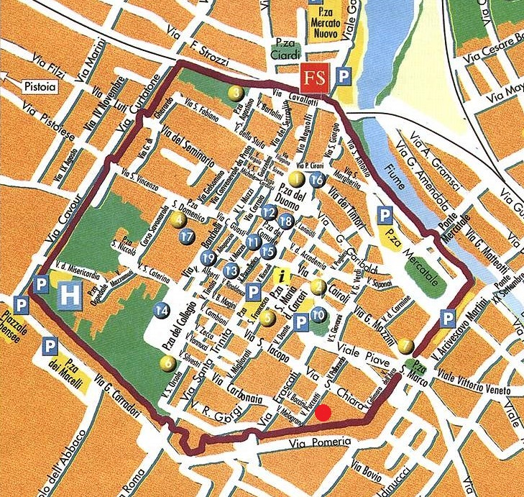
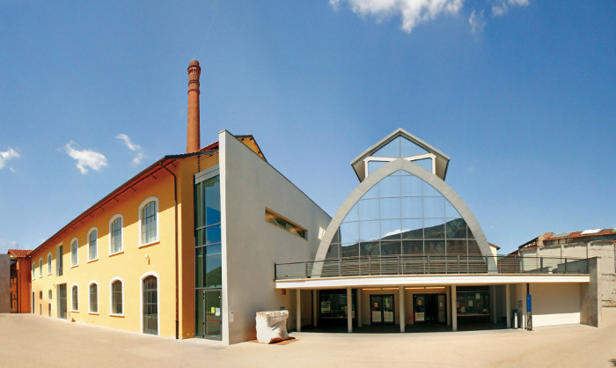
Library Guides Interface Restyling to increase access and usability
Irene Guidotti
Librarian – Monash University
14.09.2017
Lazzerini Cultural and Documentation Institute - Prato

Slide 6
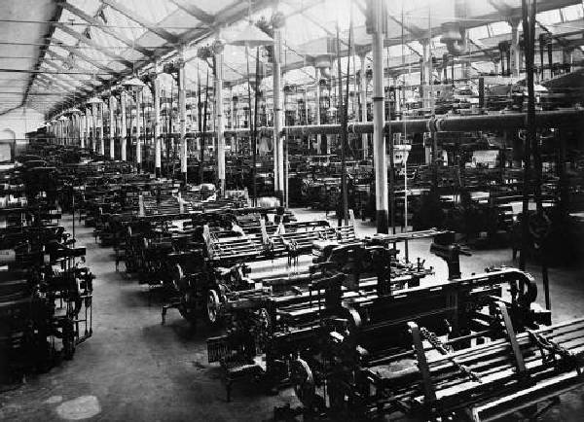
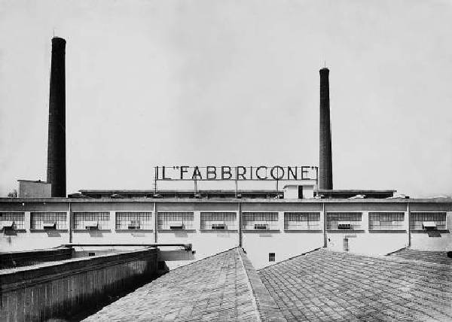
Library Guides Interface Restyling to increase access and usability
Irene Guidotti
Librarian – Monash University
14.09.2017
Prato and its Textile Tradition

Slide 7
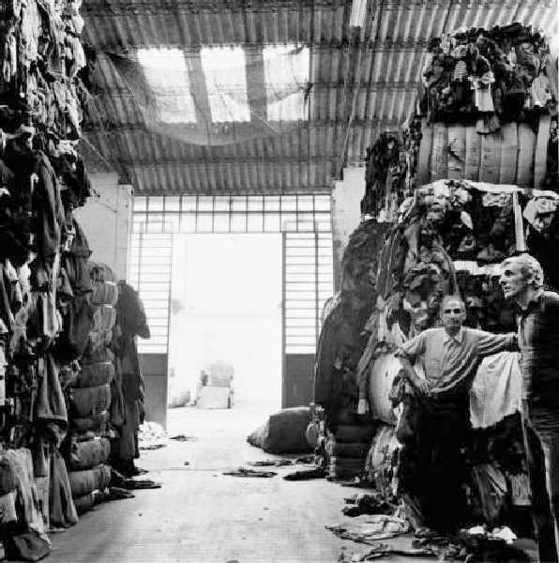
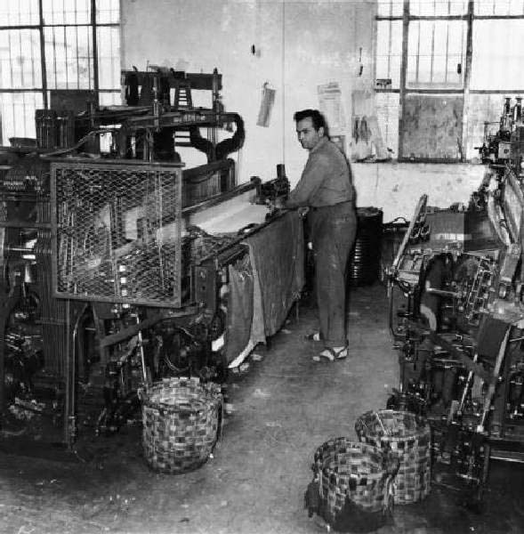
Library Guides Interface Restyling to increase access and usability
Irene Guidotti
Librarian – Monash University
14.09.2017
Warehouse of rags and factory (1950s)

Slide 8
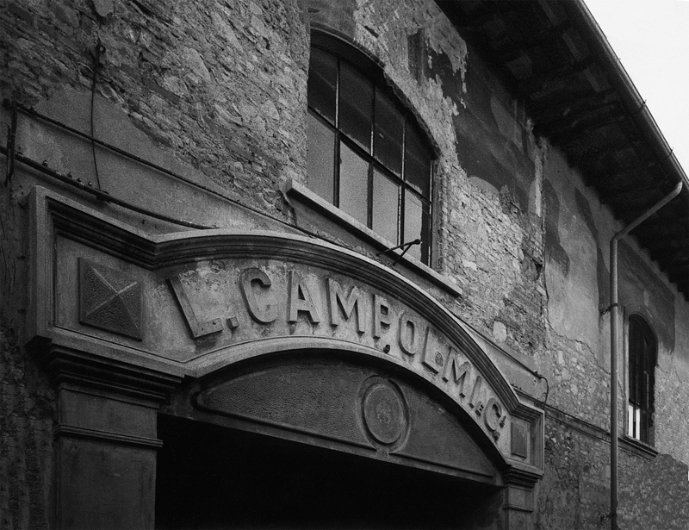
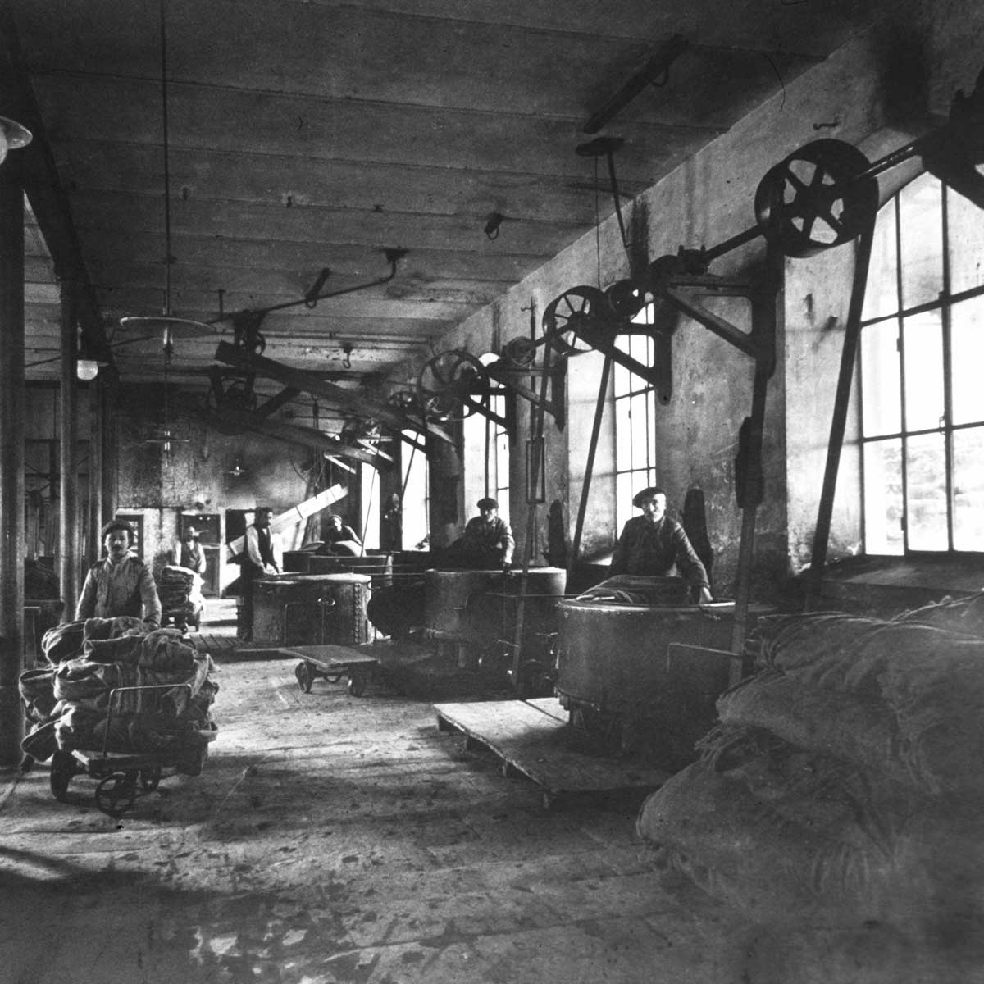
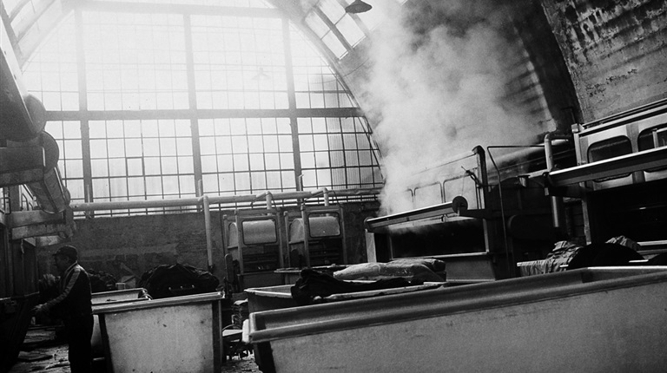
Library Guides Interface Restyling to increase access and usability
Irene Guidotti
Librarian – Monash University
14.09.2017

Slide 9
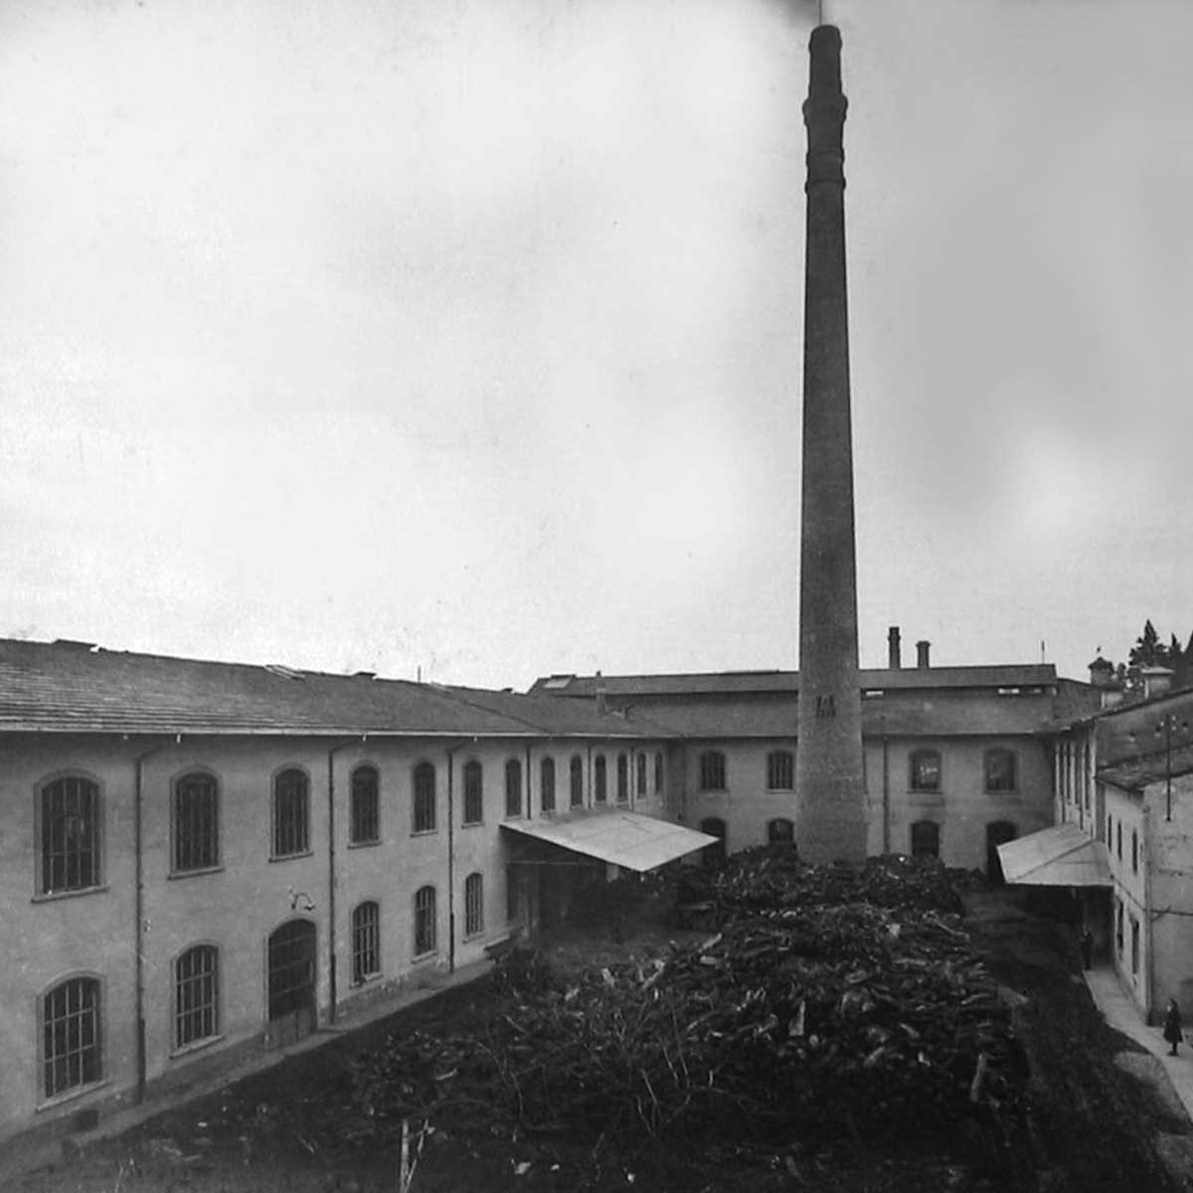
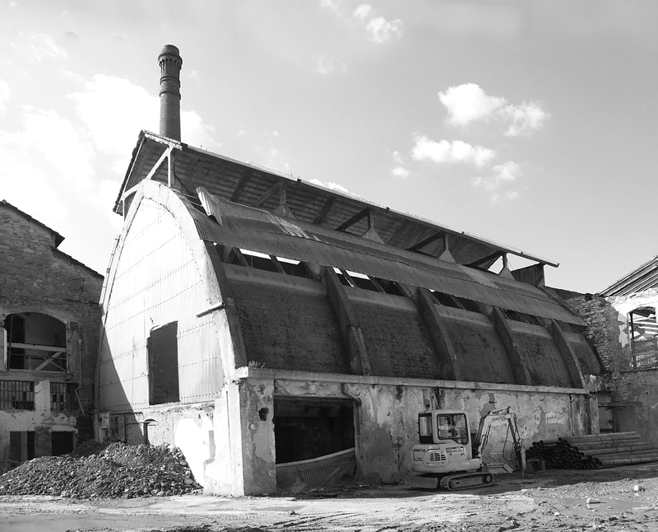
Library Guides Interface Restyling to increase access and usability
Irene Guidotti
Librarian – Monash University
14.09.2017
The decline

Slide 10
Library Guides Interface Restyling to increase access and usability
Timeline of the Project
Irene Guidotti
Librarian – Monash University
14.09.2017
1981-1982 - General intervention plan for the historic center and urban regeneration
1999 – Executive project of the Textile Museum
2001-2002 – Preliminary and executive projects of the library
2003 – Textile Museum inauguration
2009 –“Alessandro Lazzerini” Cultural and Documentation Institute inauguration

Slide 11
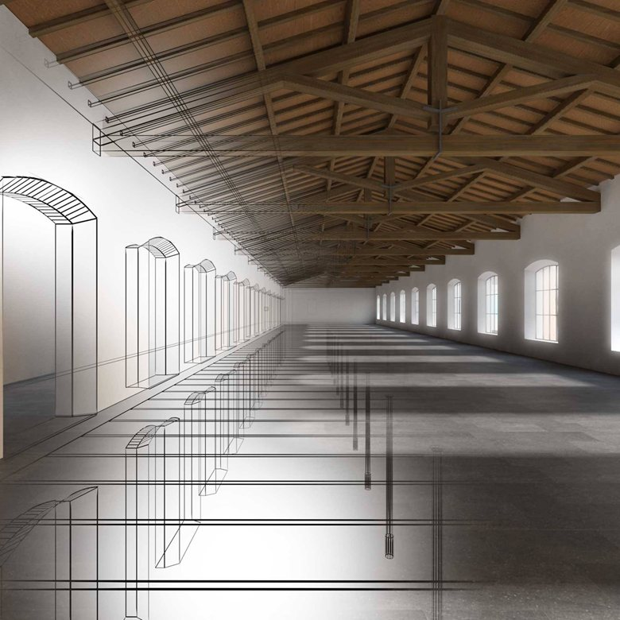
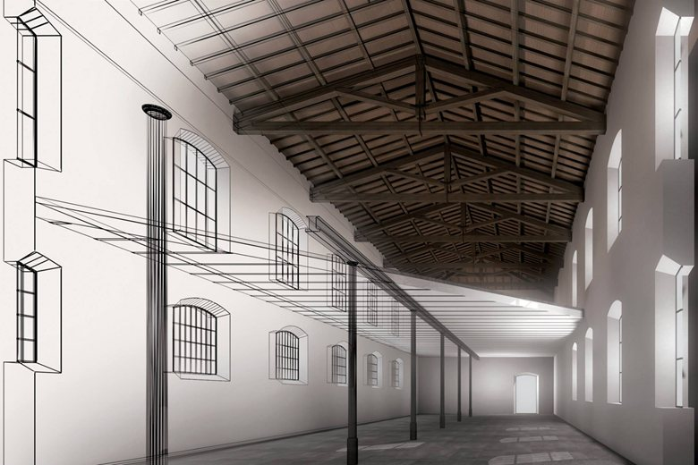
Library Guides Interface Restyling to increase access and usability
From the Campolmi Factory
to the Culture Factory
Irene Guidotti
Librarian – Monash University
14.09.2017

Slide 12
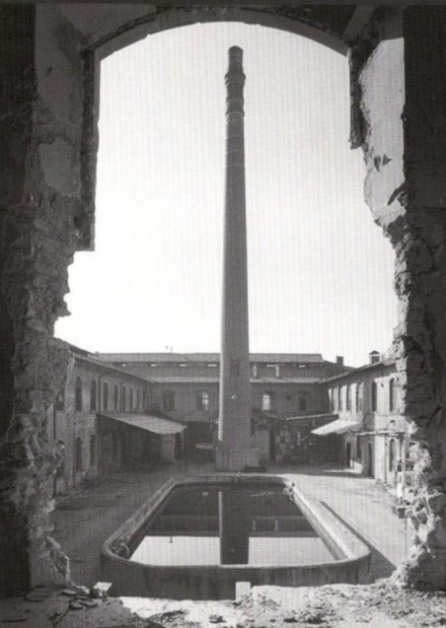
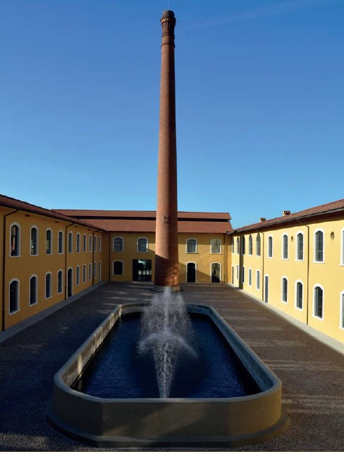
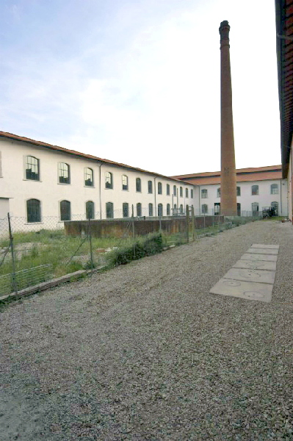
Library Guides Interface Restyling to increase access and usability
Irene Guidotti
Librarian – Monash University
14.09.2017
The chimney

Slide 13
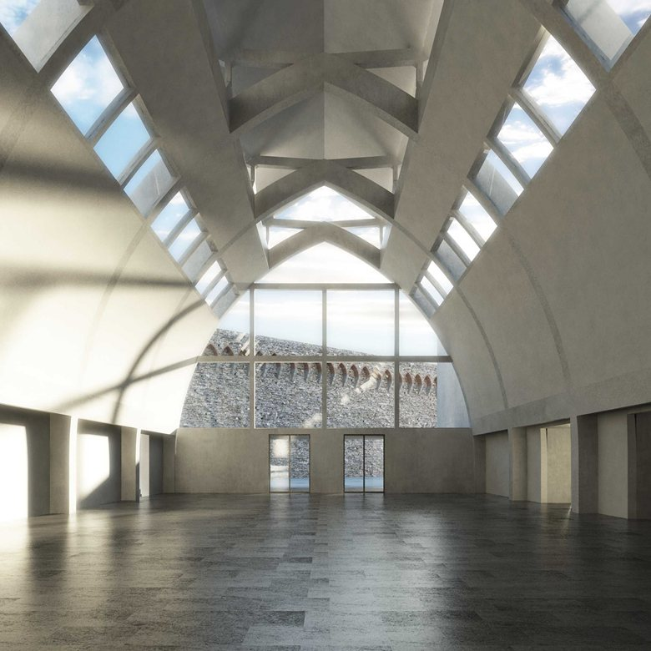
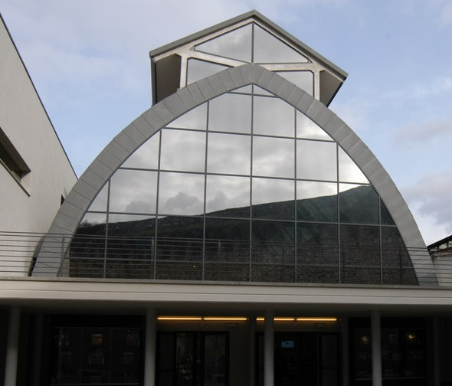
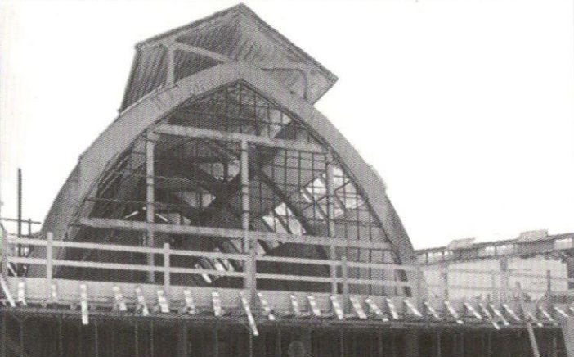
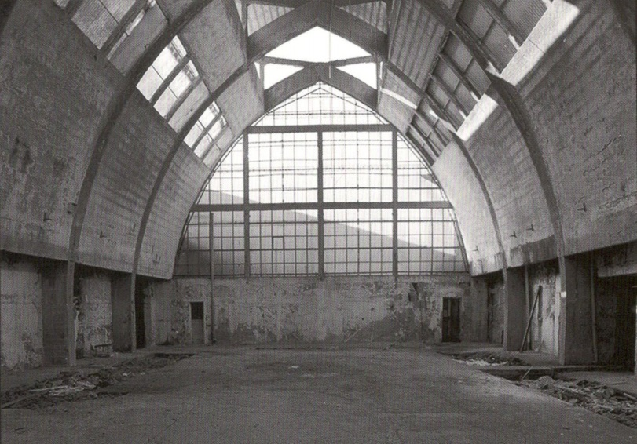
Library Guides Interface Restyling to increase access and usability
Irene Guidotti
Librarian – Monash University
14.09.2017
‘’The Textile Cathedral’’

Slide 14
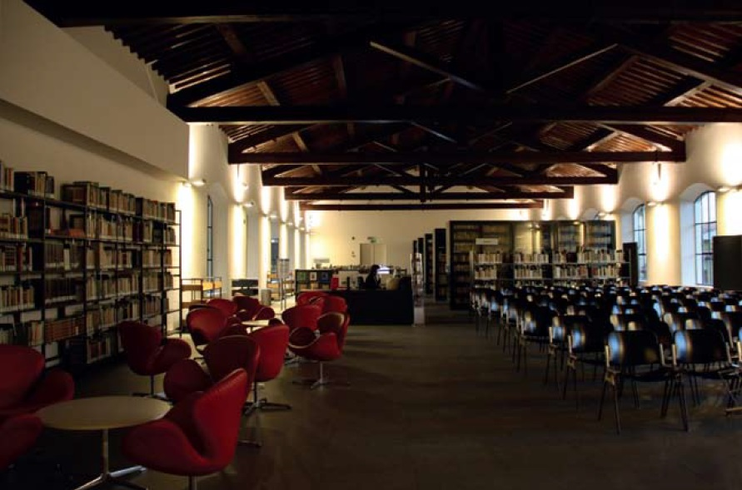
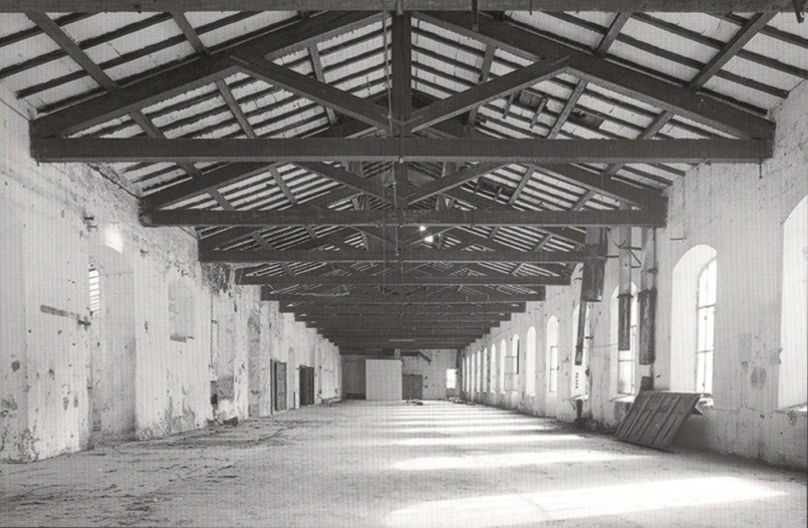
Library Guides Interface Restyling to increase access and usability
Irene Guidotti
Librarian – Monash University
14.09.2017
Timber roof truss

Slide 15
Library Guides Interface Restyling to increase access and usability
Preserving Memory
Irene Guidotti
Librarian – Monash University
14.09.2017
Historical symbols -> memory recall
Cultural heritage preservation for future communities
History of the factory and collections exhibitions
Guided tours during construction works
Synergy with different institutions

Slide 16
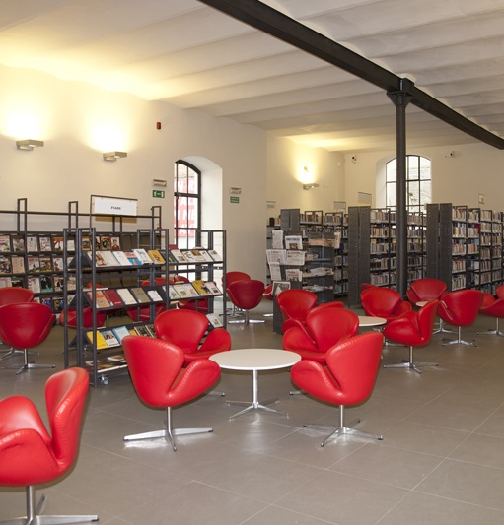
Library Guides Interface Restyling to increase access and usability
Conclusions
Irene Guidotti
Librarian – Monash University
14.09.2017
Synthesis between different phases of the past and present
Documenting traces of the cultural history and tradition of the city
Recall of memories through symbols and original frameworks
From fabric production to culture factory
Re-shaping the past for future communities
THANK YOU FOR THE KIND ATTENTION
I would like to thank Franco Neri (former Director of the Lazzerini Library) and Marco Mattei (Architect, Designer of the project) for the great availability and for providing information and suggestions.

