Slide 1
Data Fluency: Building data skills in a sustainable way
David Groenewegen
Linda Kalejs
Sonika Tyagi
July 30, 2019
Australian eResearch Skilled Workforce Summit

Slide 3
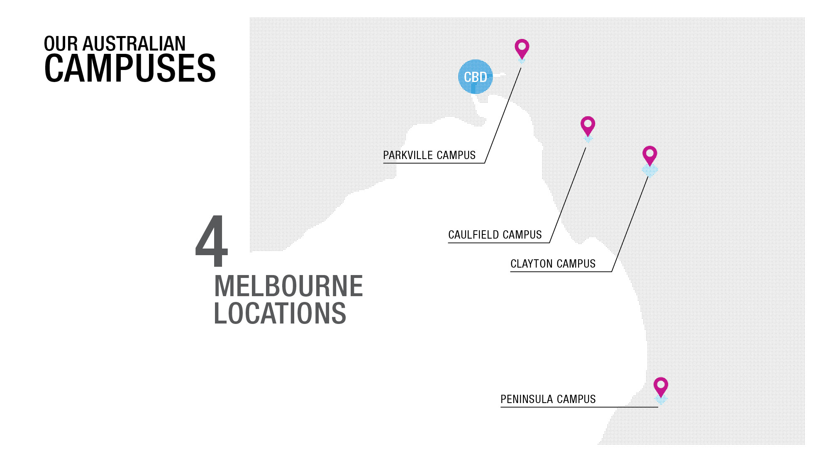

Slide 6
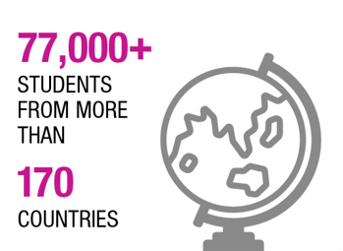
4873
HIGHER DEGREE BY RESEARCH STUDENTS
2017

Slide 7
SOLVING THE PROBLEM
SKILLS
DEMAND
CAPABILITY
CONNECTIONS
Identification of gap in data and coding skills
Monash Bioinformatics Platform Moncode led by Associate Professor David Powell
Workshop supply & demand
Monash University Library, Director Research, David Groenewegen’s interest in capability building in research and data
Need for connections due to Monash’s size, scale

Slide 8
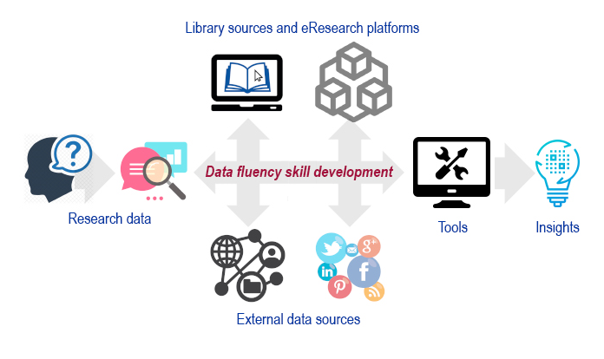
GAP: SKILL DEVELOPMENT
Sebastian Borutta, 2018

Slide 9
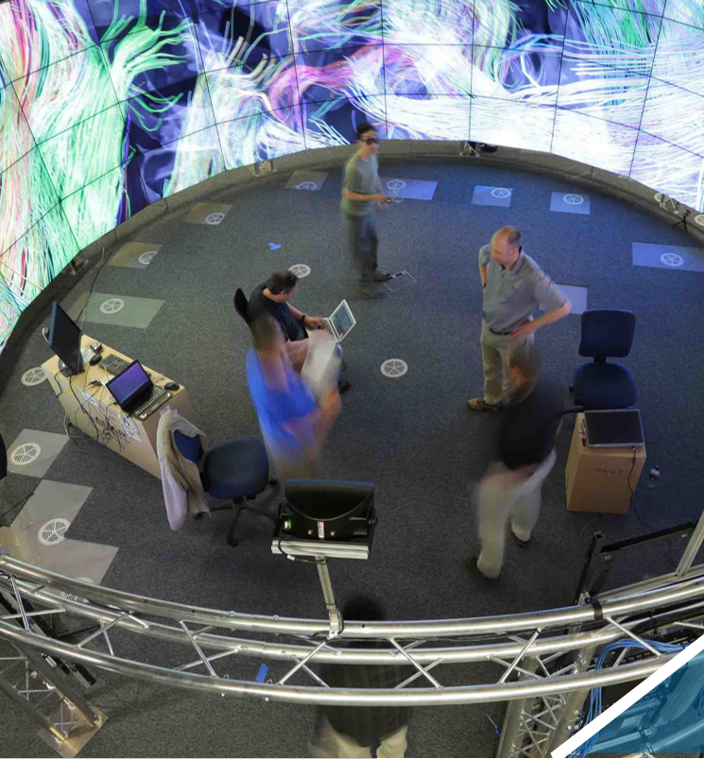
GAP: CONNECTIONS
NETWORKS
COMMUNITY
REPUTATION

Slide 10
Vision
The vision…
DATA FLUENCY
Vision- enabling our researchers to use digital tools to use, explore, interpret, analyse and visualise data in a meaningful way and effectively communicate research and ideas, by building a community of practice to share expertise and providing learning opportunities
Strategic direction- workforce enabling plan, capability building for learning and research, enabling effective research practice for enhanced impact

Slide 11
Collaboration
Data Fluency…
Collaboration – making it work
Leadership
Expertise
Structure
Communication
Resources
Logistics

Slide 12
Skill development workshops
Suite of R: Introduction; Linear models; Reproducible research in R; Programming and tidy data analysis with R; and Best practices in R
Suite of Python: Introduction; and Image analysis in Python with SciPy and scikit-image
Introduction to High-Performance Computing
Introduction to Unix Shell and Command Line Interface
Introduction to Tensor Flow and Machine Learning; and AI with Deep Learning
3D and Virtual Reality Data Visualisation for Researchers
Cleaning Data with OpenRefine
Library Carpentry
PowerBI
Introduction to REDCap
Customised workshop Monash Strategic Intelligence and Insights Unit (InSight) - R
The Carpentries Instructor Training

Slide 13
Increasing number of workshops in semester 2 to meet demand
Semester 1 2019
20 workshops; 4 monthly seminars with guest speakers; weekly dropins on Friday afternoons
12 Associate Instructors recruited and inducted midyear
Semester 2 2019
Workshop frequency increasing to 8 -10 workshops per month (fortnightly repeats for Introduction to R and Python); 5 monthly seminars; weekly dropins

Slide 14
Community building
Data Fluency…
BOOK CLUB
SEMINARS
DROP-INS
HACKATHONS
Notes:
https://youtu.be/nj8urEJskOA

Slide 15
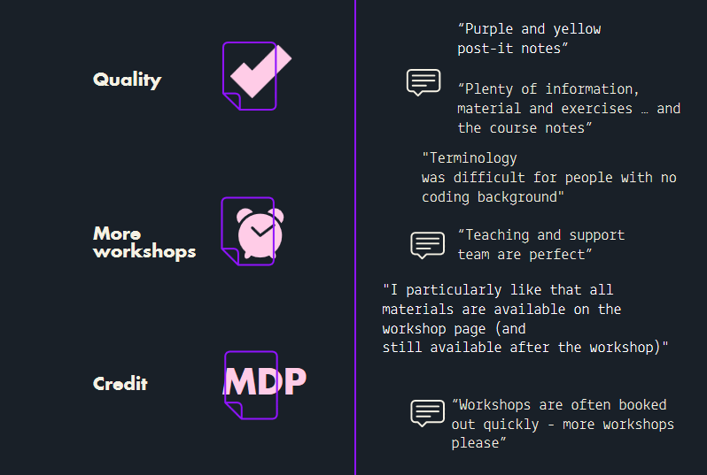
Participants…
WHAT MATTERS AND WHAT THEY THINK

Slide 16
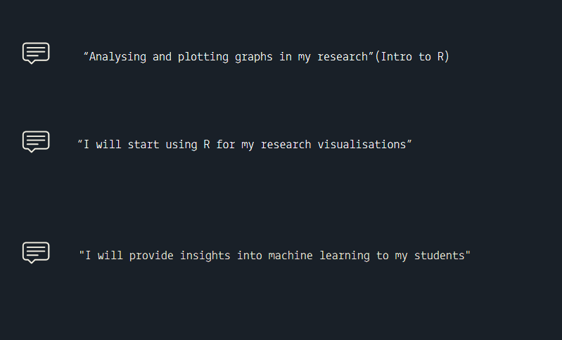
Participants…
HOW WILL YOU APPLY THE NEW SKILLS?

Slide 17
Data Fluency…
LESSONS LEARNED
Challenges outreach & logistics, consistent communications, consistent structure, multiple workflows, resourcing, meeting demand
Opportunities expanding CoP, working with other like-minded staff & researchers, extending curriculum, expanding to HASS disciplines, building the brand, linkages
Notes:
Resourcing – physical eg. booking appropriate teaching rooms and competing for space
Human resourcing – funding required – administration as well as instructors

Slide 18
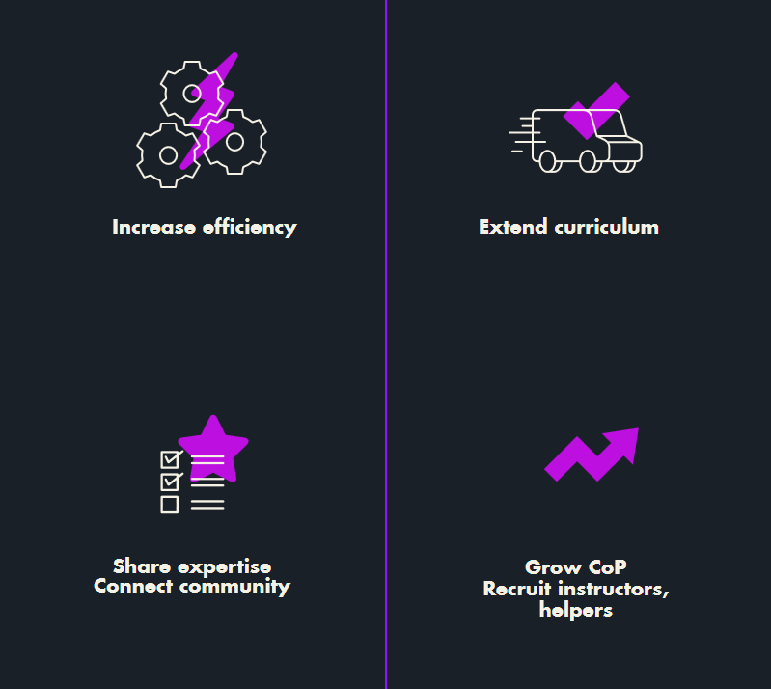
WHAT’S NEXT
Connections

Slide 19
Sector challenges
Sharing the load
Training in specialised areas
Sharing ‘train the trainers’
Training each others users?
Community
Tyranny of distance
Bringing together existing communities/initiatives and sharing expertise

Slide 20
THANK YOU
Questions…
FIND OUT MORE AT https://www.monash.edu/data-fluency
FOLLOW @resdatflu

