Slide 1
INFO SEARCH SKILLS
MONASH UNIVERSITY MALAYSIA,
LIBRARY AND LEARNING COMMONS
Esmael Yahya
Learning Skills Adviser,
School Liaison, School of Science
esmael.yahya@monash.edu
Library and Learning Commons
Building 7, Level 2

Slide 2
Learning Objectives
By the end of this session, you will be able to
Identify key terms and related terms in research question
Use search techniques
Conduct search from library search page
Search selected individual databases
Use limiters to narrow search result
Create personal account, save search and create alerts

Slide 3
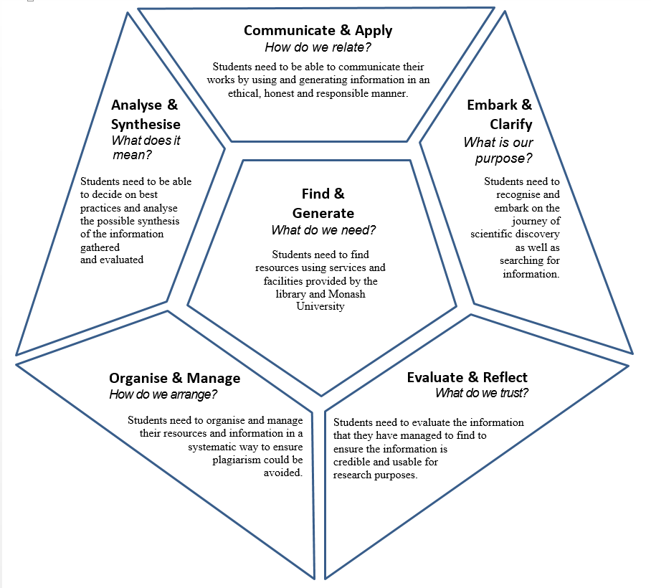
Introducing Advance Literature Search techniques
The most prominent facet:
Find and Generate
Students need to be able find resources using services and facilities provided by the Library and Monash University

Slide 4
Why learn searching skills?
Information seeking:
the ability to scan the literature efficiently, using manual or computerized methods, to identify a set of useful books, articles, conference papers, reports, theses etc.
Critical appraisal:
the ability to apply principles of analysis to identify unbiased and valid studies.

Slide 5
Approach
The systematic approach to literature review includes:
Clarify
Formulating thesis statement / research question in such a way that it leads to the identification of the major topics for the research
Find
Searching online databases and print resources to locate scholarly information
Evaluate
Evaluating critically what has been read
Manage, Analyze and Synthesize
Incorporating the selected readings to write a coherent, integrated, and meaningful review

Slide 6
Search Strategy Process
SEARCH STRATEGY
Identify key concepts & terms
Select relevant databases & resources
Combine search terms with Boolean operators
Run searches in selected resources
Review & refine search results
Monash University, 2017

Slide 7
THE RESEARCH QUESTION / STATEMENT

Slide 8
Research Questions
Formulating a concise & effective research question/statement
Too broad ?
Experimental nanotechnology testing
Too narrow?
Analysis of experimental application of nanotechnology on the brain of trauma, stressors, drub abuse and addiction patients.
Manageable?
Experimental applications of nanotechnology on trauma and recovery patients.

Slide 9
DEVELOPING THE SEARCH STRING

Slide 10
Keywords and headings
Databases don’t understand natural language, so it is important to identify the main concepts, relevant keyword and subject heading from a research statement to form a search string.
Research statement:
Experimental applications of nanotechnology in medicine
Main concepts
Experimental
Nanotechnology
Medicine

Slide 11
Keywords and headings
Concept
Broader Term
Subject Heading
Narrower Term
Singular Plural
Synonym
Spelling Variation
Consideration and tools that can be used in Identifying relevant keywords and subject headings.
Tools
Dictionary
Synonyms (visuwords.com)
Thesaurus
Database thesaurus
thesaurus.com
Database subject heading
What others have used
This is to ensure that your search is not limited to the keywords identified in the research question.
Tips: Read and review.

Slide 12
Concept Chart / Concept Map
Experimental applications of nanotechnology in medicine
Experiment | Nanotechnology | Medicine
Development | Nanoscale | Surgery
Advances | Nanoscience | Drug delivery
Innovation | Nanoparticle | Biosensors
Note: It is good to combine both keywords and subject terms within a concept. Use OR within the same concept. Use AND between the concept.
Note: These may change from time to time after you conduct some searches as you discover more.

Slide 13
Search Techniques
Identify & Develop Key Concept from Research Statement
Construct search term or keyword
Synonym/Antonym
Singular/Plural
Variant in Spelling
Acronym
Controlled Vocabulary or Subject Heading (eg: MeSH)
Documenting, Managing & Evaluating (search string & search result)
Evaluate and review the search result or search tem (precision)
Evaluate the content for selection
Keep your search documented for future usage
Organize your content
Apply Relevant Search Technique and Strategy to Develop a Search String
Truncation (child*)
Wildcard (wom?n)
Phrase (“muscle spasm”)
Same concept (OR)
Combine concept (AND)
Nesting ()
Eliminating concept (NOT)
Choose the Relevant Database or Search Engine
Index & Abstract database
Full text database
Search Engine
E.g.: WOS
E.g.: ScienceDirect
E.g.: Google Scholar
WHAT type of resources that I need? In which format?

Slide 14
Phrasing
Let’s look at some search tips to frame a good search string
Phrase search
Phrase
Use “ ” to indicate the search term as a phrase.
Example : “Global warming” or “ebola virus”
"inverted commas" or "quote marks"
More than one word
Instead of searching for the words ‘global’ and ‘warming’ wherever they appear, the search engine will search it as a phrase “global warming”, and only retrieve documents where they are side by side as “global warming”.

Slide 15
Truncation
Also known as stemming
A technique that broadens your search to include various word endings The root of a word is used followed by the truncation symbol at the end.
Truncation symbols may vary by database; common symbols include: *, !, or #
Word Variation
Truncation
Asterisk (*)
Singular/Plural
Wildcard
Varies (? Or #)
Spelling variation
Examples
child* = child, children, childhood, childish
employ*=employee, employer, employing, employment
Scien* =science, scientific, scientology,

Slide 16
Wildcard
Substitutes one letter of a word to capture spelling variations
Similar to truncation, wildcards substitute a symbol for one letter of a word.This is useful if a word is spelled in different ways, but still has the same meaning.
Word Variation
Truncation
Asterisk (*)
Singular/Plural
Wildcard
Varies (? Or #)
Spelling variation
Examples
Wom?n = Woman, Women
Colo?r = Colour, Color

Slide 17
Boolean Search
AND
Narrows the search. ( retrieves less documents)
Retrieves documents if all the words appear on the document.
It is used to join different kinds of concepts and different aspects of the question
Examples
“Global warming" AND “Sea level rise" AND California
“Marketing strategy” AND “Consumer behaviour”

Slide 18
Boolean Search
OR
Broadens the search. ( retrieves more documents)
Retrieves documents if any of the words appears on the document.
It is used to search similar, equivalent, synonymous concepts.
Examples
“Global warming" OR “Greenhouse effect"
“Marketing strategy” OR “Target marketing” OR “Market segmentation”
“Consumer behaviour” OR “Customer Satisfaction”

Slide 19
Activity:
Construct your Search String
(“experiment*" OR “advances") AND (Nanotechnology OR nanoscience*) AND Medicine
Experiment | Nanotechnology | Medicine
Development | Nanoscale | Surgery
Advances | Nanoscience | Drug delivery
Innovation | Nanoparticle | Biosensors

Slide 20
Information Evaluation Criteria
Accuracy
Currency
Relevancy
Objectivity
Authority
Now, you may end up with a lot of search result available for selection.
Use these criteria for information evaluation.
You may use the “limiter” function to simplify the analysis.

Slide 21
WHERE TO SEARCH?

Slide 22
Finding literature
So many places to find resources!
Basic sites
Library search
Monash databases ( A-Z List of databases)
Monash Library Guides
Google Scholar

Slide 23
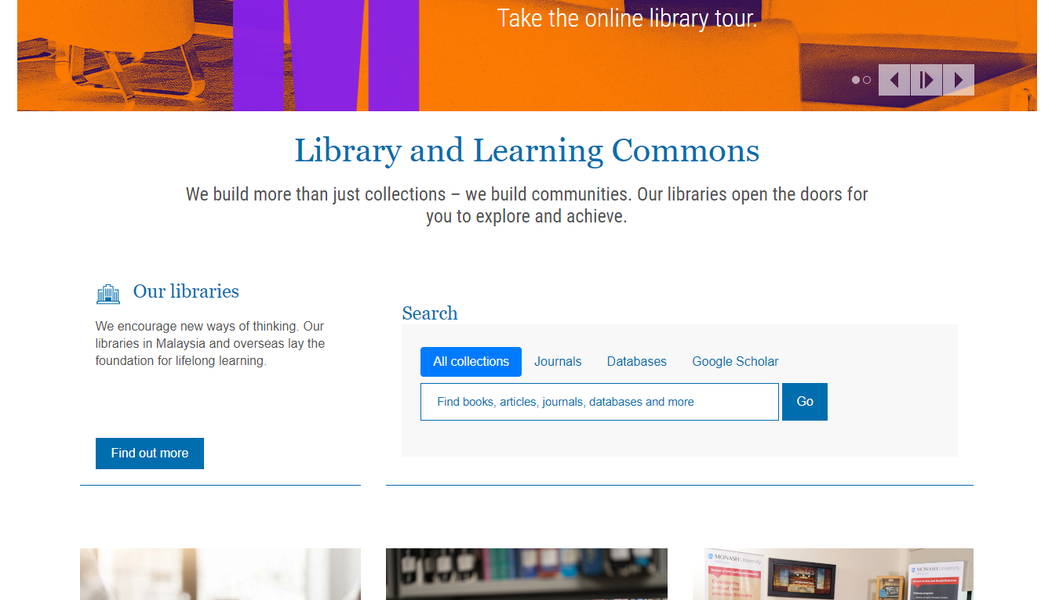
www.lib.monash.edu.my
All-in-one search ( books, ebooks, journal articles)
“sustainability”

Slide 24
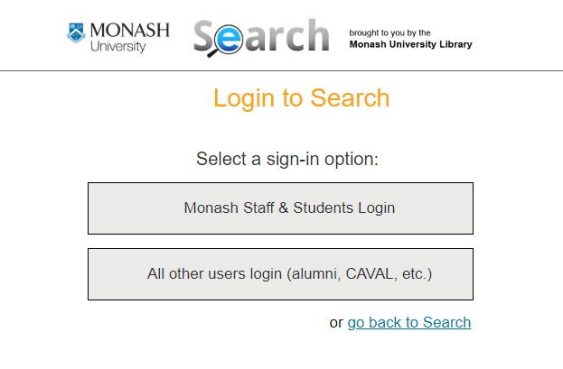

Slide 25
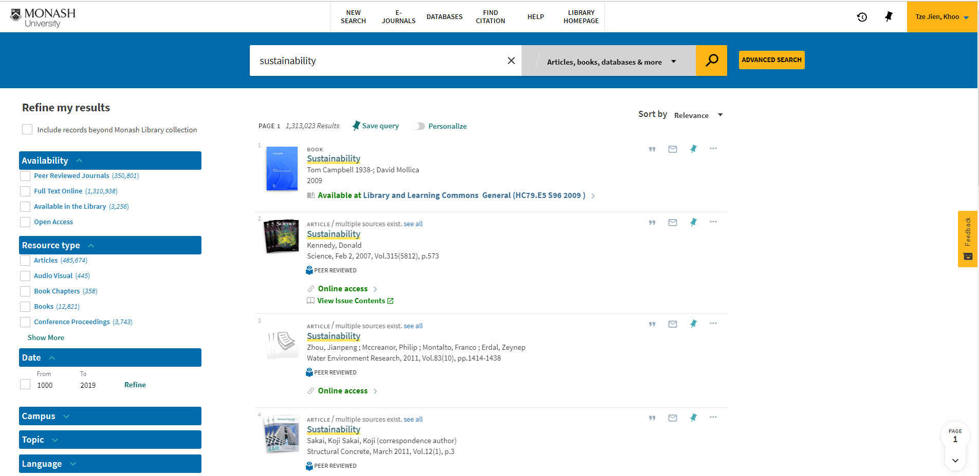

Slide 26
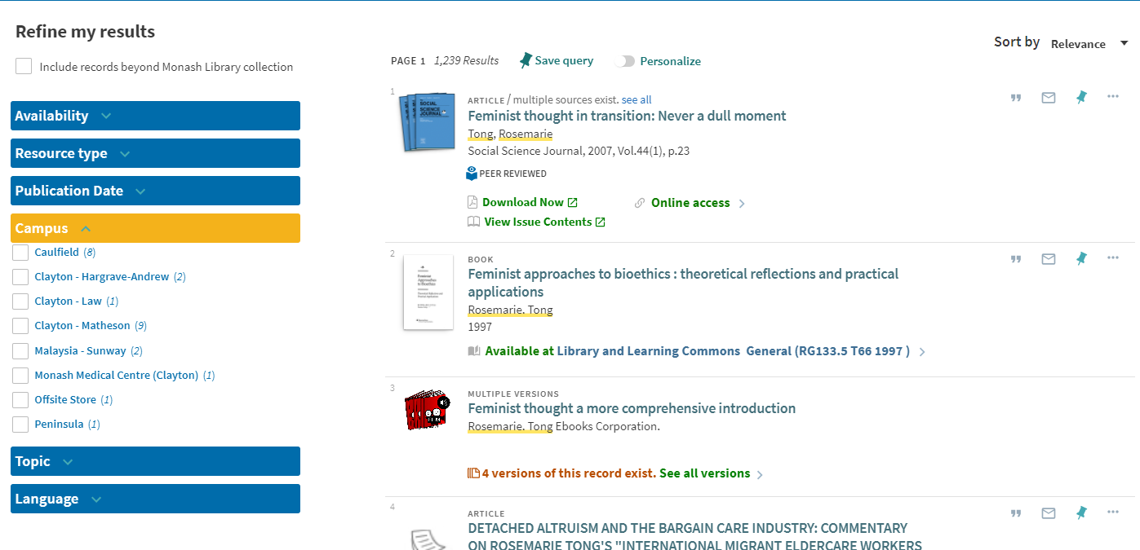

Slide 27
Citing and referencing
To look for subject specific resources

Slide 28
Citing and referencing
Popular Bibliographic Databases for SoS
Scopus
Web of Science (BIOSIS Preview)
PubMed
Ovid
CAB Direct
Academic One File
Google Scholar
Popular Full-Text Databases for SoS
ScienceDirect
Wiley Online
SpringerLink
Nature
Taylor and Francis (CRCnetBASE)
ProQuest (Agricultural & Environmental Science)
To look for specific databases like ScienceDirect, Scopus, Google scholar etc.

Slide 29
USING DATABASES

Slide 30
Databases and research
Finding resources and researcher ID
To effectively assess your resources you need to have accounts on:
SCOPUS (https://www-scopus-com.ezproxy.lib.monash.edu.au/search/form.uri?display=basic)
Web of Science (http://apps.webofknowledge.com.ezproxy.lib.monash.edu.au/WOS_GeneralSearch_input.do?product=WOS&search_mode=GeneralSearch&SID=C23EgZdKARoVd3Z95uq&preferencesSaved=)
As a researcher, you need to have accounts on:
Orcid (https://orcid.org/)
Google Scholar (https://scholar.google.com/)

Slide 31
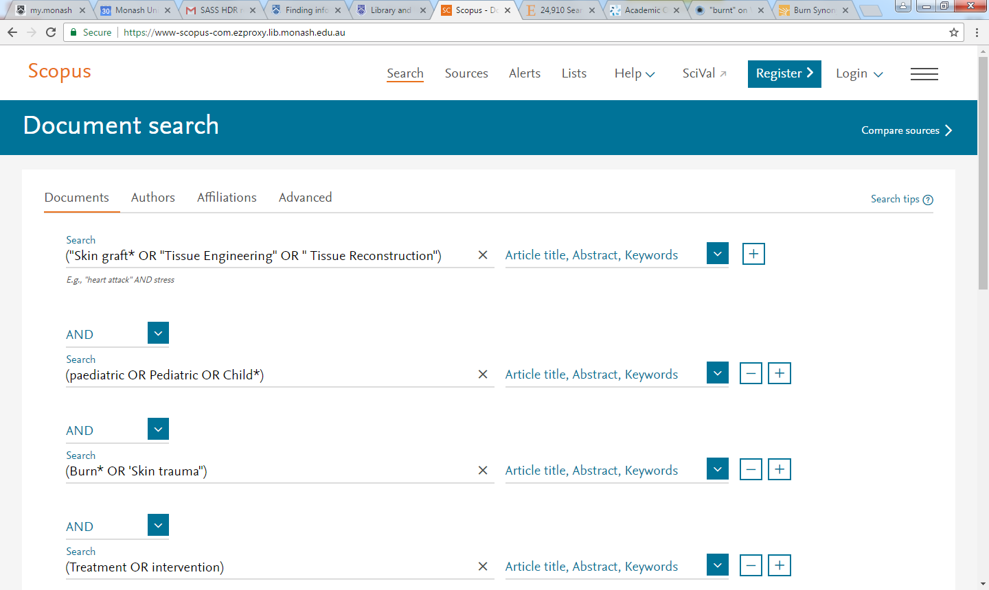
SCOPUS

Slide 32
Web of Science

Slide 33
ORCID
https://orcid.org/

Slide 34
Google Scholar
https://scholar.google.com/

Slide 35
RESEARCH DATA MANAGEMENT

Slide 36
Managing research data
What to do with your research data?
We believe managing research data is an important and valuable skill
We ask researchers to consider making research data accessible that will enable other researchers to replicate experiments efficiently and add to existing research

Slide 37
Monash Figshare
What is monash.figshare? (https://monash.figshare.com/)
monash.figshare is a collaborative digital repository for Monash University researchers and graduate research students. The key benefits include:
Compliance: easy compliance with funder and publisher requirements to make data open
Secure management: manage private or public research outputs securely on Monash storage
Multiple formats: more than 650 file types can be uploaded including audio, video, images, spreadsheets, documents, surveys, datasets and posters.
Access: research files are available online from anywhere in the world
Collaboration: research files can be shared privately with collaborators or made public
Increased citations: all research outputs made public receive a Digital Object Identifier (DOI) making them citable
Reuse: apply Creative Commons or other appropriate licenses to define terms of re-use
Visibility: greater visibility of research outputs once published
Discoverability: allows other researchers to find your work, enabling collaborative research
Embargo: research outputs can be embargoed when necessary

Slide 38
KEY POINTS TO REMEMBER

Slide 39
Key points to remember
Start early and be systematic.
Finding scholarly information takes time and patience. Remember to review and used a different strategy for your searching.
Clarify what are your keywords for search, find related terms, formulate search strategy with phrase search, Boolean search, truncation etc.

Slide 40
Key points to remember
Identify the resources you will be looking at. (books, e-books, databases, newspaper, theses, reports etc.).
Save the search string if you find that it was good in retrieving relevant resources.
Collect citation details as you read / download books/ papers. Use Endnote or other citation manager to manage your references.

Slide 41
References
Birmingham City University. ( 2011). How to write a literature review. Retrieved from http://library.bcu.ac.uk/learner/writingguides/1.04.htm
Monash University (2017). Researching for your literature review. Retrieved from http://guides.lib.monash.edu/researching-for-your-literature-review/home
Monash University (2017). Systematic review. Retrieved from http://guides.lib.monash.edu/systematic-review
North Carolina State University Libraries. ( 2009, July 30). Literature Reviews: An Overview for Graduate Students. [ video file]. Retrieved from https://www.youtube.com/watch?v=t2d7y_r65HU
Sunny Empire State College. ( 2016). Thinking in Concepts. Retrieved from http://subjectguides.esc.edu/researchskillstutorial/conceptchart
University of Leeds, Library (2017). Turning your research question into a search Strategy. Retrieved from https://library.leeds.ac.uk/researcher-literature-search-strategy#activate-searching_with_keywords
University of Toronto. ( 2008). Literature Review: a few tips on conducting it. Retrieved from http://advice.writing.utoronto.ca/wp- content/uploads/sites/2/literature-review.pdf

Slide 42
Any questions?
In-Depth consultations
By appointment
Library and Learning Commons
Building 7, Level 2
Namita Santra
Tel: +603 55146151
Email: Namita.Santra@monash.edu
Esmael Yahya
Tel: +603 55146167
Email: esmael.yahya@monash.edu

Slide 43
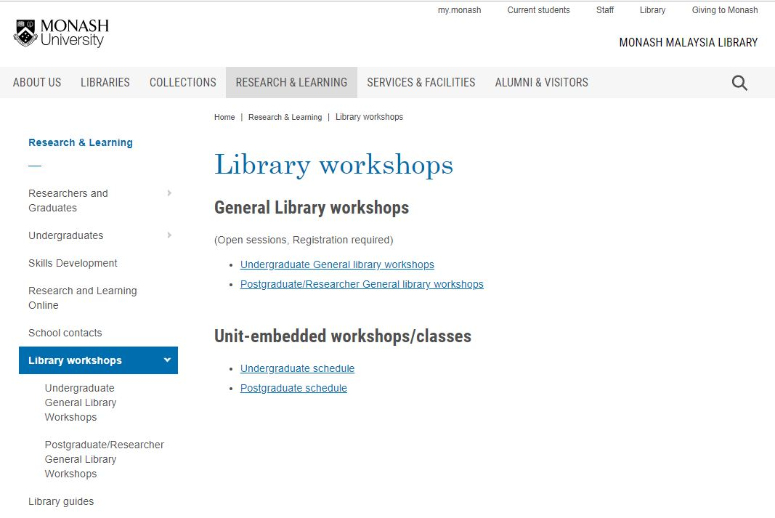
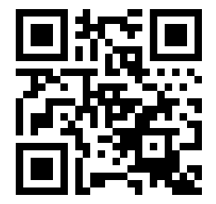
FEEDBACK
http://bit.ly/RLprograms

Slide 44
THANK YOU

