Slide 1
Migrating Content into Figshare – case study from Monash
MONASH LIBRARY
Andrew Harrison
Monash University

Slide 2
Overview
Migration
Monash University Theses
The Integrated Workflow
Outcomes

Slide 3
Monash University Research Repository
Institutional repository
190,000 Records 30,000 Open Access
Dozens of collections
publication records from the Research Office
OA working papers and journals from the faculty
theses
some datasets
special collections of primary and historical research material

Slide 4
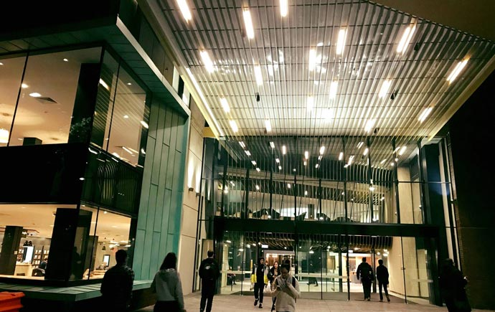
Three new Repositories platforms:
Pure for publications: managed by the research office.
Omeka for Library Special Collections
Figshare for data, theses, working papers and other grey literature.
Notes:
6200 theses out 21,000

Slide 5
Why figshare?
Improved Google search exposure
Mints a Digital Object Identifier (DOI)
Application programing interface (API)
Curation workflow

Slide 6
Timelines
Late 2016
Working papers & image collections (manual loads)
Jan – Mar 2017
Theses collection
Apr - Aug 2017
Working paper and archived journals
Notes:
6200 theses out 21,000

Slide 7
Scope of migration to figshare
17,681 Dublin core records.
Most had Open Access content
Most belonged to archived collections
Theses a special case as had to integrate with an existing publishing workflow

Slide 8
Migration – manual loading to begin
Several large photograph collections where repackaged as file sets
6,000 images that took 6 months to load into the old Institutional repository
became 40 records in figshare that took two days to load.
Some of the smaller journal collections where manually loaded by Library staff while API solution was in development

Slide 9
Migration – API Organising by groups
Groups provide browsing option – important access point for theses collection
Custom metadata specific to a collection can only defined in a group.
Projects can draw quota from groups not from accounts.

Slide 10
Migration – API Organising by project
API cannot use groups to organise uploads
Projects can draw quota from parent group. Do not want 1,000s of records loaded into user accounts
Projects do not have to be published and can remain invisible to the end user
Private Projects can be used to break larger collections into manageable chunks for bulk loading
.

Slide 11
Migration – API Coding the Calls
Exported record metadata as fedora xml
and converted into python scripts by XSLT
XSLT output was a series API calls to
Identify target project in figshare
create record metadata
remove the admin account
upload matching content files
define access conditions
publish
Python executed in a Jupyter notebook

Slide 12
Monash University Theses

Slide 13
Digital theses collection
6,200 manuscripts
51% open access
PhD and Masters by research only
Collection was migrated Jan – Mar 2017
Integrated with theses examination workflow 2017-2018

Slide 14
Monash Graduate Education
The Dashboard
Examinations management
Submission
Cloud storage
Organisation of examination stages
Delivery to examiners
Award of degree
Archiving to repository
“6 months to 6 weeks”
Rebecca Hillman, Examinations manager in conversation, 2017.

Slide 15
Workloads
Submit the thesis once in one system reduce potential for data entry errors and confusion
Growth
~100 in 2001
~700 in 2016
No increase in cataloguing team size since 2012
Notes:
6200 theses out 21,000

Slide 16
The Integrated Workflow

Slide 17
Software developer
3wks
One day to specify the changes to workflow
Two days for the team to learn the figshare API
Two days to code and test
Simple Rocket Science!
Astronaut Tim Peak EVA New old Stock. Viewed 8 Feb 2018, https://nos.twnsnd.co/image/170347451413

Slide 18
Workflow – curated 2017
Dashboard
Metadata
monash.figshare
Free head icon, Ahkâm, downloaded 08/092018
http://www.freeiconspng.com/img/6519

Slide 19
Workflow – direct publishing 2018
Dashboard
metadata + File
monash.figshare
Update metadata

Slide 20
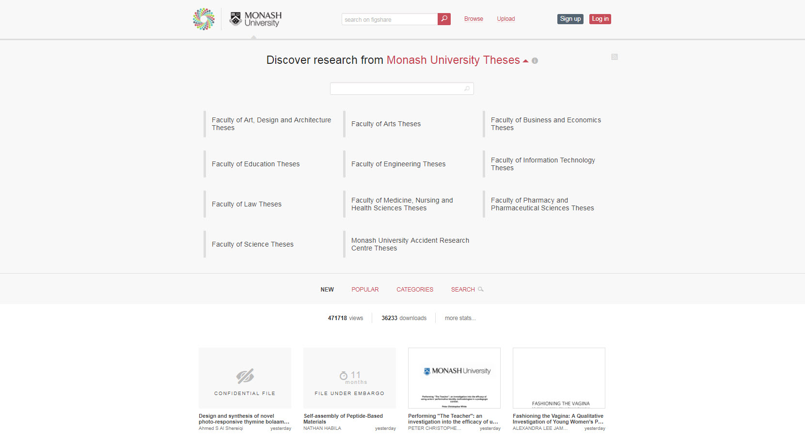
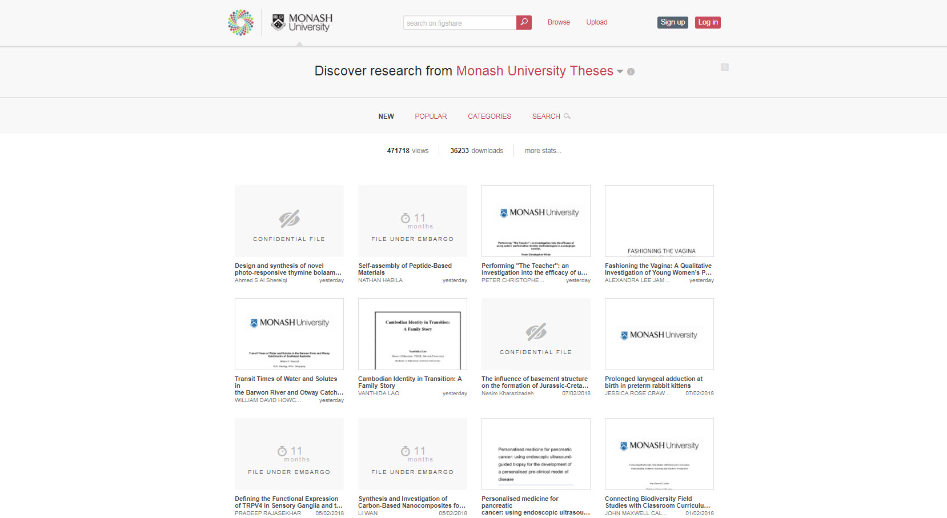
Theses in monash.figshare

Slide 21
Thesis

Slide 22
Work to be done
Transfer responsibility from cataloguing team to repository/digitisation team
Monitor metadata error rate
~ review about 60 records a month
If error rate good remove curation and publish direct in July 2018
Encourage thesis authors to link to online datasets

Slide 23
Outcomes

Slide 24
Partnerships
Monash Graduate Education
Monash eSolutions
3wks
software developer
Figshare support team
Aleš Čerin. Shaking hands, viewed 8 Feb 2018, https://www.freeimages.com/photo/shaking-hands-1240911

Slide 25
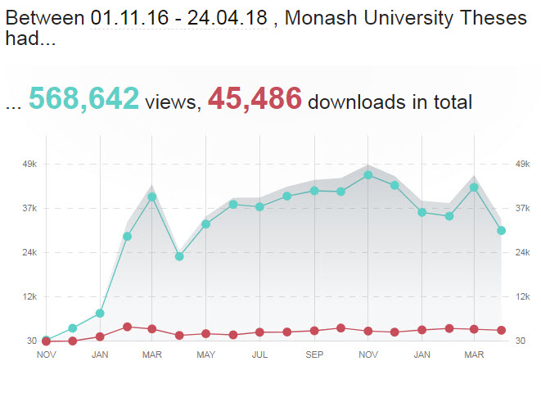
Views and Downloads
Before figshare
2008 – 2016
Views
1,293,295
Downloads
180,101

Slide 26
Altmetrics

Slide 27
Thank you
andrew.Harrison@monash.edu
https://www.monash.edu/about/who/glance

