Slide 1
ANZREG Conference 2018-Panel 1
The future of authorities and identifiers in national & international data sources & ROI
The Monash perspective
Jenny Klingler
Metadata Team Leader
Monash University Library
monash.edu/library

Slide 2
History of authority work at Monash
1999
ABN authority records added to Voyager
Early 2000s
Monash aligned with LC authority records.
Validator implemented
2006
Validator import program stopped working
2008
LC authority files & weekly updates purchased & loaded to Voyager
Gary Strawn trained Monash University Library cataloguers
September 2013
Monash migrated to Alma
Gary Strawn’s programs did not work in Alma
November 2013
Monash University Library joined the NACO program
Cataloguers completed NACO training

Slide 3
Why join NACO?
NACO is part of the Program for Cooperative Cataloging, which is an international scheme. NACO authorities automatically go into the LC Linked Data Service and VIAF
LC authorities are in the Alma Community Zone (CZ). We can link to them, & authorities we create will be available for all other Alma users
We can decide on the preferred form of name for Monash University corporate bodies and our researchers
We can insert identifiers in MARC field 024 which can help enable Linked Data
monash.edu/library

Slide 4
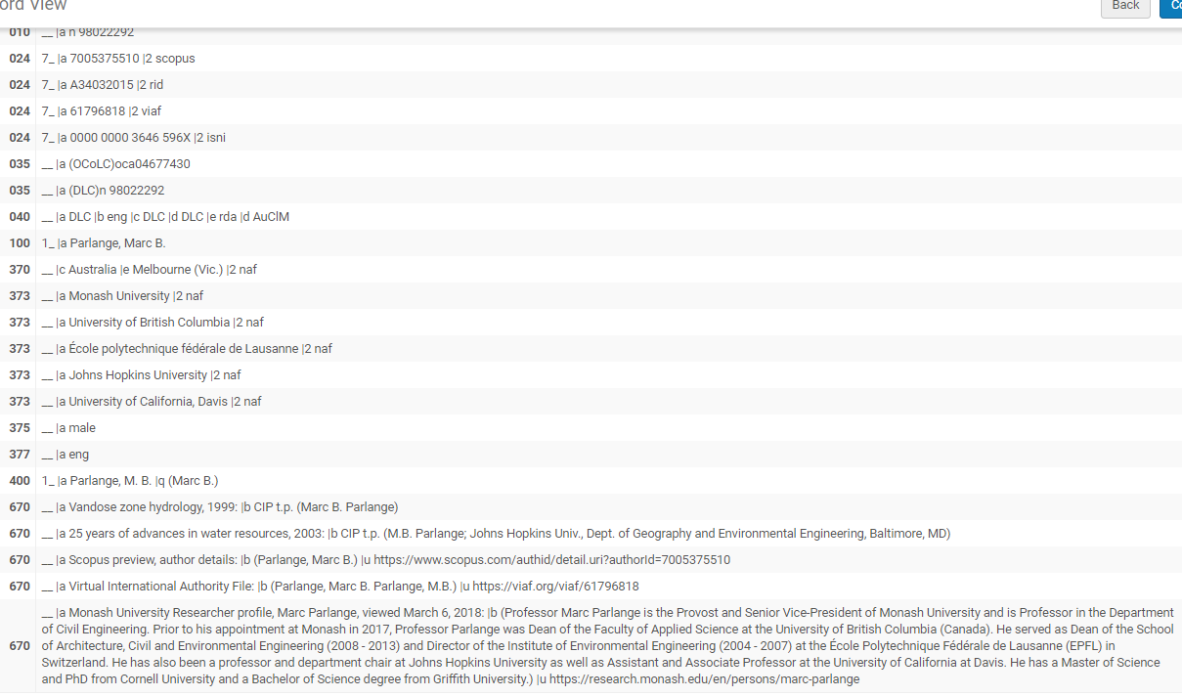
NACO record for Marc Parlange in the Alma Community Zone
monash.edu/library
Notes:
NACO record for a Monash academic in the CZ created by LC but enhanced with identifier fields & other 670 data by Monash

Slide 5
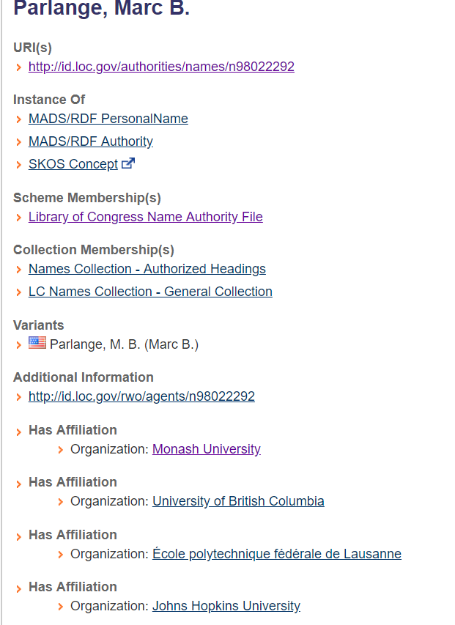
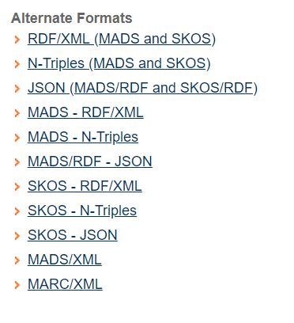
LC Linked Data Service record for Marc Parlange

Slide 6
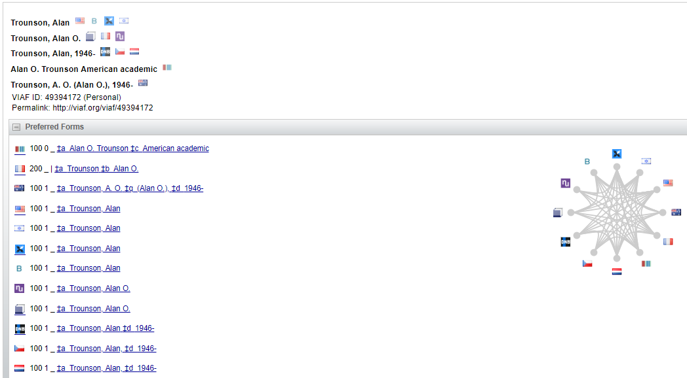
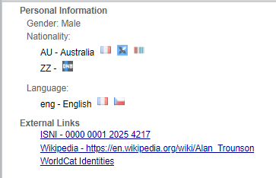
VIAF record for Alan Trounson
monash.edu/library
Notes:
VIAF record includes the preferred form of his name in different thesauri, & links to the ISNI record WorldCat Identities

Slide 7
NACO records - best practice in the Alma environment? - for the future of Linked Data?
Seamless workflow - our bib headings link to NACO records in the Alma CZ. These link to, & correct bib headings in our local zone
NACO records require data in well-delineated fields & subfields which are more easily converted to machine-readable data for linking
The inclusion of identifiers in MARC field 024 provides another point of linking. These are then being shared through the LC Linked Data Service & VIAF, which will help link the profiles & works of authors
URIs to Monash University researcher profiles entered in MARC field 670 are another avenue of linking
monash.edu/library
Notes:
NACO records (which are RDA but with other stringent guidelines)
Linked Data Service & VIAF will help link the profiles & works of authors, particularly as more of them associate their identifiers with their works

Slide 8
Issues & challenges
Staffing has been a major issue in the metadata area at Monash University Library since 2009
At Monash University Library there has been a lack of support at management level for metadata work in general for over 10 years, though this may be changing…
There is a tension between NACO headings & bib headings we get with records from LA
NACO work is more time intensive than creating local authority records
Although NACO records get into LC, the Linked Data Service & VIAF in a day or 2, they take nearly 2 weeks to be loaded into the CZ
NACO requires participants to create or update a minimum number of records per year & with staffing issues this is hard to achieve

Slide 9
Future directions
As systems such as Alma evolve to enable BIBFRAME and URIs our authority and bib data will be able to be linked and exposed through multiple avenues & we will be able to demonstrate their value
With the Feb. 2018 release of Alma non-preferred terms of authority records linked to bib records in the CZ are now able to be published to Primo. If this exciting change was extended to institution zone records it would link more of authors’ works together
Researcher profiles are being created by Universities using PURE or other software. At Monash we are hoping to interact in that space sharing data, especially researcher ids, which will help expose the work of our researchers more widely and link varying forms of their names & therefore their outputs
monash.edu/library
Notes:
As systems such as Alma evolve to enable BIBFRAME and URIs If our data is in fields in a way that it can be manipulated easily in machine-readable form to be convertible to URIs our authorities and bibliographic data will be able to be linked and made accessible …

Slide 10
In Conclusion
We are on the cusp of enabling Linked Data.
This will allow us to better demonstrate the benefit of
our metadata & authority work.
We think it is worth
continuing down this path
jenny.klingler @monash.edu

Slide 11
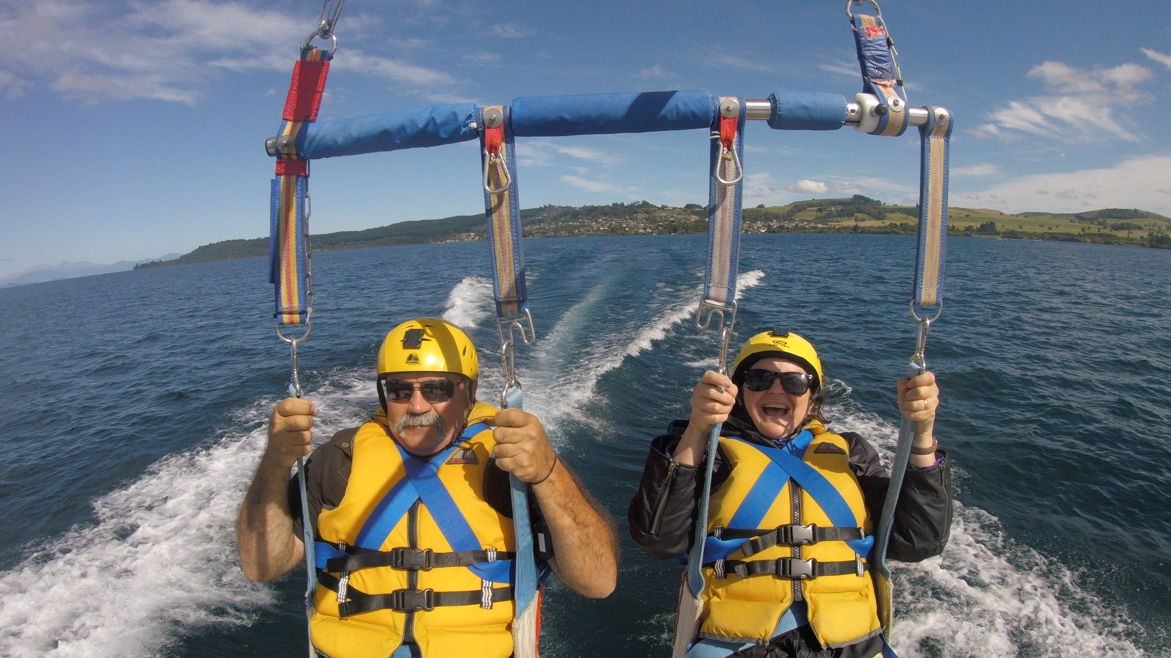
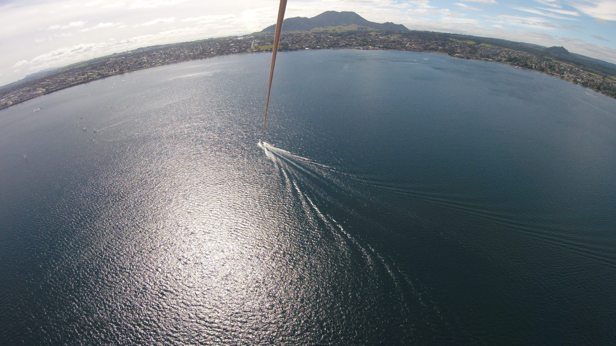
jenny.klingler @monash.edu

