Slide 1
Primo UX review
Project update
Highlight future critical dates
20180913
Rachelle Orodio & Megan Lee

Slide 2
Project drivers
A new version of Primo has been released
We have five years of user feedback to work with:
library user surveys
R&L and LS staff user interactions
unsolicited feedback from Ask Monash and eSolutions Remedy jobs.
Users tell us that they sometimes have problems finding resources in Primo

Slide 3
Why?
They find the landing page busy and confusing
Sometimes they see titles listed in their results sets that had little relationship to their search
The name ‘Search’ is confusing, because Monash has a ‘Search’ box on every web page

Slide 4
Project goals
Take advantage of the increased functionality in the new Primo UI
Better understand how users search and discover resources in Primo
Leverage off our increased expertise working with Primo
Seek unanticipated feedback by testing the new Primo User Interface with the Innovations Studio team

Slide 5
How did we start?
Reviewed past user behaviour in Primo user logs and Primo analytics
Developed two Primo beta environments for testing
Ran usability testing to identify the user preferred system look and feel
Redesigned both Primo beta test environment, based on user feedback

Slide 6
Our approach to usability testing
Worked with the Monash User Experience Design Team to run usability sessions in the Monash Innovations studio
URL – https://tinyurl.com/y9hvqruv

Slide 7
Our approach to usability testing
Worked with Library Research and Learning staff volunteers who observed the usability testing and took an active part in reviewing and analysing the data collected
URL – https://tinyurl.com/y9hvqruv

Slide 8
Our findings to date

Slide 9
From data logs and analytics

Slide 10
From data logs and analytics
3.4 million searches were run in Primo between July 2016 and June 2017
Only 15% of user sign into Primo
97.5% of the searches are run in the basic search screen
98.5% of searches are run against the ‘All collections’ scope
Less than 1% of user select Library collections, Online articles or the Rare book collections scope

Slide 11
From data logs and analytics

Slide 12
From data logs and analytics
Users refined their search results using facets in 17% of searches
45% of facet use was use of the Top level facet (Peer reviewed | Full text online | Available in Library)
3 facets account for 92% of facet use; Top level, Resource Type, Date Slider
96.5% of users don’t re-sort their search results

Slide 13
From data logs and analytics
Words used in Primo search | Percentage | Count
2 | 15.901% | 138,559
3 | 15.410% | 134,284
4 | 13.114% | 114,281
5 | 9.113% | 79,415
1 | 6.424% | 55,981
6 | 5.651% | 49,244
7 | 3.677% | 32,043
54 | 3.199% | 27,879
51 | 2.870% | 25,009
56 | 2.796% | 24,367
53 | 2.794% | 24,349
57 | 2.737% | 23,851

Slide 14
From data logs and analytics
44% of user searches are between two to four words long.
When users search in Primo, 60% of users enter a keyword search of five words or under, while 14% enter a search that includes fifty words or more
Only 1.13% of searches provide no search results
The most unsuccessful searches are searches for ISBN/ISSN (8.5%)

Slide 15
From usability testing
For general study, users ranked discovery interfaces in the following order:
Their first preference is Google and discipline specific databases like EBSCO/Proquest
Their second preference is Google Scholar & Wikipedia and
Primo is their third choice

Slide 16
From usability testing
When users need authoritative information their search preferences change slightly;
First preference is Google Scholar & discipline specific databases
Second is Primo

Slide 17
From usability testing
Of these users,
2 use it daily, 3 use it weekly and the remaining 3 monthly
4 said they often find information, 2 always find something useful, 1 occasionally does and 1 says it’s only sometimes they find useful information
2 users said they use the sign-in feature daily
6 users sort their results by date
4 users hadn’t previously used the My Loans to check fines, Export item to citation or use the Language facet
6 users had never use the Rare books collections dropdown scope.
7 have never used the bX Hot articles Recommender feature

Slide 18
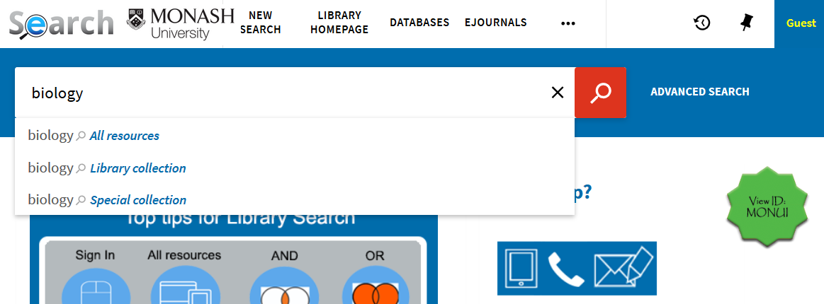
In usability testing
User feedback from the usability scenario testing was:
6 of the users noticed the difference between the two views presented to them. Of these, only 3 identified significant differences.
5 users strongly agreed that the redeveloped view (Environment 2) was easier to find resources in.

Slide 19
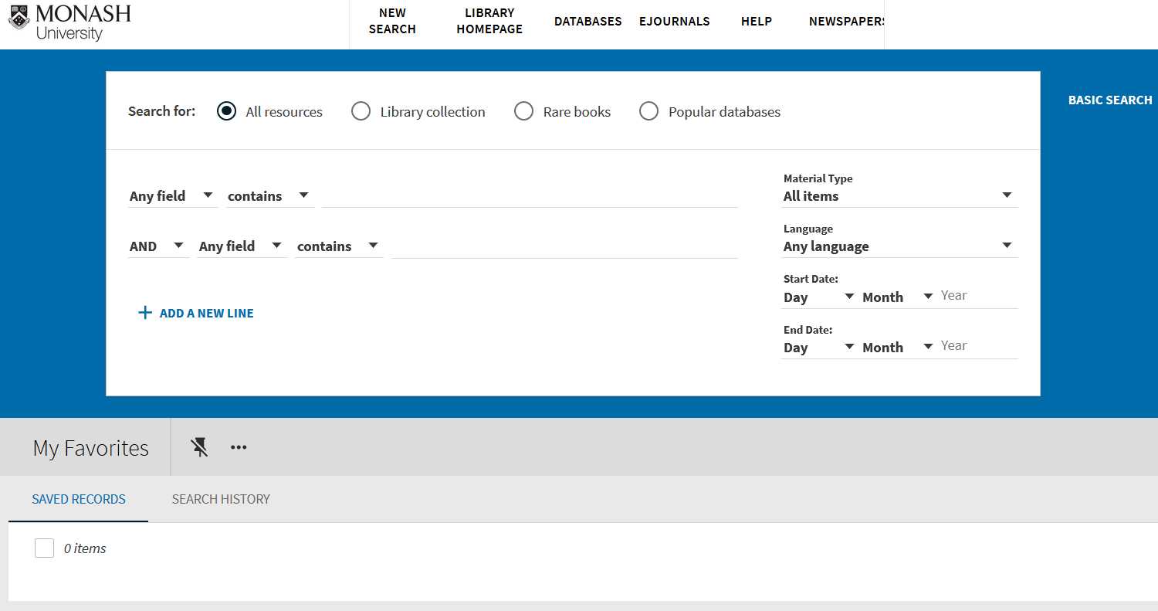
In usability testing
Most useful features were:
Advance search; Favourites icon; and Citation Link to Styles (e.g. APA/MLA etc)
Least useful features included features that users use less than 10% of the time:
Testers selected Advance search, the Favourites ‘pin’ and the Citation Link to Styles (e.g. APA/MLA etc) as the most useful of these features

Slide 20
What’s next?

Slide 21
2nd round of usability testing
Second stage of usability testing will start on 17 September
This testing will focus on:
How much metadata we want to add or remove from Primo’s search normalisations rules
User response to:
FRBRisation
Browzine Integration at brief results screen
bX recommender

Slide 22
Why are we looking at metadata?
In a Boolean search environment, searching across an exhaustive list of metadata fields is an advantage. Each search term you enter, narrows your search results to a more and more specific and relevant set.
In a keyword search environment, each search term you enter broadens your search results to a less and less specific results set, so that your final search results are less specific and less relevant

Slide 23
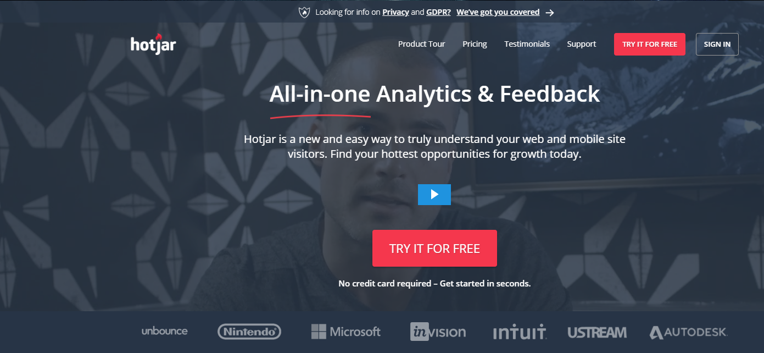
Collect user feedback
Primo Beta release with built in user feedback and analytics application HotJar From October to January

Slide 24
Rename Primo
User led brainstorming session to find a new name for Primo
Talk about what Primo does and run a quick demo – then ask “What should we name it?”
Allocate students to groups to brainstorm new names for Primo
Each group will pick their top name and
Develop a 60 second presentation and pitch it
We’ll offer prizes for
The group that thinks of the most names
The best name pitch

Slide 25
New Primo released in beta
October 2018 to January 2019
Tweak new Primo design based on user feedback

Slide 26
New Primo roadshow
The project team will visit all libraries to:
give library staff the opportunity to see the new Primo user interface and
discuss the user feedback and other drivers that influenced it’s configuration

Slide 27
Launch new Primo
Early February 2019
Replace current Primo production environment with new Primo design

Slide 28
Communication strategy
Available as a project document at
S:\Library\all-library\projects\Primo UX Review\Communication\Communication-Strategy-Primo-UX-review-20180911.docx

Slide 29
Preview New look primo at
http://monash-staging.hosted.exlibrisgroup.com/primo-explore/search?vid=MONUI&lang=en_US&sortby=rank

